Slide 1
Three Articles from the Society for Women's Health Research

Slide 2
Anticipating Menopause
Nancy Fugate Woods, BSN, MN, PhD, FAAN, FGSA
Professor Emerita
University of Washington School of Nursing

Slide 3
Aims
Support women in anticipating their progression through reproductive aging
Consider how Baby Boomers anticipated menopause in the 1990s
Describe an approach to Staging Reproductive Aging that women can use
Explain changing hormonal patterns during reproductive aging
Relate hormonal changes to symptoms women experience during the menopausal transition and early postmenopause

Slide 4
The Seattle Midlife Women’s Health Study

Slide 5
Ellen Sullivan Mitchell, PhD
Associate Professor Emeritus
University of Washington School of Nursing
Collaborator since 1982!

Slide 6
Phase I: Study Population and Methods
Population Based sample from ethnically mixed Seattle neighborhoods with full ascertainment of all midlife women by phone (N=508) begun in 1990
In-person interview conducted in homes or site of choice
2-hour interview included introduction of Menstrual Calendar
Health diary kept for one complete menstrual cycle during first 3 years of the study
Annual health update and symptom diaries

Slide 7
What does midlife mean to women?
An age, being middle aged
A time of transitions -changing physical body, changing emotions, from feeling and being younger to feeling and being older, changing outlook on life, changing relationships, change of life, changing health
Life half lived, half left to live
Goal attainment and reappraisal
Woods and Mitchell, 1997

Slide 8
What does Menopause Mean?

Slide 9
Expectations of Menopause (N = 508)
Frequency
123
112
108
88
66
11

Slide 10
Women’s Questions for Researchers
When will this (menopause) be done?
How long will it take?
What can I expect?
What’s happening to my hormones?
How do changes in my hormones influence my symptoms? My health?

Slide 11
Seattle Midlife Women’s Health Study: Phase 2
Aims: Characterize the biological (hormonal) and psychosocial dimensions of the menopausal transition
Included developing a staging system for reproductive aging spanning the menopausal transition and tracking the natural history of the transition
Methods: first am urine samples obtained monthly and assayed for estrone glucuronide, FSH, cortisol, catecholamines; continued calendars and other measures from Phase 1

Slide 12
Motivations for Developing a Staging System for Reproductive Aging for the Seattle Midlife Women’s Health Study
Researchers and clinicians would benefit from a standardized system that would allow them to compare women and compare data across studies
Women would benefit from a staging system by understanding the timing and duration of the transition to menopause, the consequences for their fertility, and whether their bleeding patterns were normative
A staging system could help clinicians and women time decisions about assessment and prevention, e.g. osteoporosis screening or fertility control

Slide 13
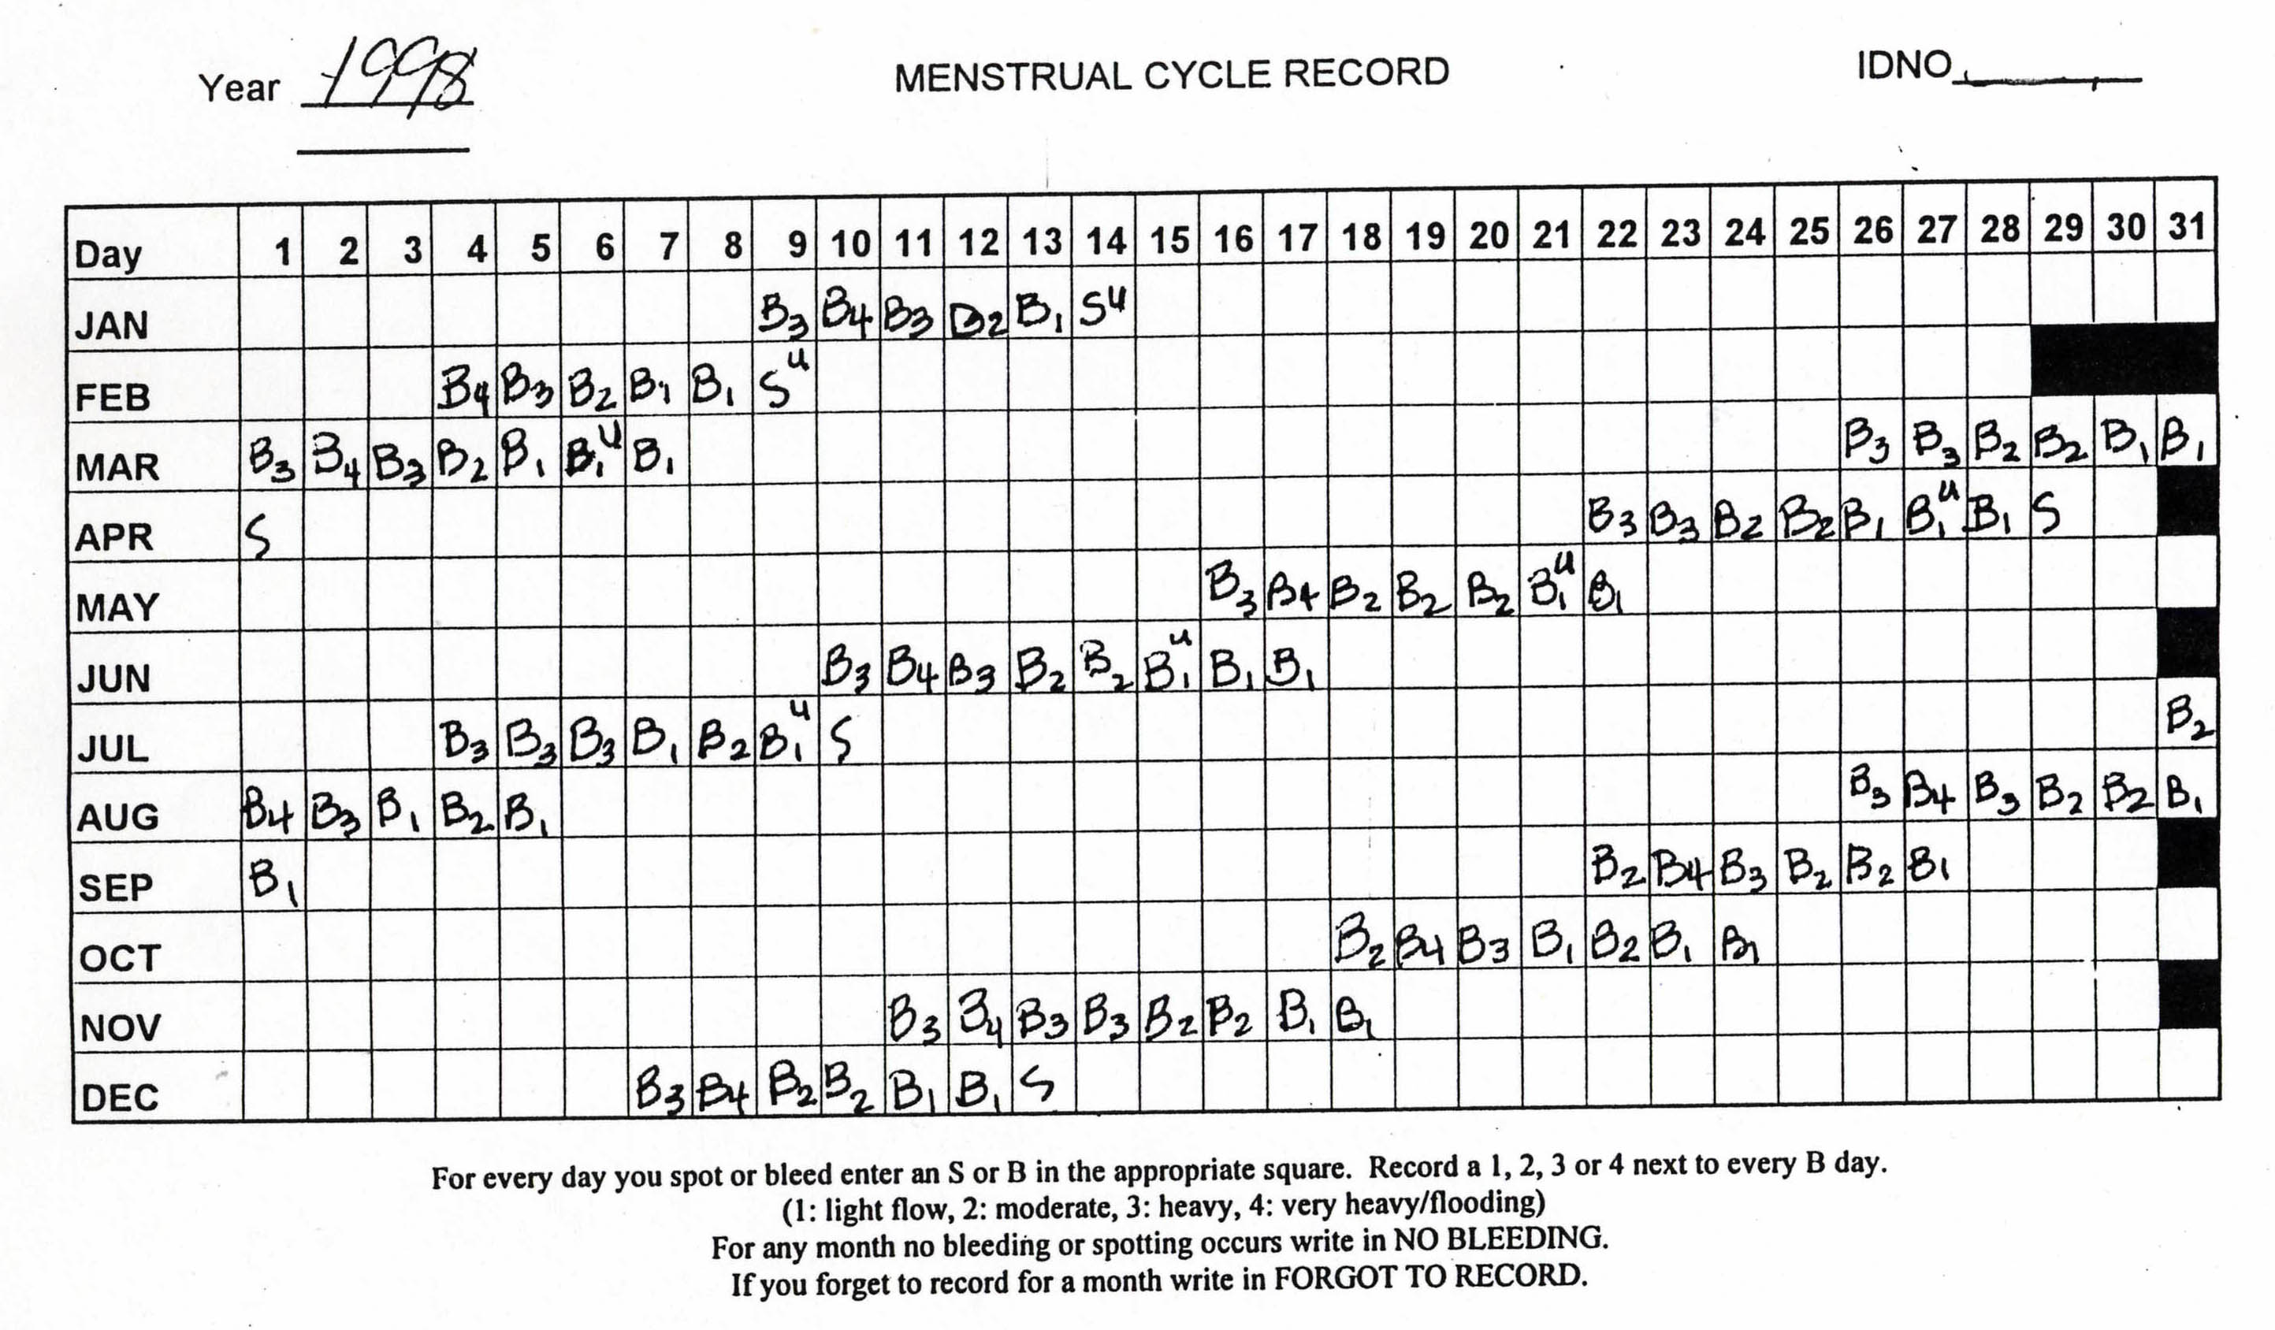
MENSTRUAL CYCLE CALENDAR Late Reproductive (STRAW)
Notes:
This presentation is part of a larger ongoing longitudinal project.

Slide 14
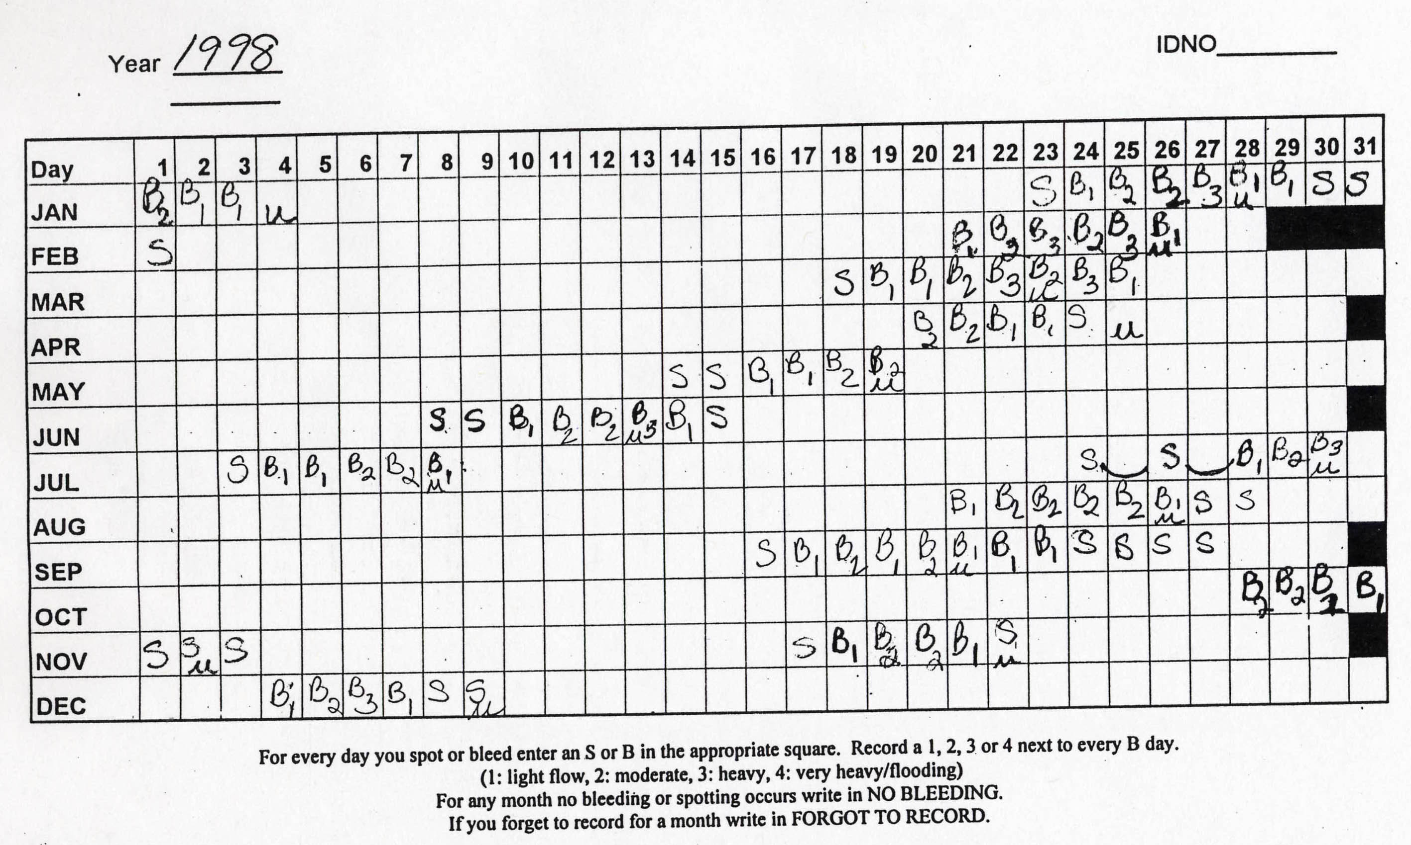
MENSTRUAL CYCLE CALENDAR Early Transition (STRAW)
Notes:
This presentation is part of a larger ongoing longitudinal project.

Slide 15
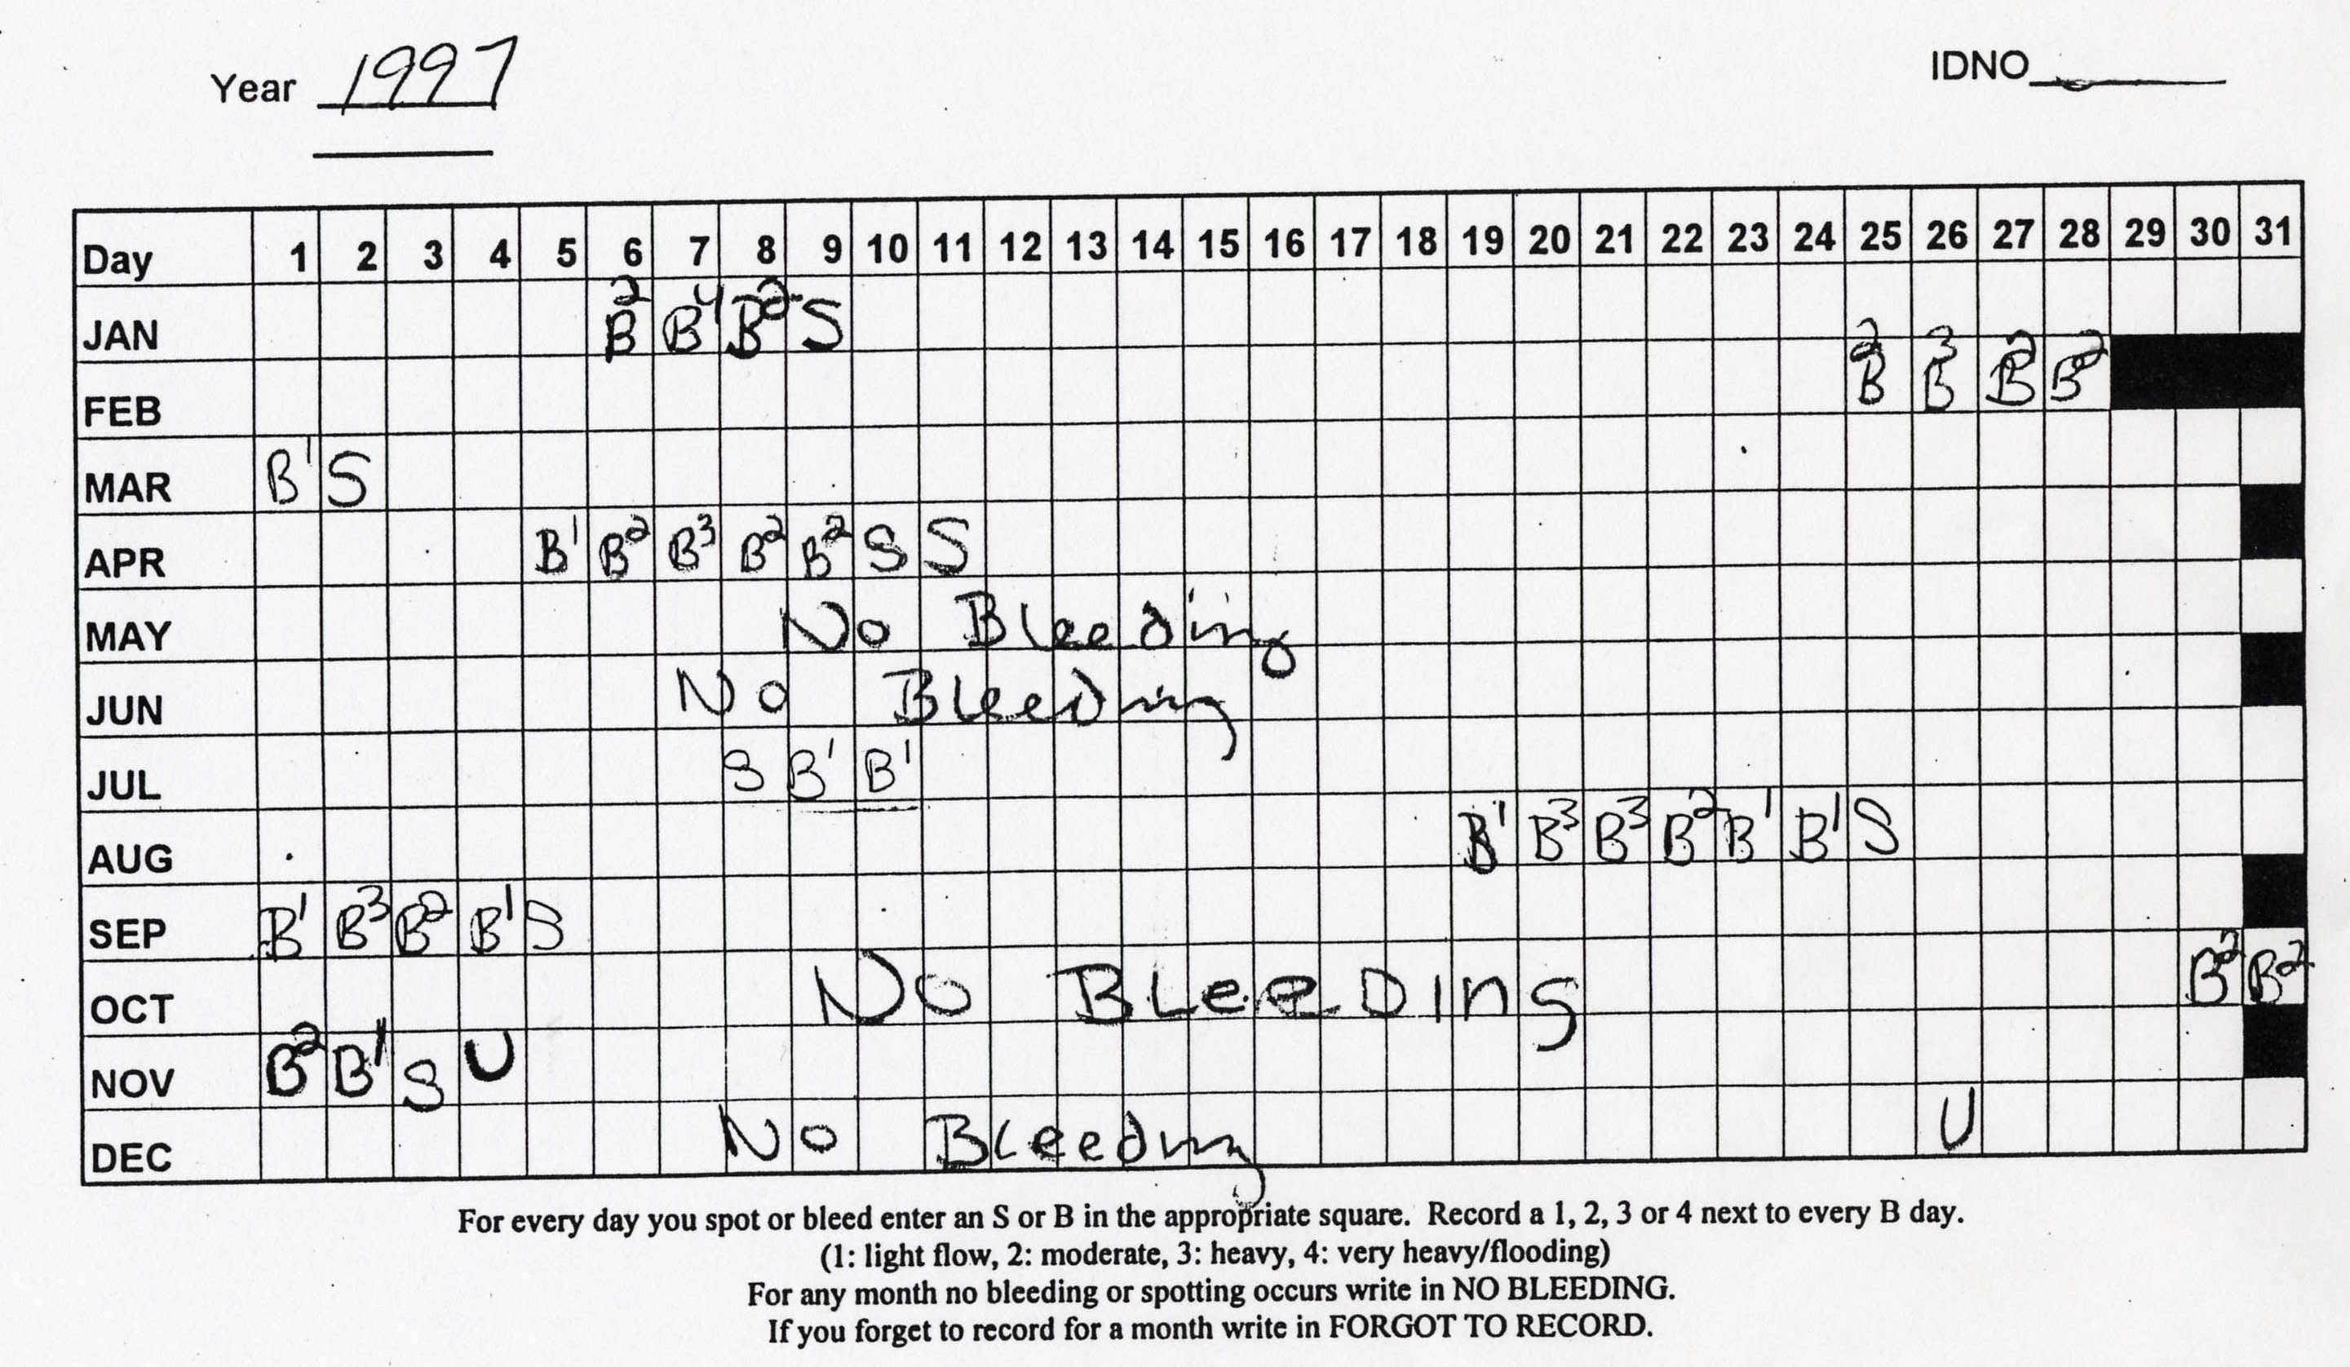
MENSTRUAL CYCLE CALENDAR Late Transition
Notes:
This presentation is part of a larger ongoing longitudinal project.

Slide 16
Reproductive Aging Stages (Mitchell, Woods, Mariella 2000; STRAW 2001)
Late Reproductive Stage – changes in flow or cycle length with regular cycles noted in annual health update and on calendars, may be 2 days shorter
Early Transition – Cycles are irregular (differs by >6 days from previous years in calendars)
Late Transition – Cycles are irregular with skipping of periods ( no menses for > 60 days)
Postmenopause – no menses for > 1 year

Slide 17
Age of Onset and Duration of Menopausal Transition Stages (Mitchell, Woods, and Mariella, 2000; 2015 update)
 | Early Stage STRAW | Late Stage STRAW | Post menopause – 1 year no menses
Age of onset years M, SD, range | 46.4,3.4 36.6-53.2 | 49.4,2.7 43.1-55.0 | 52.1, 2.9 43.7-58.3
Duration years M, SD, range | 2.8,1.5 .2-6.5 | 2.5, 2.7 .4-7.0 | -

Slide 18
Proposed Staging System for the Menopausal Transition (STRAW Conference Soules et al 2001)

Slide 19
Women’s Concerns: What’s Happening to My Hormones?
Changing Physiology during the Menopausal Transition

Slide 20
Urinary Estrone (E1G) and FSH Midlife Levels by Menopausal Transition Stages: Seattle Women’s Health Study
Di Julio et al, Maturitas (2008)

Slide 21
Endocrine fluctuations and follicle growth in the menstrual cycle
Broekmans, F. J. et al. Endocr Rev 2009;30:465-493
Copyright ©2009 The Endocrine Society

Slide 22
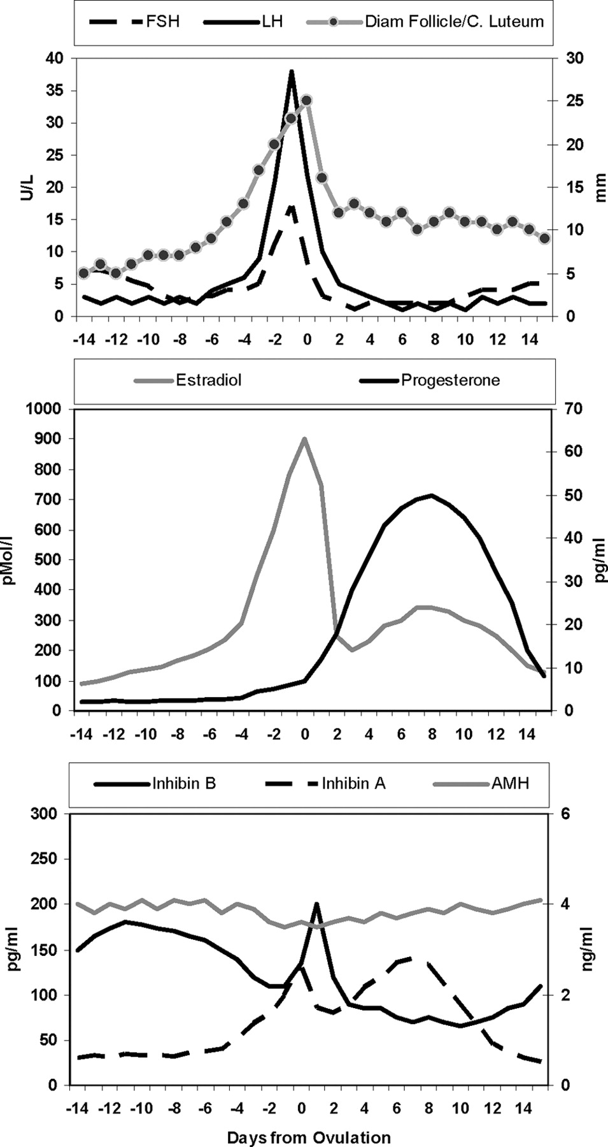
Endocrine fluctuations and follicle growth in the menstrual cycle
Broekmans, F. J. et al. Endocr Rev 2009;30:465-493
Copyright ©2009 The Endocrine Society

Slide 23
Which symptoms do women report during the perimenopause?
Vasomotor symptoms – hot flashes and night sweats
Dysphoric Mood – e.g. depressed mood, irritable, tense
Sleep disruption – awakening during the night, difficulty getting to sleep
Sexual concerns or problems
Cognitive changes – e. g. forgetful, difficulty concentrating
Vaginal dryness
Urinary incontinence
Somatic/bodily pain symptoms
Breast pain
Bleeding symptoms, heavy bleeding

Slide 24
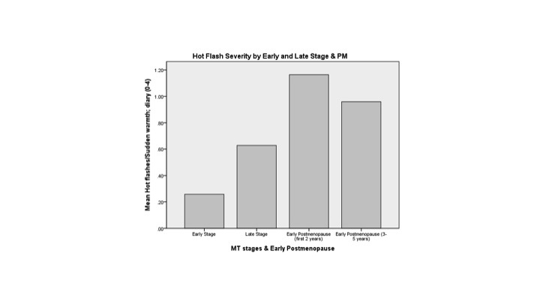
Hot Flash Severity by MT Stages and PM (Mitchell & Woods 2015)

Slide 25
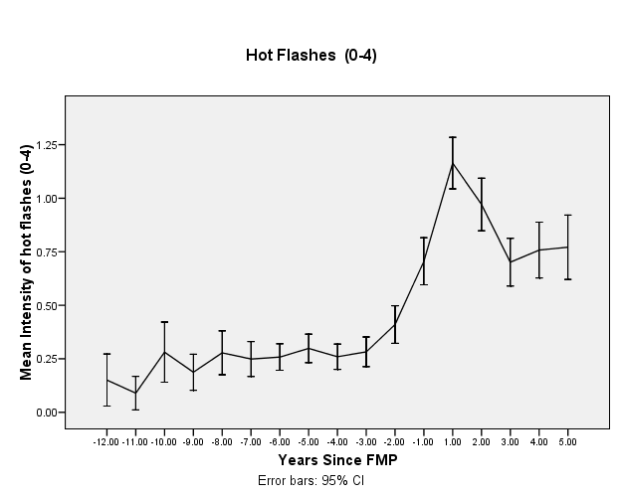
Hot Flash Severity by Years from FMP (- before, + after)

Slide 26
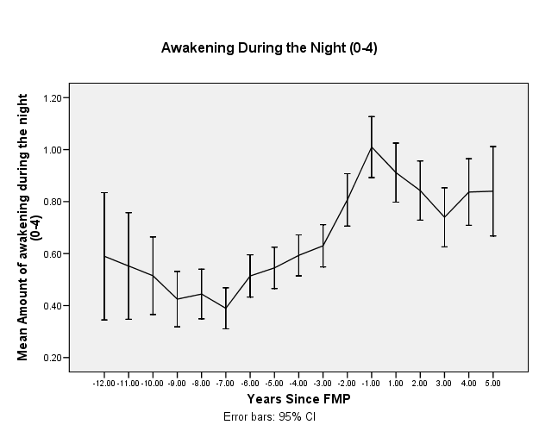
Awakening During the Night by Years from FMP

Slide 28
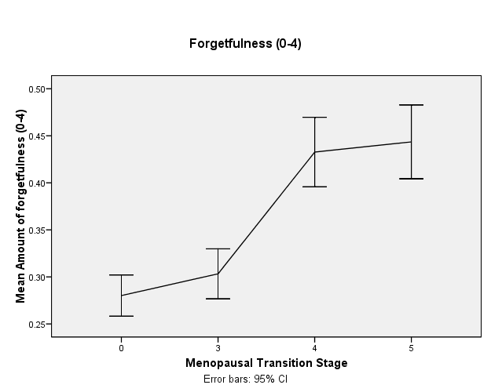
Forgetfulness by Reproductive Aging Stage

Slide 29
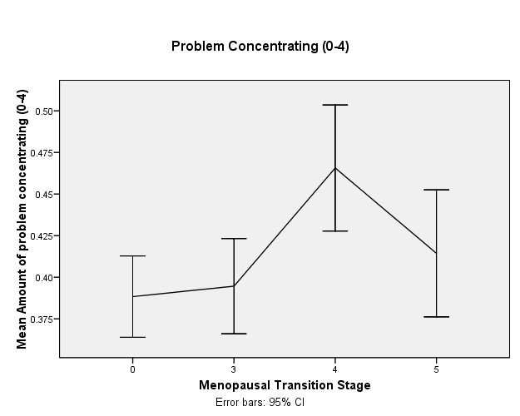
Problem Concentrating by Reproductive Aging Stage

Slide 30
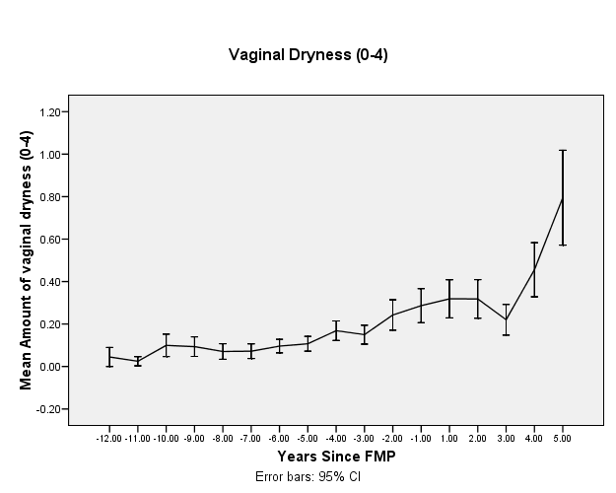
Vaginal Dryness by Years From FMP

Slide 31
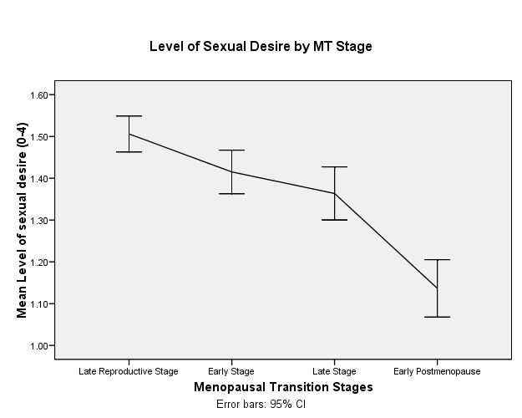
Level of Sexual Desire by Reproductive Aging Stages

Slide 32
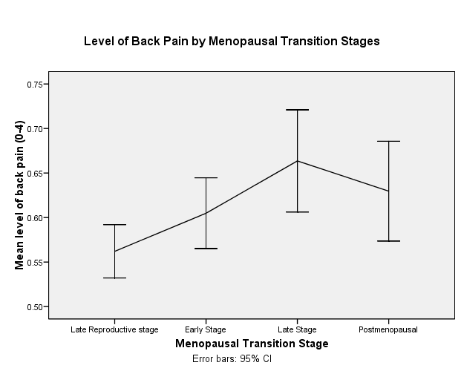
Low Back Pain by Reproductive Aging Stages

Slide 33
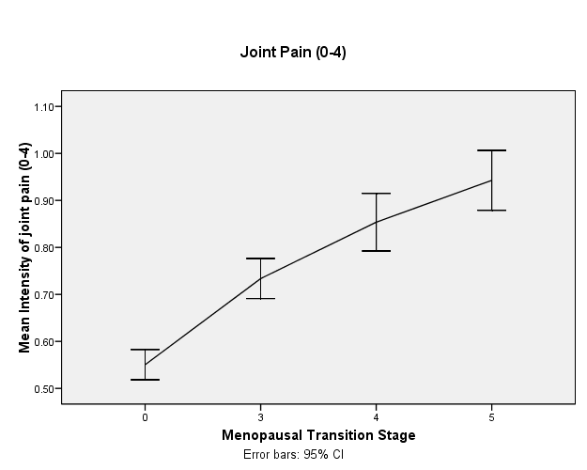
Joint Pain by Reproductive Aging Stage

Slide 34
Is the Menopausal Transition Stressful?
YES and NO!
NO: direct effects of MT stages or E2 or FSH levels on perceived stress
YES: stressful period for women with depressed mood, employment, history of sexual abuse, limited social support, increased role burden, low-income adequacy, aging changes, and poor health !

Slide 35
Women continue to menstruate as they pass through stages in reproductive aging and have cyclic symptoms …
Women who had Premenstrual Symptoms (before their menses) continue to experience some of the symptoms during the menopausal transition stages
Anger, irritability and feeling out of control were more severe premenses than postmenses
Impatience was significantly more severe during the early menopausal transition than during late reproductive aging stages

Slide 36
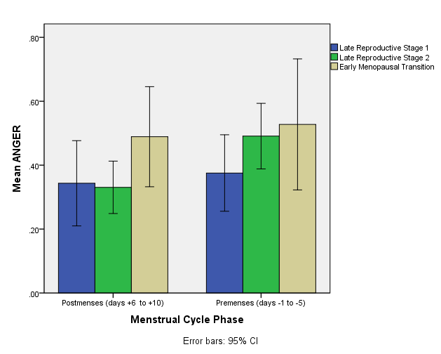
Anger Severity by Menstrual Cycle Phases (Postmenses, Premenses) and Reproductive Aging Stages

Slide 37
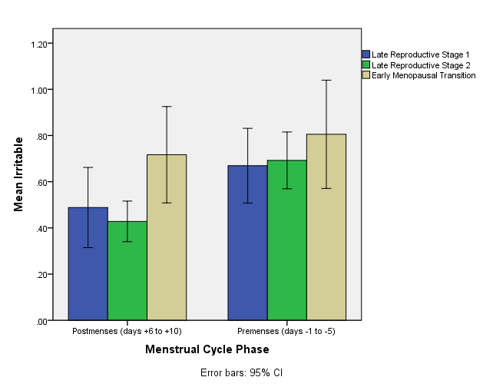
Irritability Severity by Menstrual Cycle Phase and Reproductive Aging Stages

Slide 38
Feeling out of Control by Menstrual Cycle Phases and Reproductive Aging Stages

Slide 39
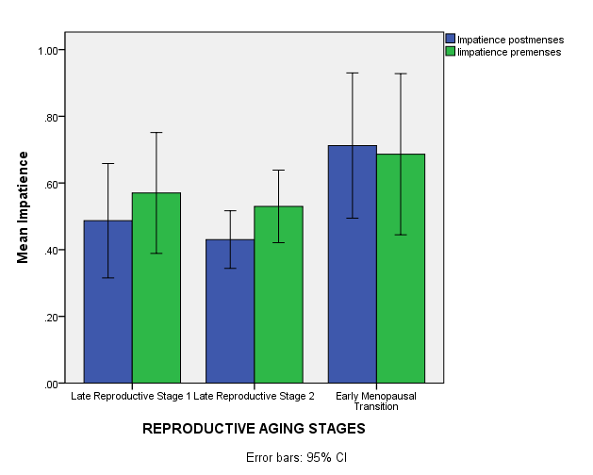
Impatience by Reproductive Aging Stages and Menstrual Cycle Phases

Slide 40
Consequences of Symptoms
Some women are more bothered by their symptoms than others (Carpenter et al, 2007)
Some symptoms interfere more than others with work and relationships (especially mood and concentration symptoms) (Woods and Mitchell, 2010)

Slide 41
Options for Tracking Menstrual Cycles
Calendar Method, Paper and Pencil – simple vs more complex options
Can record days of bleeding, cervical mucus, amount of flow
Tally number of days, estimate ovulation date
Period Tracking Apps – Clue, Flo, Period Tracker
Basal Body Temperature – fertility timing
Ovulation Detection – LH surge, fertility timing
Smart Watch
Can also track symptoms
CAUTION: Privacy Issues

Slide 42
Women Living Better — a non-commercial resource for women

Slide 43
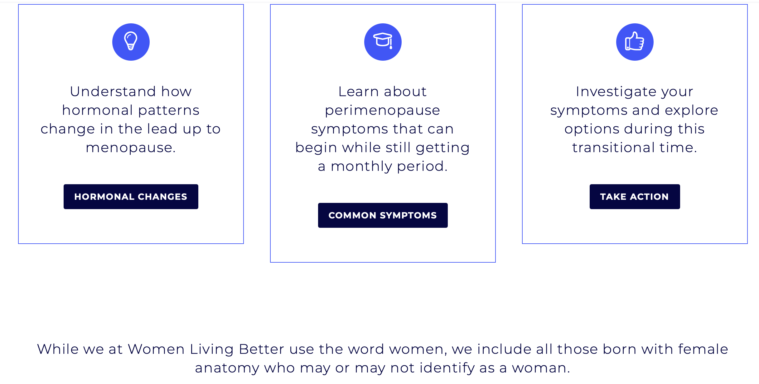
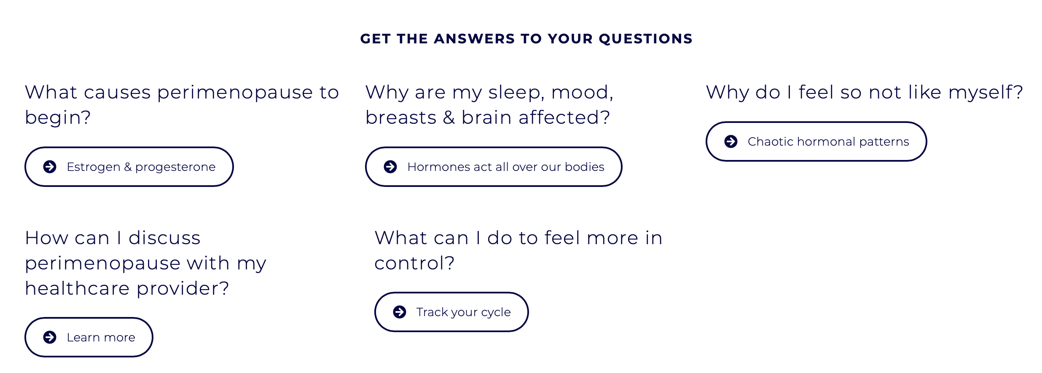
Content anticipates the questions women may have

Slide 44
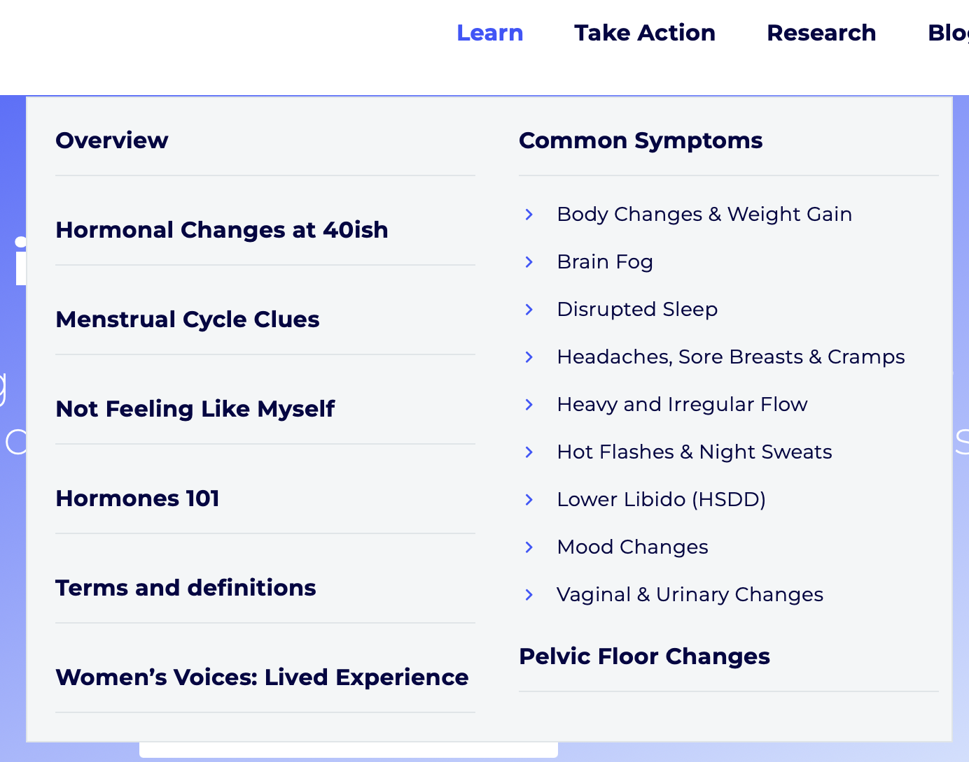
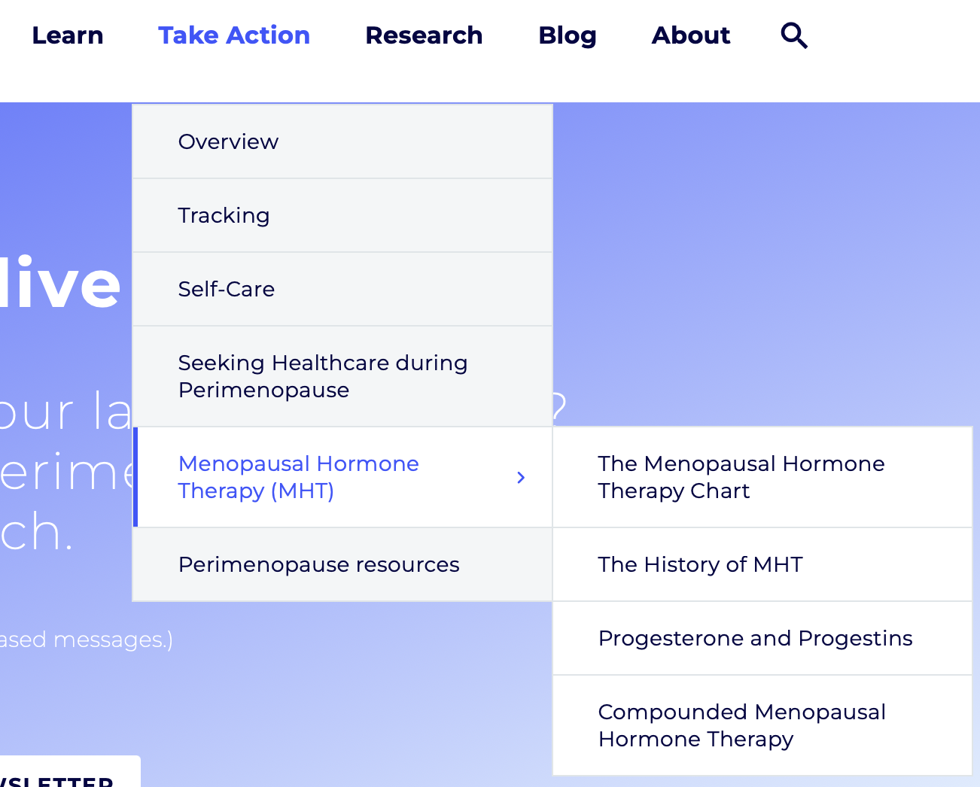
What’s available deeper in the site

Slide 45
The “LRS team” research

Slide 46
Thank you for your interest in women’s health!

