Slide 1
Supporting Department Chairs: Self Care in the Face of Burnout, Crisis and Trauma
2021-22 ADVANCE Leadership Workshop Series:
Self Care for Department Chairs
March 8, 2022

Slide 2
Agenda
1:30 – 1:35 pm Welcome and Introductions
Your microphone is set on mute
Slides: https://tinyurl.com/Wi22slides (view only)
Google Doc access
1:35 – 2:55 pm Self-Care Presentation and Breakouts
Robin Clayton, Associate Director for Engineering Excellence, Office of Inclusive Excellence, College of Engineering
2:55 – 3:00 pm Wrap-up and Evaluations
Handouts and Slides posted after the event
Evaluation link: https://tinyurl.com/ADVLWeval

Slide 3
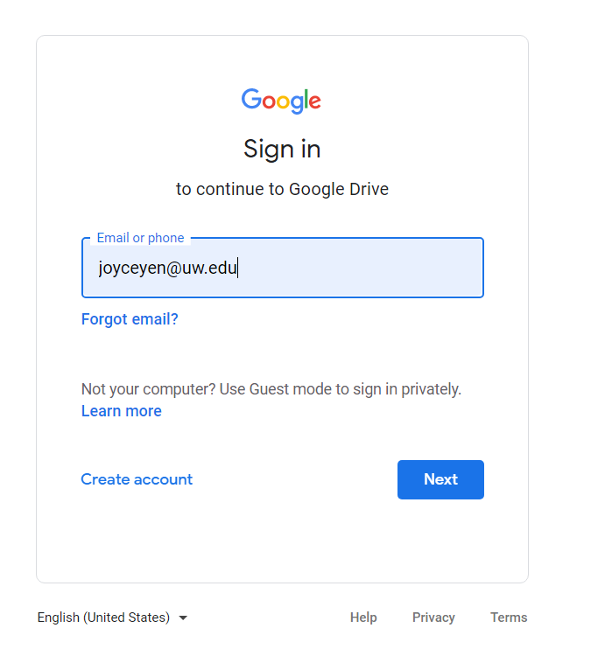
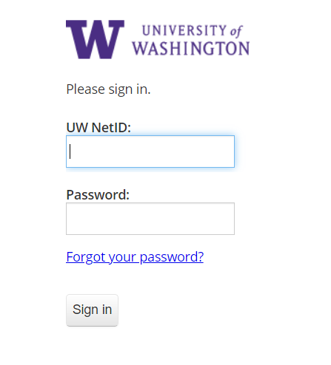
Google Docs
Must be logged in with your UWNetID
www.drive.google.com
Two Handouts:
Trauma Exposure Response
Strategies Reflection/Practice

Slide 4
Robin Clayton
Associate Director for Engineering Excellence Office of Inclusive Excellence
College of Engineering

Slide 5
SUPPORTING DEPARTMENT CHAIRS:
Self Care in the Face of
Burnout, Crisis and Trauma

Slide 6
LAND ACKNOWLEDGMENT
The University of Washington acknowledges the Coast Salish peoples of this land, the land which touches the shared waters of all tribes and bands within the Suquamish, Tulalip and Muckleshoot nations.
Cordova, TN – Chickasaw and Quapaw nations

Slide 7
GET READY
We will have breakout groups
Please have a pen and paper for exercises
LISTEN WITH AN OPEN MIND

Slide 8
COLLABORATORS
ROBIN NEAL CLAYTON – Associate Director for Engineering Excellence, College of Engineering’s Office of Inclusive Excellence
LUZ INIGUEZ – Director for the Educational Opportunity Program, Office of Minority Affairs & Diversity
ANN VU LOVERIDGE –Director for TRIO Student Support Services, Office of Minority Affairs & Diversity

Slide 9
WHY ARE WE TALKING ABOUT THIS NOW?

Slide 10
COMPASSION FATIGUE
“Vicarious traumatization”
The cumulative emotional strain of constant exposure to the trauma of others in our work.
Low level erosion of care and concern for others.
May cause you to react differently to situations than others would normally expect.

Slide 11
RACIAL BATTLE FATIGUE
The physiological, psychological and behavioral strain resulting from racially marginalized groups’ constant exposure to, and battle against everyday racial microaggressions and racism found in the campus climate.

Slide 12
COMMON SYMPTOMS
COMPASSION FATIGUE – Feeling burdened by others’ suffering, isolating yourself, blaming others for their suffering, getting complaints about your work, physical & mental fatigue, feeling hopeless & powerless.
RACIAL BATTLE FATIGUE – Suppressed immune system, headaches, chronic pain, hypertension, constant anxiety, increased swearing or irritability, insomnia & nightmares, difficulty thinking or speaking coherently, emotional & social withdrawal.

Slide 13
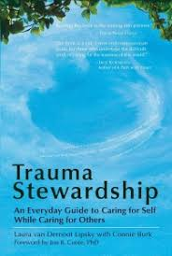
TRAUMA STEWARDSHIP FRAMEWORK
Framework developed by Laura van Dernoot Lipsky with Connie Burk
A way of engaging in trauma or oppression in our work with others while taking steps to avoid others’ struggles as our own
Recognition that we cannot control many things, but we can control “how we interact with our situation from moment to moment”

Slide 14
3 LEVELS OF TRAUMA STEWARDSHIP
Personal Dynamics
Organizational Tendencies
Societal Forces

Slide 15
TRAUMA EXPOSURE RESPONSE
Transformation that takes place within us as a result of repeated exposure to the trauma of others

Slide 16
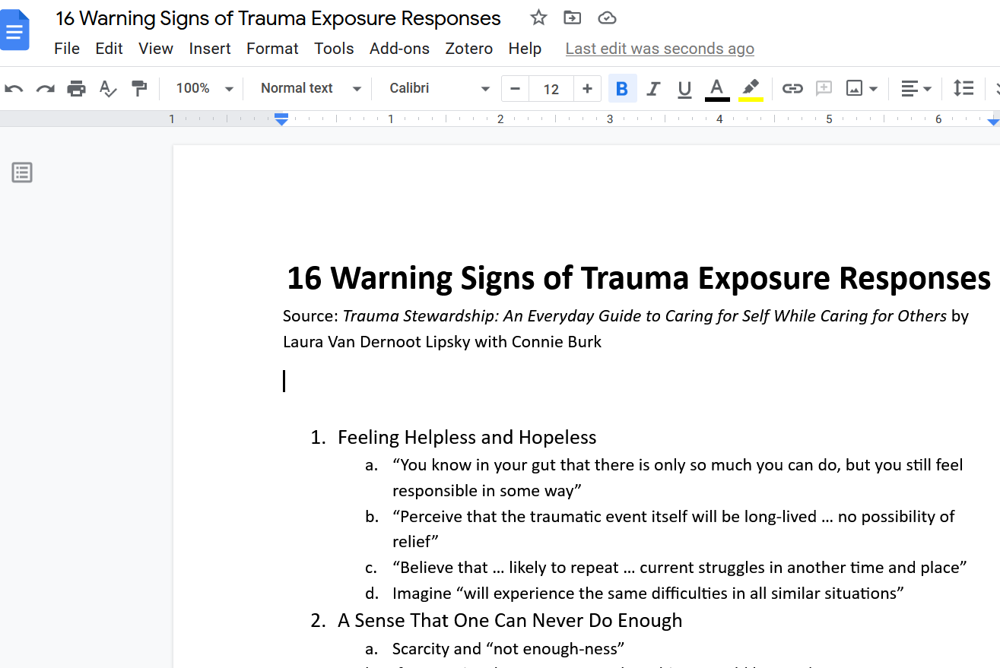
https://tinyurl.com/ADVLW16
Click here for outline

Slide 17
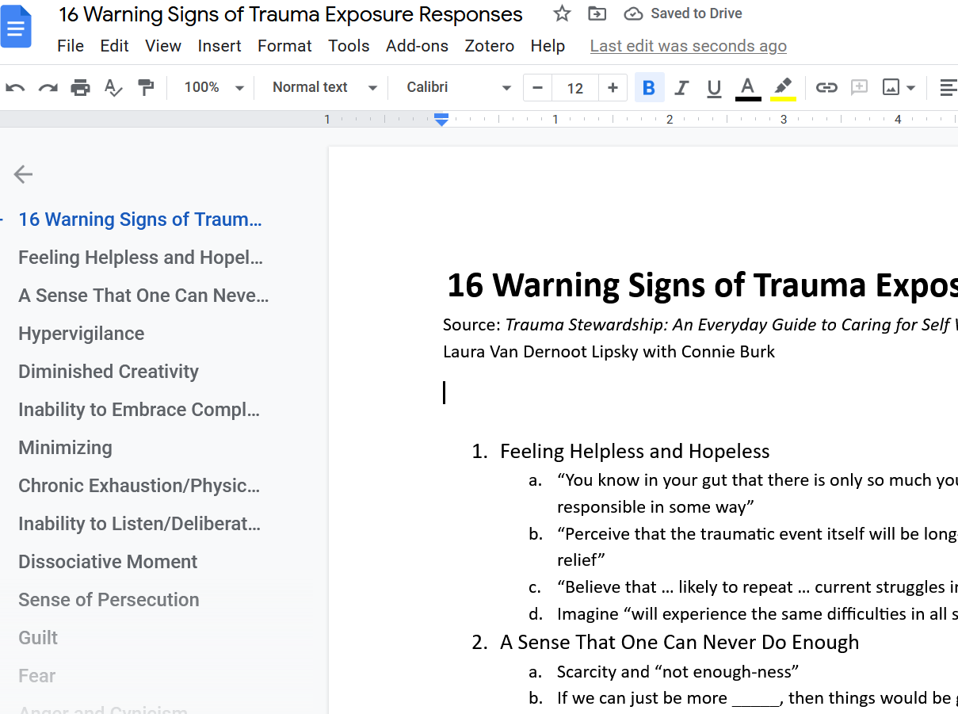
https://tinyurl.com/ADVLW16
Click to navigate document

Slide 18
SYMPTOMS OF TRAUMA EXPOSURE RESPONSE
Feeling helpless & hopeless A sense that one can never do enough Hypervigilance Diminished creativity Inability to embrace complexity Minimizing Chronic exhaustion/physical ailments Inability to listen/deliberate avoidance | Dissociative moments Sense of persecution Guilt Fear Anger & cynicism Inability to empathize/numbing Addictions Grandiosity: An inflated sense of importance related to one’s work

Slide 19
Your experiences Menti Poll: https://tinyurl.com/LWpoll

Slide 20
THINK/REFLECT
In looking at the list of Trauma Exposure Responses (TERs), what came up for you?
Notes:
Let people share their responses here.

Slide 21
THINK/REFLECT
In looking at the list of TERs, what came up for you?
Let’s turn our focus to Self Care in the Face of Burnout, Crisis and Trauma

Slide 22
COMING INTO THE PRESENT MOMENT
Living life in the current moment rather than anticipating the future or dwelling in the past
Focus on your felt sense, which is where you are now and how you feel in this moment
Related: Hyperintellectualism

Slide 23
STRATEGIES
“Five Directions”
Inquiry
Choosing Our Focus
Building Compassion and Community
Finding Balance
Our Centered Self
Or in TRAUMA STEWARDSHIP terms…

Slide 24
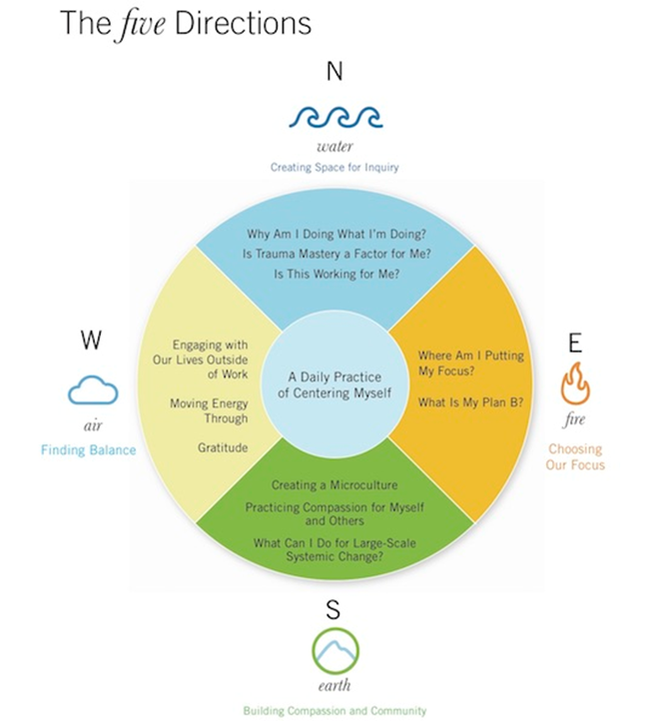
STRATEGIES
THE FIVE DIRECTIONS
NORTH = Inquiry
EAST = Choosing Our Focus
SOUTH = Building Compassion and Community
WEST = Finding Balance
CENTER = Our Centered Self

Slide 25
1. INQUIRY
“Why am I doing what I’m doing, and is it working for me?”
Contemplate your intentions
Related: Trauma Mastery
WATER – The element of courage & wisdom

Slide 26
INQUIRY: Practice
Take a moment to reflect with intention on the question, “Why am I doing what I’m doing?” Write down your answer. Try doing this before you start your workday.
Regularly consult with someone about why you are doing what you’re doing.

Slide 27
2. CHOOSING OUR FOCUS
“Where am I putting my focus?”
Recognize your personal power to intentionally reframe your experiences (perception)
Expand possibilities by imagining Plan B
Related: Resourcing
FIRE – The element of new life and enlightenment

Slide 28
CHOOSING OUR FOCUS: Practice
WHERE AM I PUTTING MY FOCUS?
Think of a current, challenging work situation. Write down 3 things that make it challenging. Write down 3 things that you appreciate about it. Look at your lists and ask yourself, “Where am I more likely to focus and why?”
For one day, commit to paying attention to the running commentary in your mind. Is your mind in the habit of seeing the glass as half-empty or half-full? Are you able to reframe things as half-full, or do you feel an investment in seeing things as half-empty?

Slide 29
CHOOSING OUR FOCUS: Practice
WHAT IS MY PLAN B?
Ask yourself, “If I weren’t doing this work, what would I love to do?”
Generate a list of 5 things you can do over the next 5 weeks to help you get closer to realizing your Plan B.

Slide 30
3. BUILDING COMPASSION & COMMUNITY
Practicing compassion and creating a microculture
Microculture – Creating a community of support to encourage you and hold you accountable to steering clear of our own harmful, internal patterns. Brings a variety of perspectives.
Practicing Compassion - The deeper our sense of compassion, the better we can figure out the best way to take systemic action.
EARTH – The element of peace and renewal

Slide 31
BUILDING COMPASSION & COMMUNITY: Practice
CREATING A MICROCULTURE
Identify the members of your microculture. To what degree do they nurture hopefulness, accountability, and integrity? Think about whether or not you could use stronger role models in any of these areas.
Take some time to examine how your outside surroundings connect with your internal state. Are there shifts you can make in your external reality to achieve a more peaceful and productive internal reality?

Slide 32
BUILDING COMPASSION & COMMUNITY: Practice
PRACTICING COMPASSION
Recall a time when you were particularly hard on yourself. Ask yourself what your deepest fear was at that time. Close your eyes and replay the situation in your mind, imagining how you could have responded to yourself more compassionately. Notice how this shift in response feels.

Slide 33
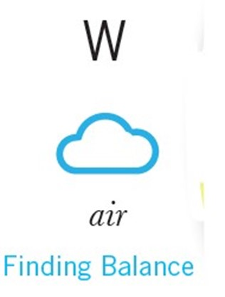
4. FINDING BALANCE
“Moving energy through” versus staying stagnant in trauma.
Contemplate your intentions
Incorporate things that make work a healthier space to be in.
Do things to recharge your battery.
Related: Conscious breathing
AIR – The element of strength and introspection

Slide 34
FINDING BALANCE: Practice
MOVING ENERGY THROUGH
Commit to walking, running or biking outside for 5 minutes during every hour that you’re working. During this 5 minutes, focus on breathing in deeply and breathing out slowly. Notice anything beautiful around you and breathe that in as well.

Slide 35
FINDING BALANCE: Practice
ENGAGING OUR LIVES OUTSIDE OF WORK
Identify one thing that you would love to incorporate into your workday but are certain you could not. Now try everything in your power to make that aspiration a reality.
Write down all your sick leave time, vacation time, and mental health days. Start planning ahead… now.

Slide 36
FINDING BALANCE: Practice
PRACTICING GRATITUDE
At both the beginning and end of your workday, take a distinct moment to think of one thing you are grateful for.
Advocate for your workplace to create a forum where you and your colleagues can express gratitude to one another. Take the lead in thanking others.

Slide 37
Breakout Session
Choose a direction for discussion and practice:
NORTH = Inquiry
EAST = Choosing Our Focus
SOUTH = Building Compassion and Community
WEST = Finding Balance

Slide 38
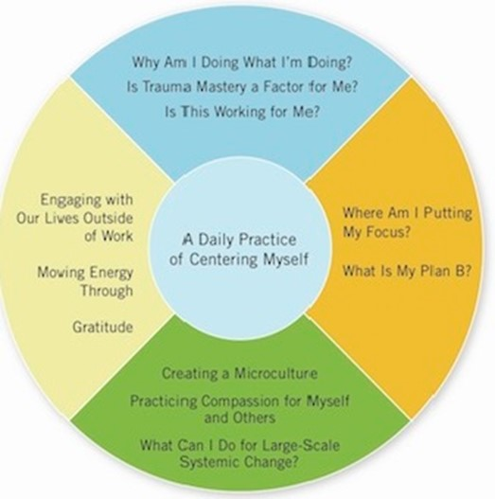
5. OUR CENTERED SELF
Connect with our core and then go back out into the world renewed, allowing us to bring our best to the work we do.
Practice centering daily
TECHNIQUES:
Set an intention for your day
Have a reminder (e.g., an alarm)

Slide 39
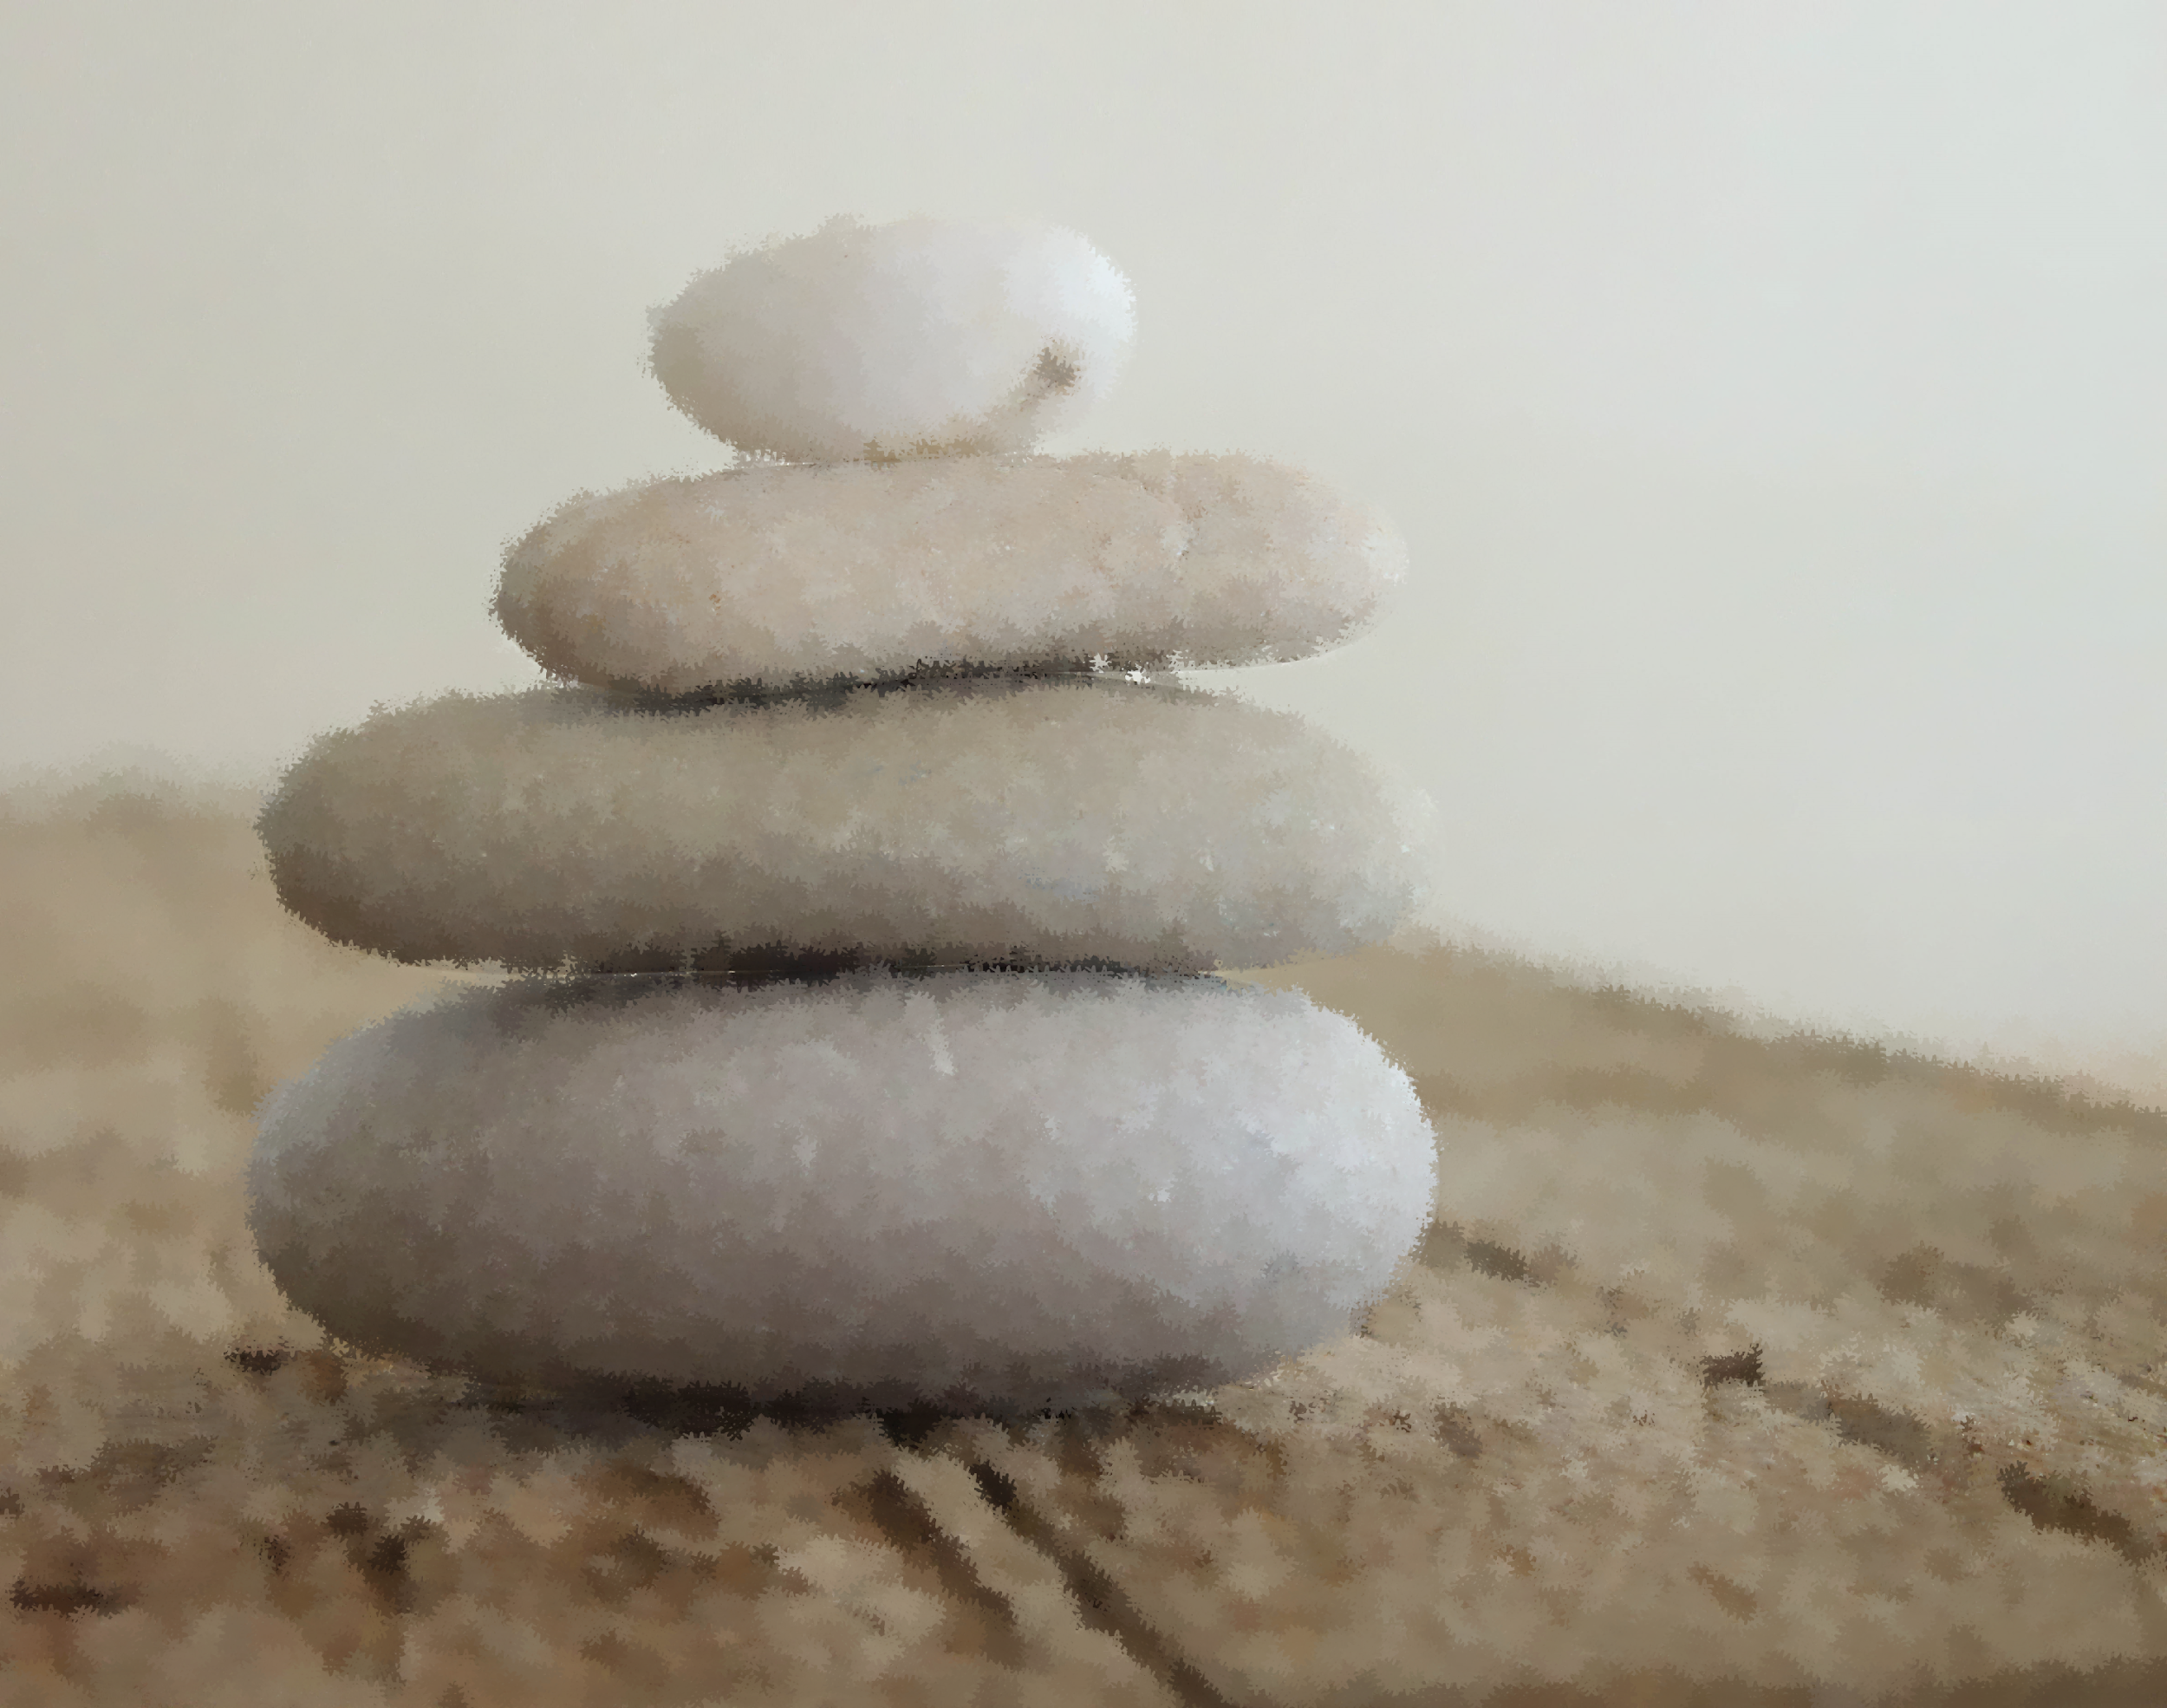
CENTER: Practice
CENTERING OURSELVES
When your day begins, close your eyes, take several deep breaths, and ask yourself, “What is my intention today?”
At the end of your day, before going to bed, ask yourself, “What can I put down? What am I ready to be done with? What don’t I need to carry with me for another day?” Put it down, and don’t pick it up again the next day.

Slide 40
INTENTION SETTING
Now we’ll take a few minutes for you to think about how you might apply what you learned during this session and how you intend to use it. We call this setting an intention, and when we set an intention to do something, we’re making a commitment to ourselves to try to do it.
Developing new skills for our mind takes time – committing to apply what you learn in this session will help make these skills second-­nature. Research shows that being specific about when we practice new skills helps us stick to our goals.

Slide 41
Q & A/RESOURCES
Lipsky, Laura Van Dernoot, and Burk, Connie. Trauma Stewardship : An Everyday Guide to Caring for Self While Caring for Others. Oakland, CA: Berrett-Koehler, 2009.
Lipsky, Laura Van Dernoot. The Age of Overwhelm: Strategies for the Long Haul. Oakland, CA: Berrett-Koehler, 2018.

Slide 42
CONTACT:
Robin Neal Clayton
Associate Director for Engineering Excellence
Office of Inclusive Excellence
robin712@uw.edu

Slide 43
Conclusion and Evaluations
Thank you to Robin!
Evaluation form: https://tinyurl.com/ADVLWeval

