Slide 1
Workshop on Faculty Diversity
National Data on Faculty Composition
Donna Nelson, University of Oklahoma
Studies of the “Playing Field”
Implicit assumptions are there
Personal Comments
The reality of small numbers
Advice for Chairs
Small things can make big improvements
Marjorie Olmstead
Department of Physics
olmstd@u.washington.edu

Slide 2
Faculty Diversity Study
Donna Nelson, U. Oklahoma Chemistry
14 Fields -- 10 UW-ADVANCE fields
Survey 50 top departments
Ranked by research expenditures in 1999-2000
Biased toward large depts supporting students
Faculty composition by race and gender
Compare to Ph.D. Data from NSF

Slide 3
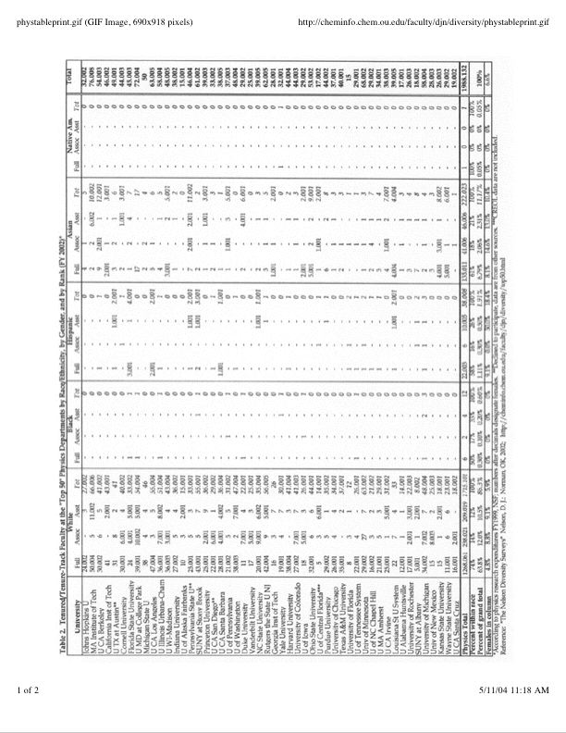
Example Data: Physics Faculty
http://cheminfo.chem.ou.edu/faculty/djn/diversity/top50.html
UW 2002: Full Professor: 35 WM, 3 WF, 1 HM
Associate Professor: 2 WM
Assistant Professor: 6 WM, 1 WF
Women of Color
Hidden in Statistics
UW 2004: Full Professor: 31 WM, 3 WF, 2 HM
Associate Professor: 3 WM, 1 WF, 1 AM
Assistant Professor: 2 WM, 1 WF
50 Departments: 1,988 Faculty
132 Women (6.6%); 263 Minorities (13%); 31 Women of Color (1.5%)
Full Professor: 1207/61 WM/WF; 6/0 BM/BF; 19/3 HM/HF; 124/11 AM/AF; 1/0 NAM/NAF
Assoc. Professor: 207/21 WM/WF; 2/0 BM/BF; 6/0 HM/HF; 35/6 AM/AF; 0/0 NAM/NAF
Asst. Professor: 190/19 WM/WF; 4/0 BM/BF; 5/5 HM/HF; 40/6 AM/AF; 0/0 NAM/NAF

Slide 4
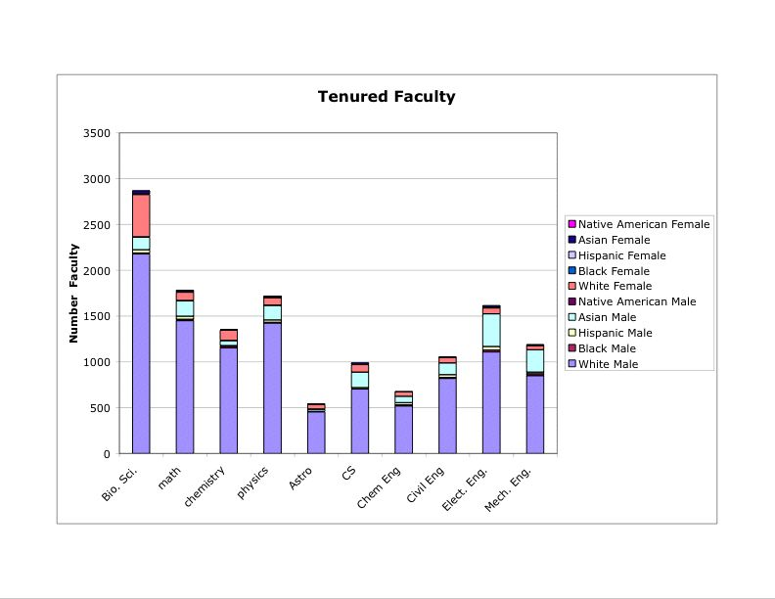
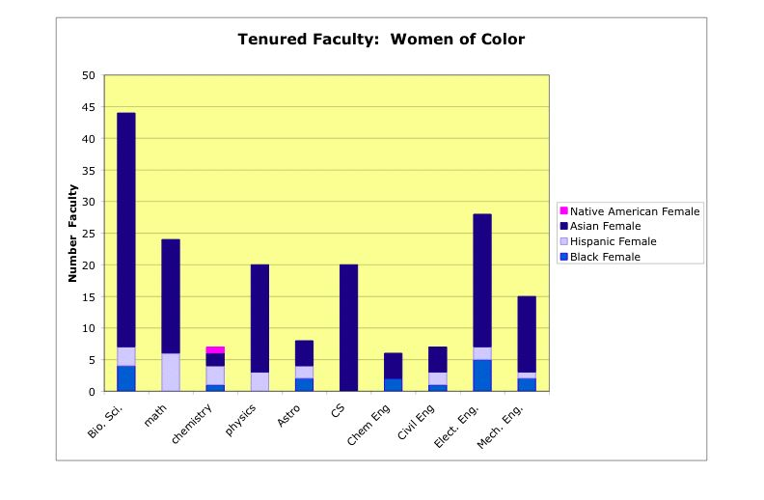
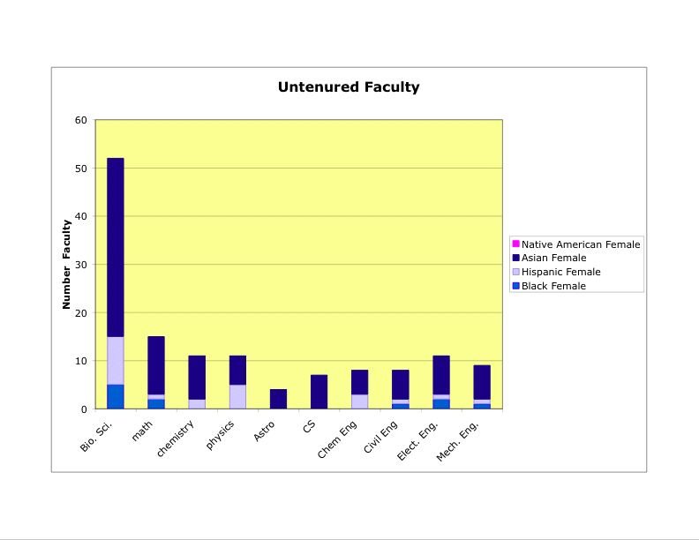
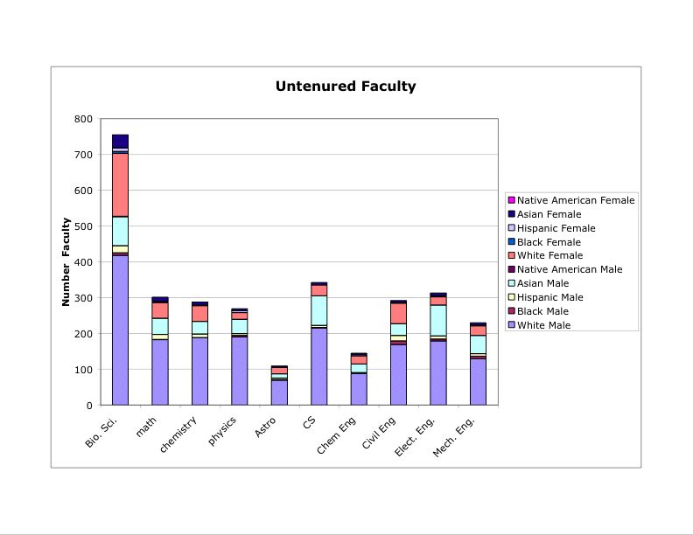
10 Fields, 500 Departments
Total: 13,796
Total: 179 (1.3%)
Total: 3,044
Total: 136 (4.5%)

Slide 5
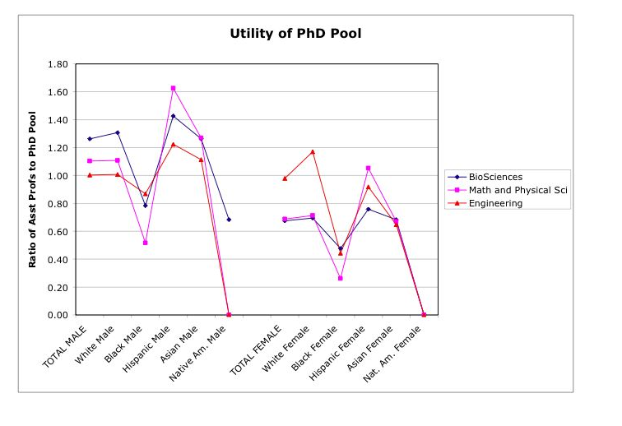
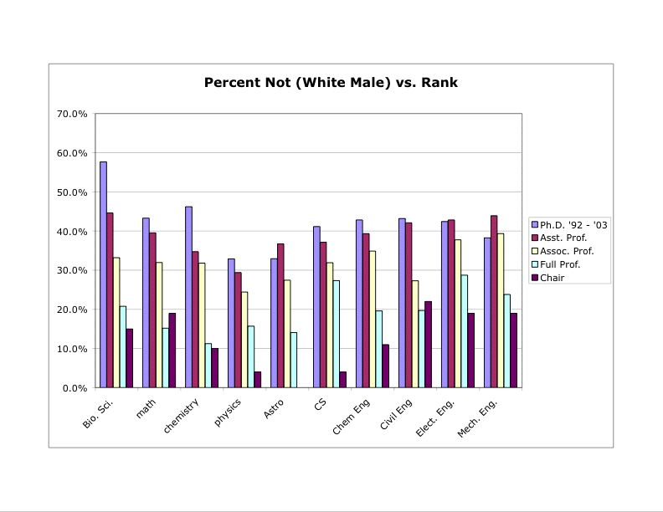
Representation Declines with Rank
Women nearly HALF as likely to become professors
Few Blacks, No Native Americans
Foreign Asians and Hispanics increase ratio: US born still underrepresented on faculty
Bio
Eng
MPS
All Men 1.17
All Women 0.63

Slide 6
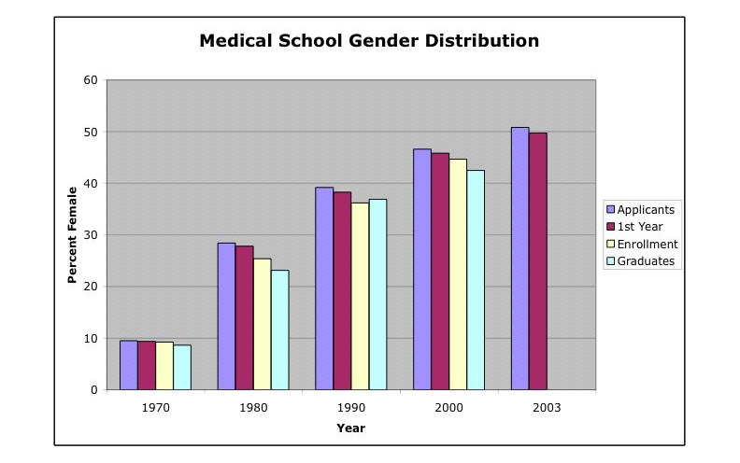
Why so Few?
MYTH: “It’s THEIR fault -- women just don’t apply.”
REALITY: “My grad school experience was so awful I just want to get out of there.”
Example of Change: Medical Schools after Title IX
Parity in 30 years
50%
10%
Widely Practiced
10% Quota
Matriculation rate = Applicant rate
1972 Law -- Education Gender Discrimination Made Illegal

Slide 7
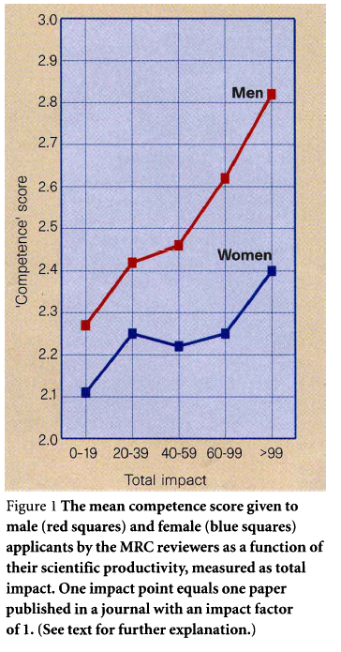
Tilted Playing Field
Large body of research shows: Implicit Assumptions Impact Evaluation
Gender Bias and Research Papers
Paludi and Bauer (Sex Roles, 1983)
Reviewer (1-5, 1 top) | John T. McKay | Joan T. McKay | J. T. McKay
Male
Female
Rating Score
1.9 | 3.0 | 2.7
2.3 | 3.0 | 2.6
Δ = 3 Nature Papers
Gender Bias and Post-Doc Applications
Wenerås and Wold (Nature, 1997)
Impact
Gender Bias and Performance Evaluation
Orchestra tryouts behind curtain
Stereotype threat on exam performance

Slide 8
(Implicit) Discrimination
Lower expectations
Uneven evaluation
Narrow view of excellence
Exclusion from informal networks
Other people feel uncomfortable
Accumulation of Disadvantage

Slide 9
Personal Observations
Small numbers mean everybody counts
UW Physics nearly lost 60% of women in one quarter
Physics PhDs -- 10 years*50 departments: 8,261 total
2 Native American Women
21 Black Women
31 Hispanic American Women
Each person must consciously confront their implicit assumptions
Grew up in 99 % white suburb
Adult before I knew professional, educated minorities
Scientific and educational enterprise requires trust
Different cultural expectations must be dealt with head on

Slide 10
Good Chairs Make a Difference
Take ownership of the “problem” to create a public, inclusive climate for students and faculty
Consciously and publicly counter implicit assumptions and accumulated disadvantage
Set transparent and inclusive criteria and processes for hiring, promotion, salary and resources.
Give women and minorities assignments to gain leadership skills (both scientific and administrative)
Have all faculty actively mentor and recruit minority students to the profession. One more/year is significant.
Compare attitudes of 1st and 5th year grad students -- do they still want to be academics? Is there a gender and/or racial difference in the response? Find out WHY.

