Slide 1
Applying for NSF CAREER Grants
UW ADVANCE Spring Quarter Pre-Tenure Faculty Workshop
May 3, 2018

Slide 2
Speakers
Kristian Wiles, Office of Minority Affairs and Diversity
Cole DeForest, Chemical Engineering
Laura Prugh, Environmental & Forest Sciences
David Masiello, Chemistry

Slide 3
KRISTIAN WILES
Executive director of retention & academic support programs, office of minority affairs & diversity

Slide 4
COLE DEFOREST
ASSISTANT Professor, CHEMICAL engineering

Slide 5
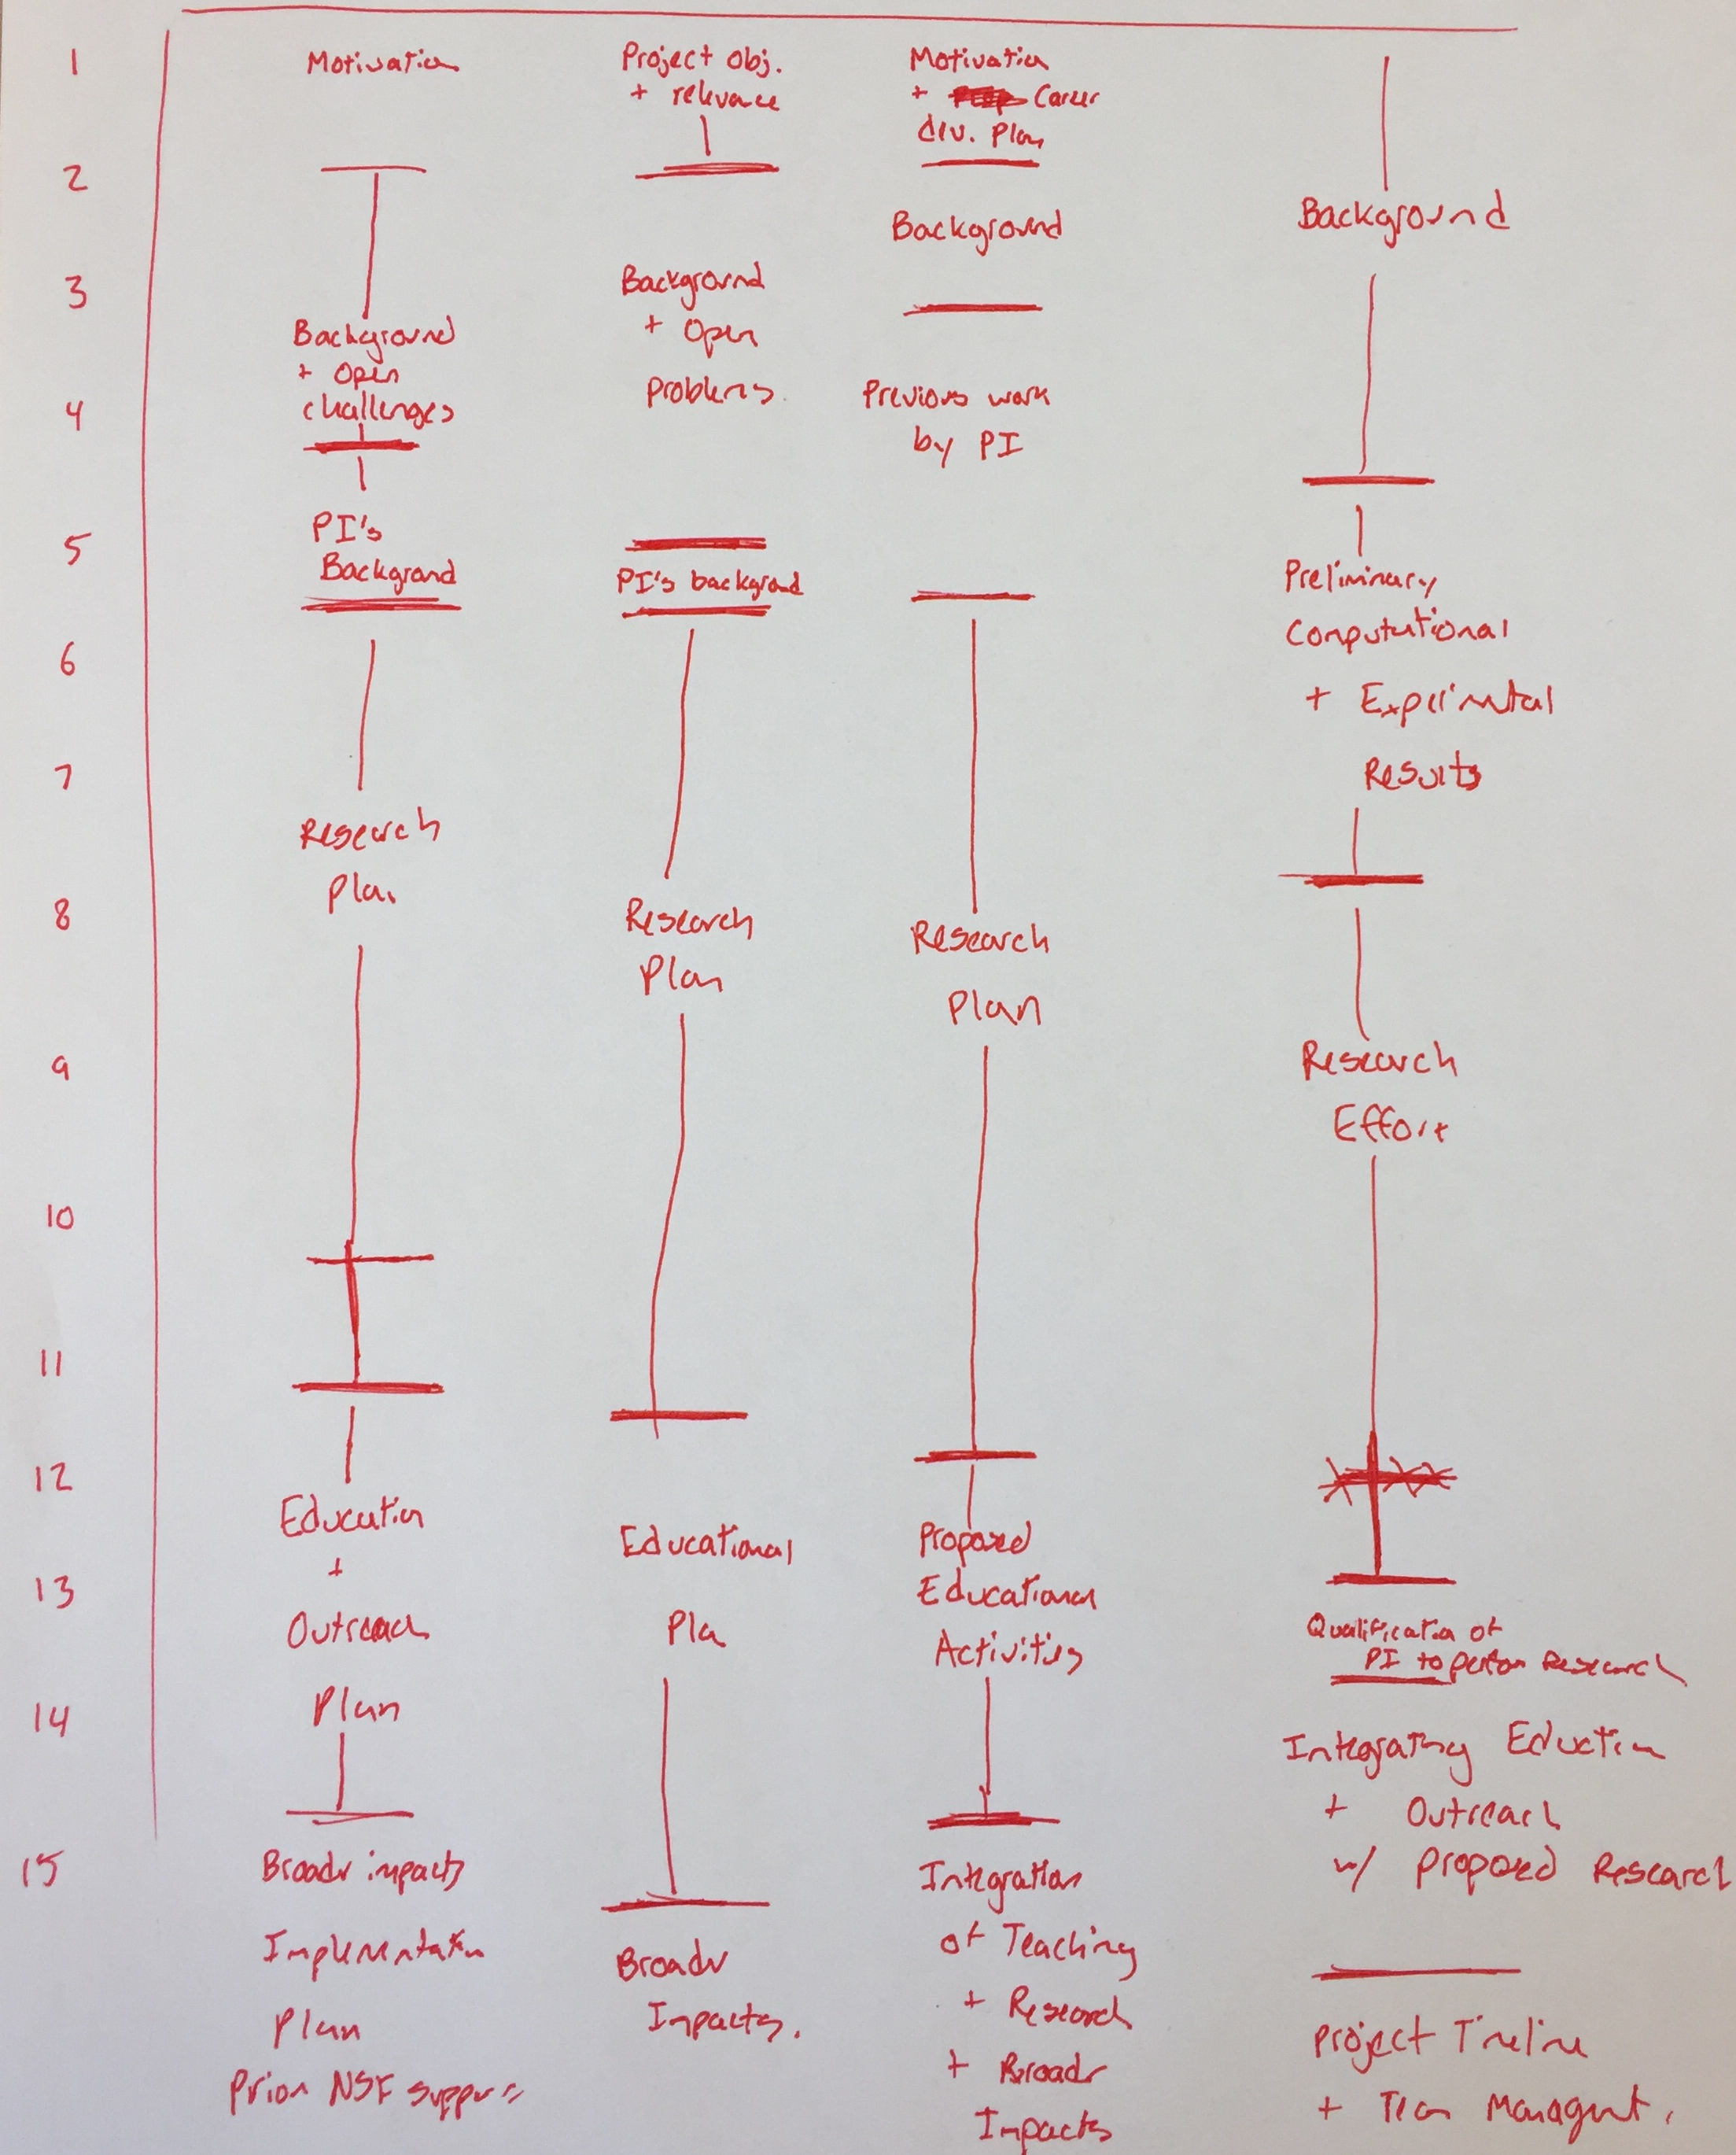
Know the mechanism goal
“Support of junior faculty who exemplify the role of teacher-scholars through research, education and the integration of education and research”
Also know program goal
Know the grant format
Study examples from past awardees (ideally in same program as you)
Talk to past award winners

Slide 6
Partner with existing resources…
No need to fully reinvent the wheel
Bigger reach, proven track record, less effort on your end,
Support letters (stick to new format!)
Office for Advancement of Engineering Teaching & Learning
…but create something new, too!
Be creative! Doesn’t have to be groundbreaking, but does have to be interesting!
Go hard!
Most CAREER winners receive in first submission (at least within CBET)
Don’t apply until you’re ready…
…but don’t wait such that you can’t use all 3 chances!

Slide 7
Miscellaneous Thoughts
Department letter tailored to you!
Proposal needs to be realistic, doable, and unique to you
Know the min/max of award
Don’t make reviewers angry
Don’t reinvent the wheel
Educational component has to have same rigor as research – references, preliminary data, support letters, evaluation criteria
NSF changes call and structure from year to year

Slide 8
LAURA PRUGH
ASSISTANT Professor,
Environmental & forest Sciences

Slide 9
Laura Prugh, School of Environmental and Forest Sciences
DEB CAREER: Integrating positive and negative interactions in carnivore community ecology
Message 1: Intellectual Merit is key
Your proposal is evaluated alongside “normal” proposals; panelists tend to weigh “normal” criteria higher than “special” criteria
What is your Big Idea and why is it novel and important?
“The joint study of scavenging and intraguild predation represents a new frontier in carnivore ecology”
What is your plan to tackle your Big Idea?
Reviewers must clearly understand how your methods allow your hypotheses to be tested
How will your project resolve an important gap in your field?

Slide 10
Laura Prugh, School of Environmental and Forest Sciences
DEB CAREER: Integrating positive and negative interactions in carnivore community ecology
Message 2: Show how the grant will launch your (already promising) career
Include an “about the PI” section
Give reviewers a sense of who you are and what your integrated research/teaching program is all about: what is your vision for your career?
Indicate how the proposed project fits naturally within your broader program
Provide evidence of past success: key papers, preliminary results to build from, teaching innovations, existing partnerships

Slide 11
Laura Prugh, School of Environmental and Forest Sciences
DEB CAREER: Integrating positive and negative interactions in carnivore community ecology
Message 3: Teaching is not the same as broader impacts
“Integrated research and teaching program”
“Teacher-scholar” (get a good letter from your department!)
What are your educational goals? Cite pedagogical literature
How will you assess the success of your educational objectives?
How are you integrating the teaching and research components?
Explain how the teaching side improves the research side, not just vice versa (how are they synergistic)
Ratio of ~10 pages on research plan, 5 pages on teaching plan and BI

Slide 12
DAVID MASIELLO
ASSOCIATE Professor, CHEMISTRY

Slide 15
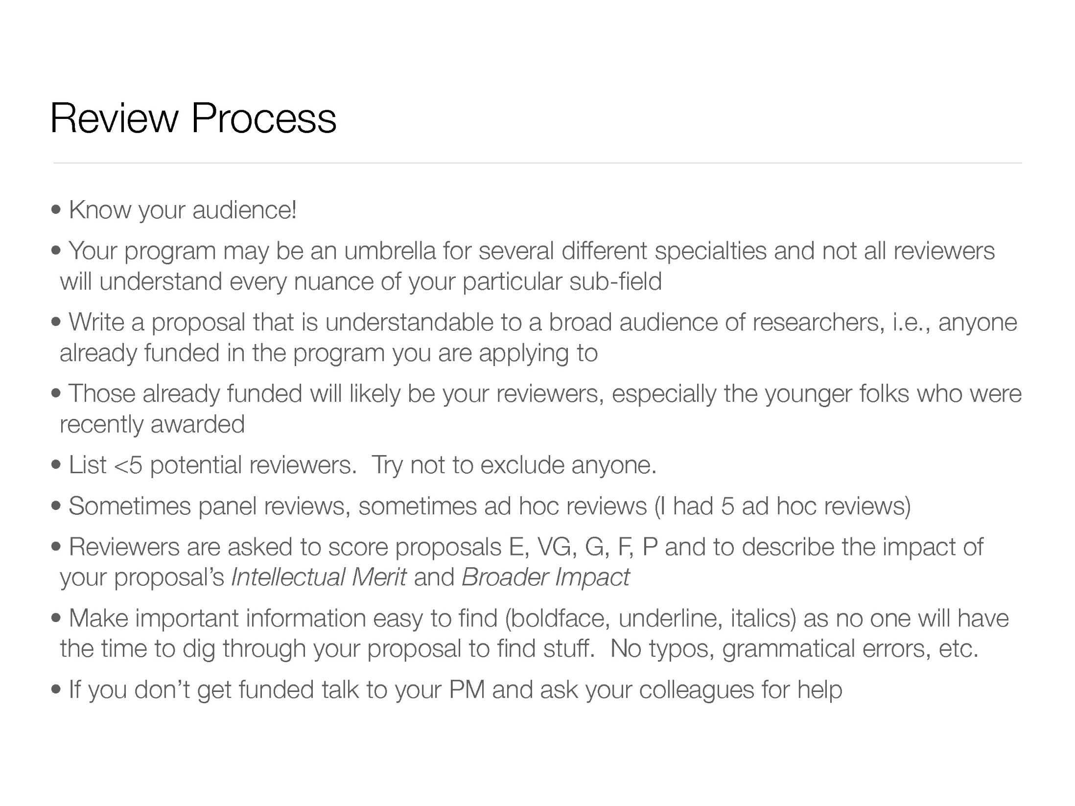

Slide 16
Questions?

