Slide 1
Demographics and UW’s Future Students -- Predictions (and Data) for the Coming Decade
Philip Ballinger
University of Washington
May 18, 2010

Slide 2
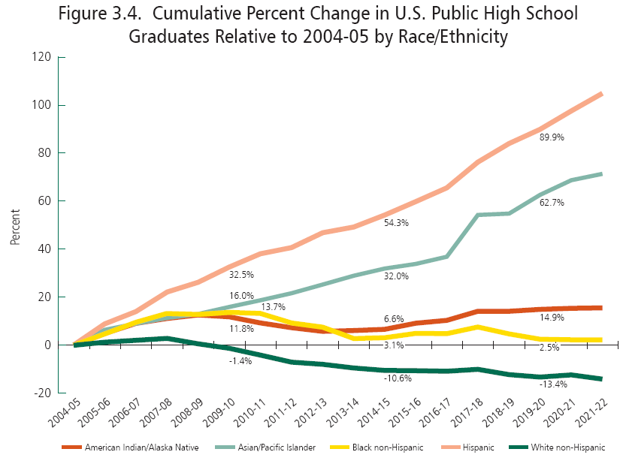
Source: WICHE, Knocking at the College Door, 2008
Notes:
SHELLEY
However, the real story is the change in racial/ethnic composition of the cohort of high school graduates

Slide 3
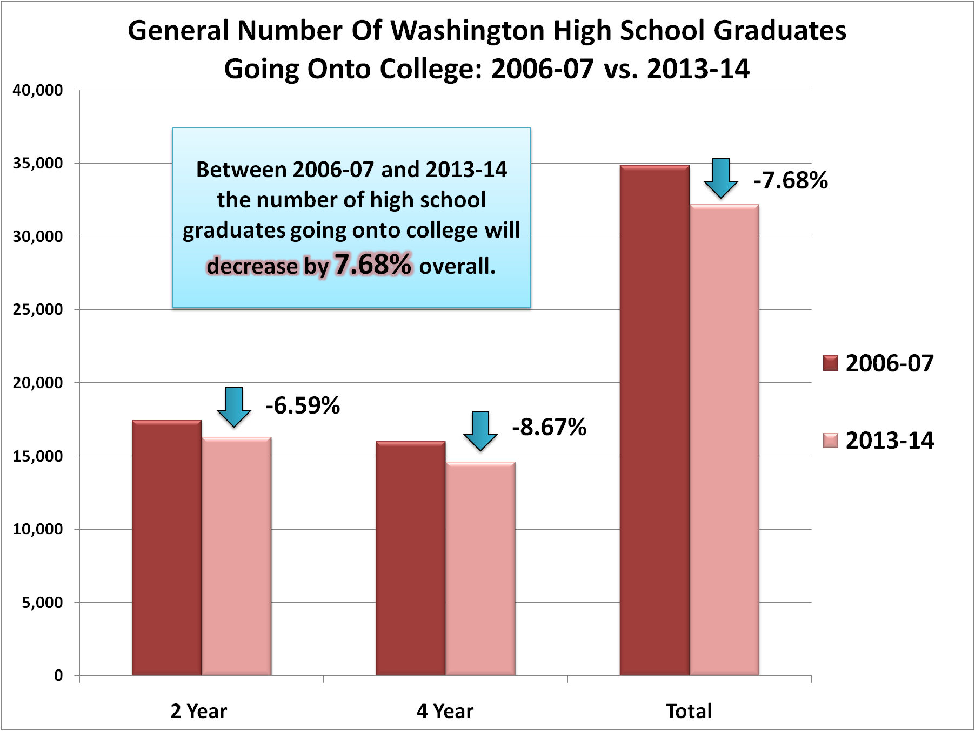
Notes:
PHIL

Slide 4
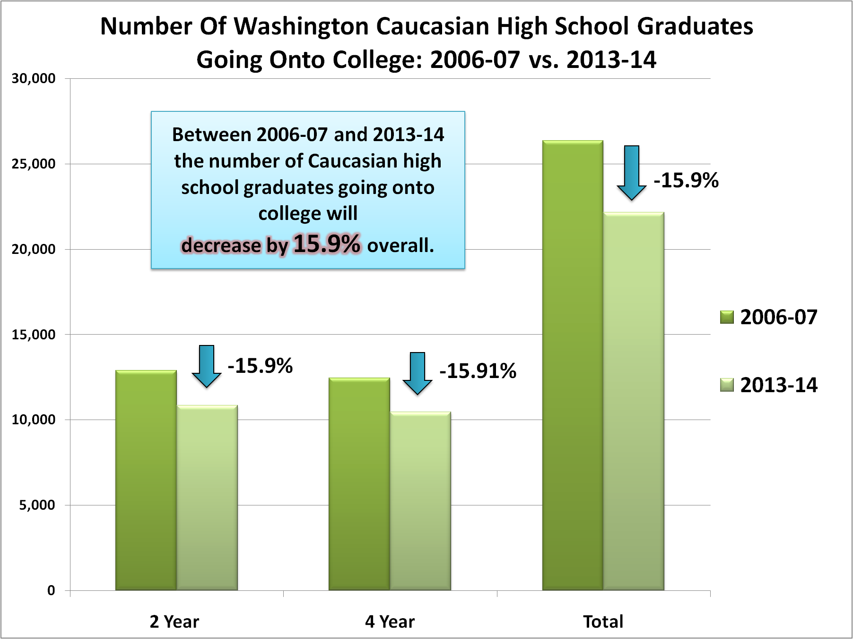
Notes:
PHIL

Slide 5
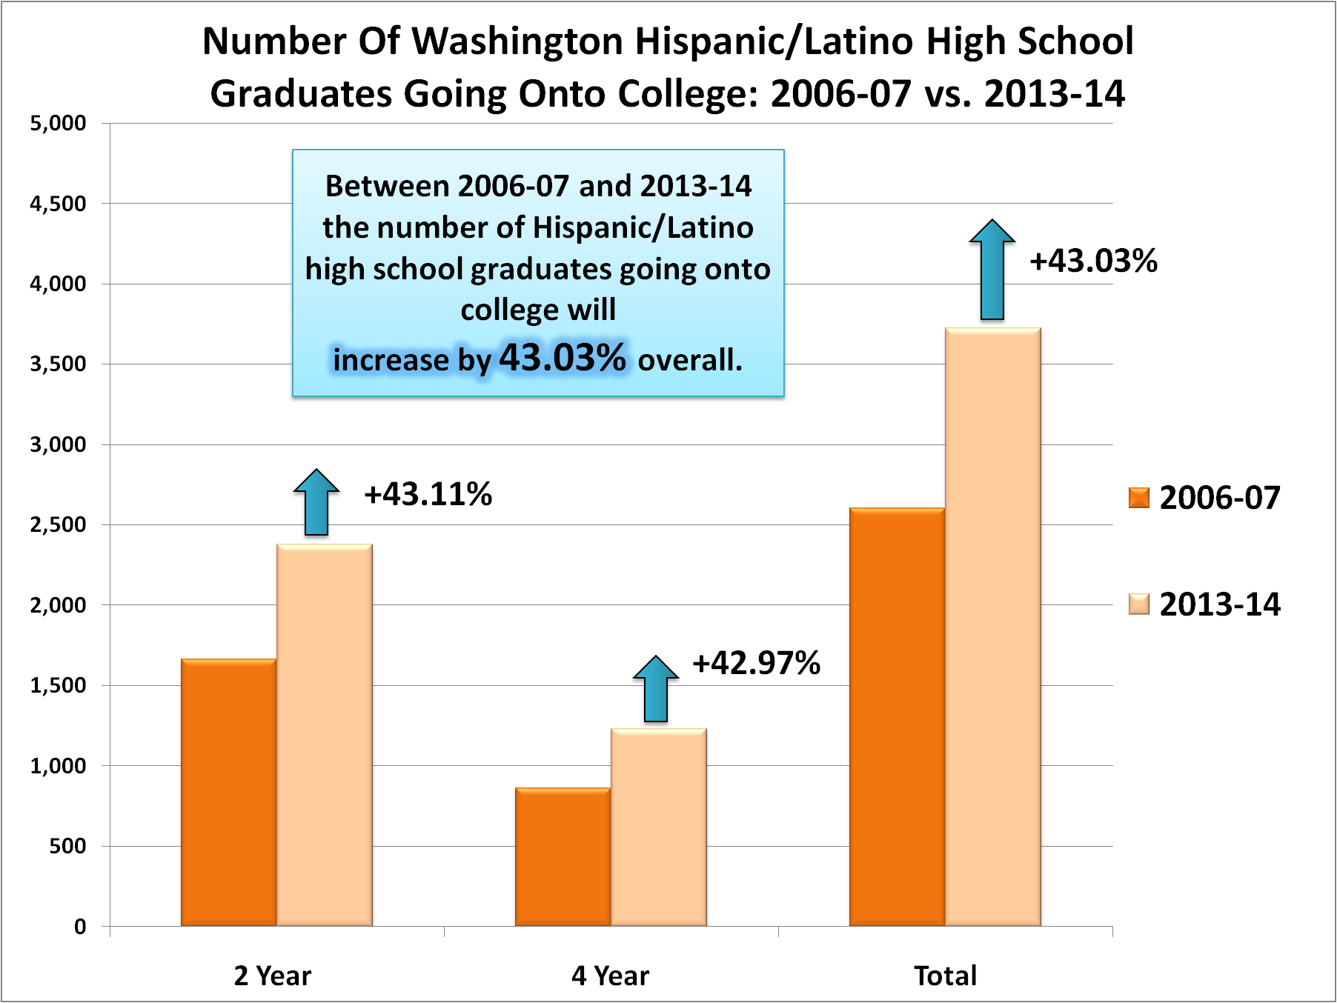
Notes:
PHIL

Slide 6
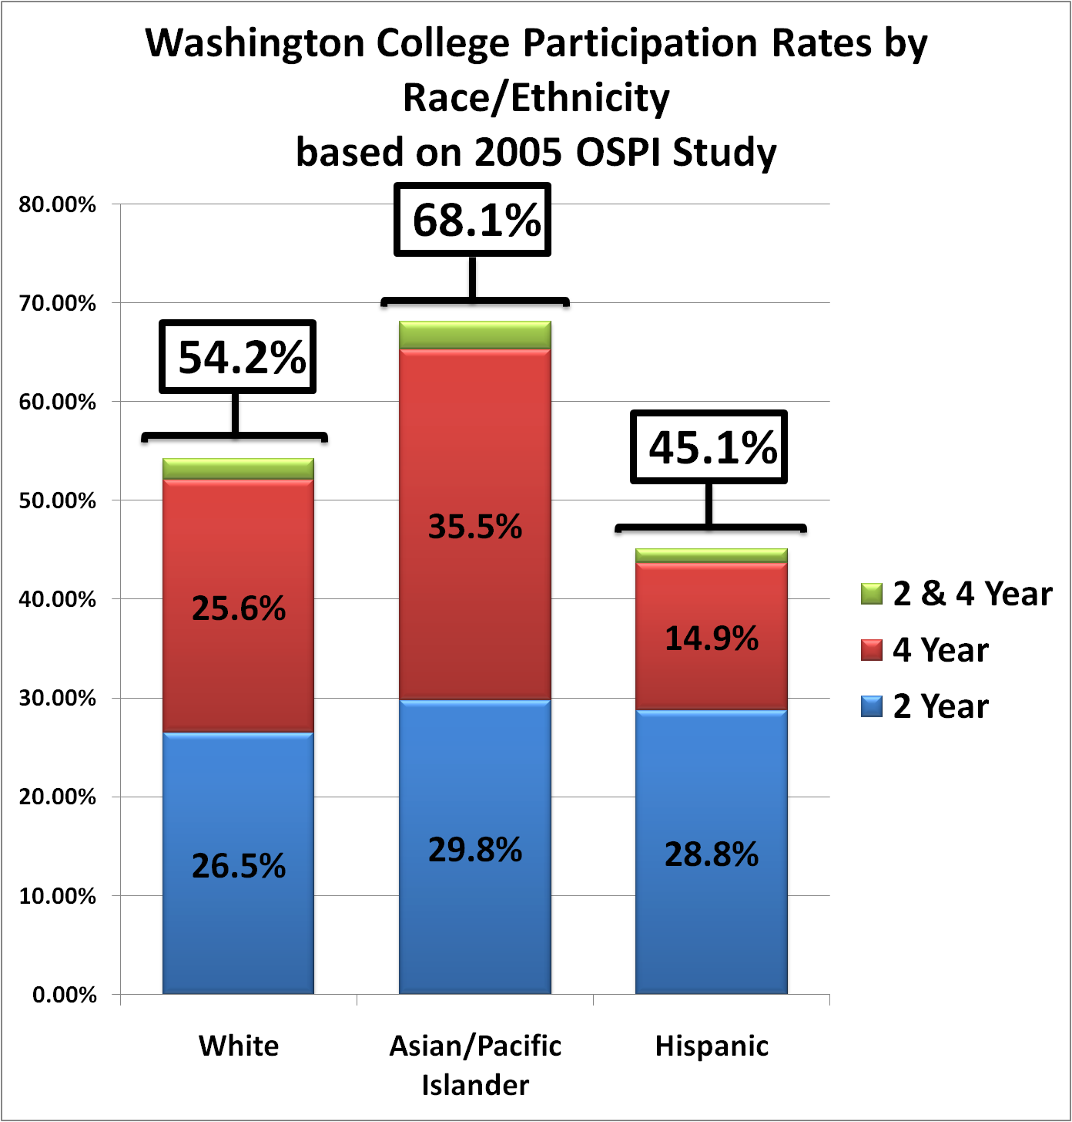
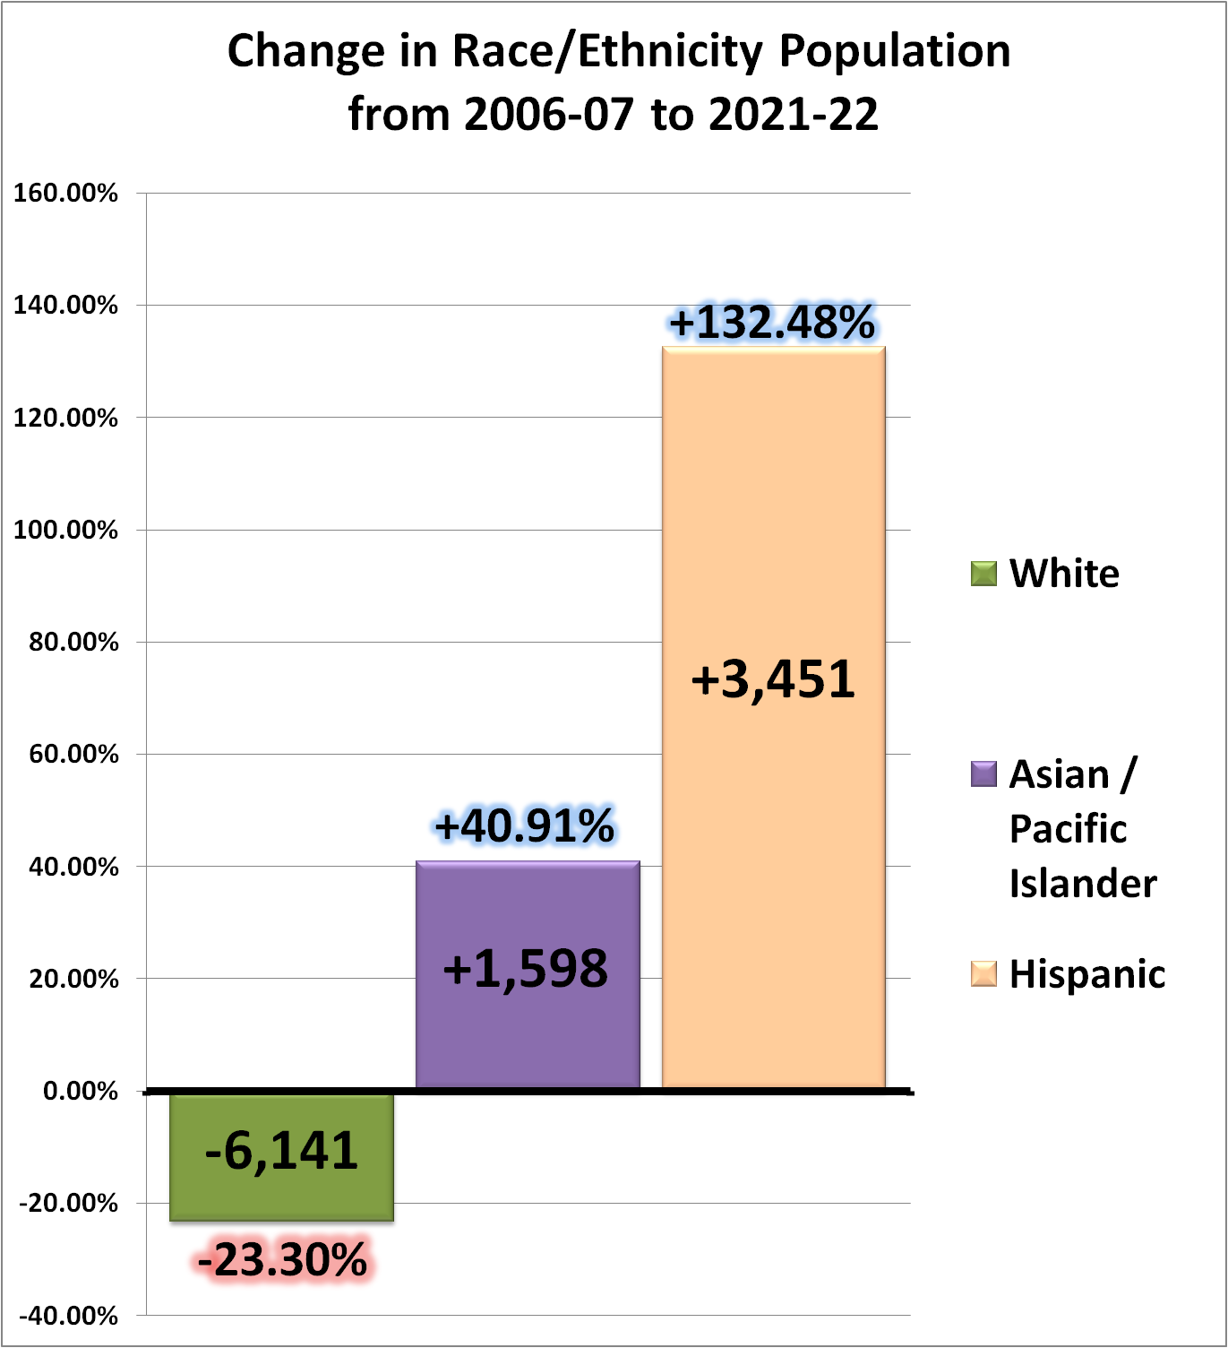
Notes:
PHIL

