Slide 1
Graduating Your First Students
UW ADVANCE Fall Quarter Pre-Tenure Faculty Workshop
November 29, 2016

Slide 2
Jayadev Arthreya
Associate Professor, Mathematics
Director, Washington Experimental Mathematics Lab
Jessica Lundquist
Associate Professor, Civil & Environmental Engineering

Slide 7
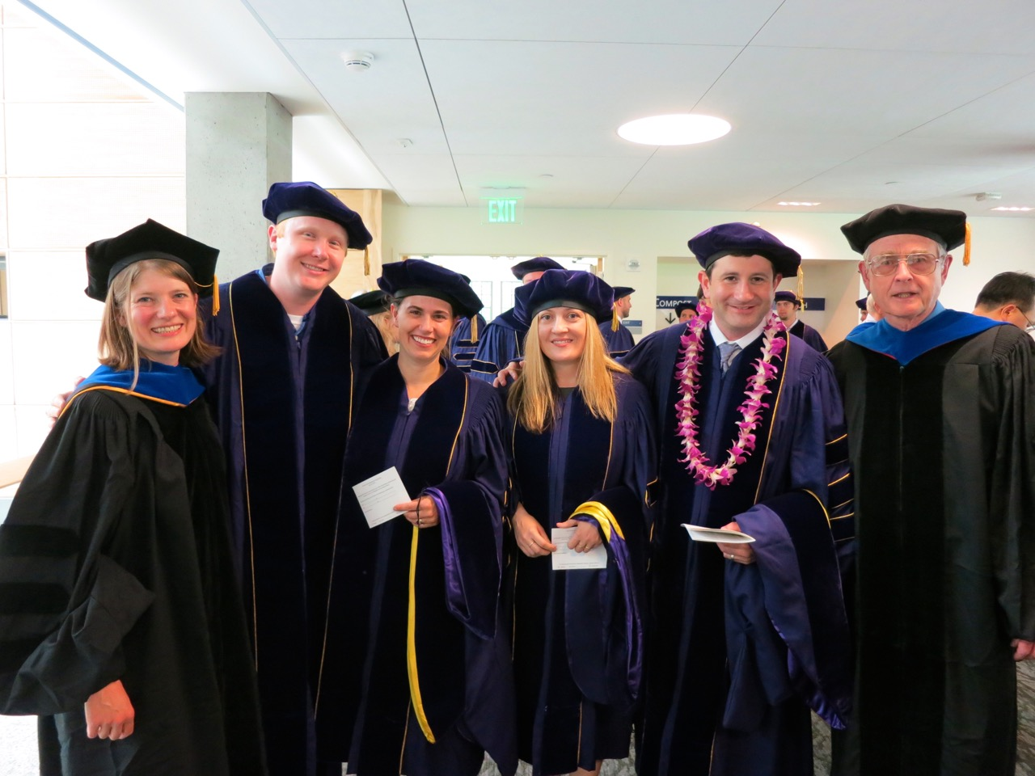
Graduating your First Grad Student

Slide 8
It’s all about goals
Finishing grad school is remarkably about persistence – try to pick students who don’t give up and create a culture of not giving up
Even if you feel compelled to graduate a student so that you can get tenure, remember it’s all about the student and his/her goals
Semi-annual goals and objectives worksheet
Why are you here? Why do you want a PhD?
Where do you want to go next?
You need to write 3 chapters to get there

Slide 9
It’s all about stories
Thesis is 3 chapters = 3 papers = 3 stories
Story-board your idea and tell it to the group
Make a powerpoint of ~10 slides with images that tell your key story
If you can’t officially make the graph yet, just draw a cartoon of it
These slides can become the figures in your paper, and you can write around them.
Write to find if your story has holes in it

Slide 10
Write, write, write
Make a group (combine with another professor or add some undergrads) so that it’s not just you and one grad student
Make everyone write regularly, and regularly review each other’s writing
Everyone has trouble writing, and most people have similar mistakes
You’re not picking on one person
Submit thesis chapters early (if they’ve been through peer review, committee members won’t bother with them) – do not save writing for the end

Slide 11
Questions?

