Slide 1
Effective Reinforcement
Neil M. Kirkpatrick, Ph.D.
Director, Parent Child Clinic
Department of Psychology, University of Washington

Slide 2
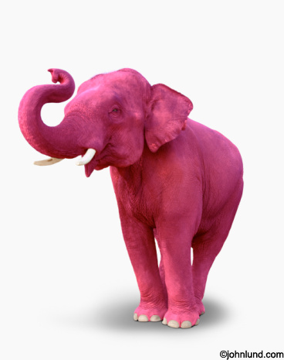
Assumptions
What can you control?
-Emotions
-Thoughts
-Behavior

Slide 3
Behavior Basics
Positive Reinforcement Rule
Attention Rule
Pos
Neg
Control
Duration
Intensity
Enjoyable

Slide 4
Traps
Sleeping Dogs Trap
Criticism Trap
  “Getting It” Fallacy

Slide 5
Rewards
Tangible
  Satiation Effect
  Inflexibility
  Entitlement/ Materialism
  Uses:
    Celebration
    Getting initial buy in to new recurring behavioral demand

Slide 6

Rewards
Tangible
Physical
  Most important!
  Communicates Love & Acceptance
  Not specific to behavior
  Non-Contingent!!!!!!!
    NY Times article

Slide 7

Rewards
Tangible
Physical
Verbal
  Attending = Noticing/ Acknowledgement
  Praise
    Unlabeled
    Labeled

Slide 8
Rewards
Labeled Praise
-Closer in time to behavior the better
-Focus on Improvement
-No “However” or “But”

Slide 9
It deosn't mttaer in waht oredr the ltteers in a wrod are, the olny iprmoetnt tihng is taht the frist and lsat ltteer be at the rghit pclae. The rset can be a toatl mses and you can sitll raed it wouthit porbelm. Tihs is bcuseae the huamn mnid deos not raed ervey lteter by istlef, but the wrod as a wlohe.

Slide 10
Rewards
Labeled Praise
-Closer in time to behavior the better
-Focus on Improvement
-No “However” or “But”
-Labeled (Behavioral), not labeling!
-Altruism exception

Slide 11
What Stops Us?
1) Should?
  No one praises me?
  Why do they need it?
2) Vulnerability
  What if they don’t care?
  Who am I to praise them?

Slide 12
In Summary
Be behavioral (Charades Rule)
Be specific
Be prompt
Be brave…. What type of world would you like to live in?

Slide 13
Questions?
Thank you!

Slide 14
Behavioral Principles
Positive Reinforcement
Bx
PR
Generalizes!
Time
Bx Increases
Bx
Punishment
Suppresses behavior
when cue present
Bx Decreases
1st Time Learning
exception
Pun
Bx
Negative Reinforcement
Only with aversive
Or cue for aversive
Bx Increases
NR

Slide 15
Extinction Bursts
Time

