Slide 1
Selecting Graduate Students for Your Lab
UW ADVANCE Fall Quarter Pre-Tenure Faculty Workshop
December 14, 2017

Slide 2
JENNIFER NEMHAUSER
Professor, BIOLOGY

Slide 3
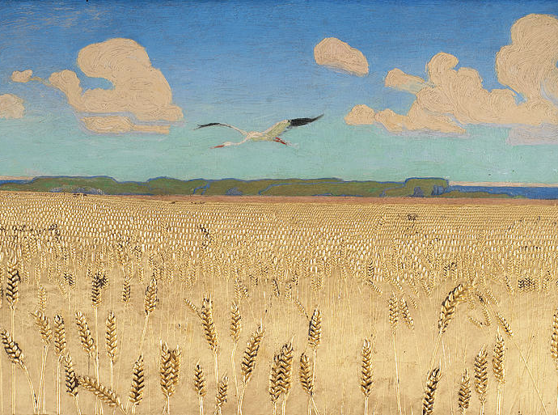
Raising the next crop of scientists
Jennifer Nemhauser, UW Biology
ADVANCE workshop, December 2017
Harald Slott-Møller,1891

Slide 4
Know thyself: What’s your mentoring style?
Step 1: Brainstorm 7-10 ideal qualities you would like to see in a graduate student
Step 2: What 3 can you NOT live without
Step 3: What 3 can you live without?
resources:
Rose, G.L. Enhancement of Mentor Selection Using the Ideal Mentor Scale Research in Higher Education (2003) 44: 473
Baker & Griffin. Beyond mentoring and advising: Understanding the role of faculty developers in student success About Campus (2010) http://works.bepress.com/kimberly_griffin/24/
Jennifer Nemhauser, UW Bio
ADVANCE workshop, December 2017
Notes:
What kind of mentor are you?
Highly involved? Hands-off?
Scheduled check-ins or drop bys?
Like to see a lot of independence? Like to have a close collaboration?
The Challenger: The Challenger’s role is to push a student to put in the hard work, to sweat the details that matter, to hit key milestones and to outwork his/her competition.
The Cheerleader: The Cheerleader’s role is to say “You can do this.”
The Educator: The Educator is someone willing to sit down and teach him/her when needed.
The Ideator: The Ideator loves to play the role of thought partner.
HuffPost 10/25/13

Slide 5
Know thyself: Why are you recruiting a grad?
What is motivating you to recruit a new trainee?
Why a graduate student specifically?
What is your bandwidth?
Your answers will likely change:
-over your career
-the type and extent of current funding
-the size and make-up of your lab
Jennifer Nemhauser, UW Bio
ADVANCE workshop, December 2017

Slide 6
Prescreen for what you are looking for
In applications, look for:
-relevant expertise or experience
-letters with specific descriptions of things you value
(e.g., grit, creativity, work ethic)
-gender balance in mentors (if possible)
Absolutely do a Skype interview if at all possible!
Jennifer Nemhauser, UW Bio
ADVANCE workshop, December 2017

Slide 7
Match the interview to your style/goals
Behavioral interviews—interview for specific skills/qualities
-Ask about relevant situations and how they did or would respond.
-Ask them things they are unlikely to have rehearsed.
-Ask them to do something.
-Listen more than talk.
-Trust your instincts.
-Trust your colleagues.
Jennifer Nemhauser, UW Bio
ADVANCE workshop, December 2017

Slide 8
Questions?

