Slide 1
Applying for NSF CAREER Grants
UW ADVANCE
Spring Quarter Pre-Tenure Faculty Workshop
May 11, 2016

Slide 2
KRISTIAN WILES
Executive director, retention & academic support programs, office of minority affairs & Diversity

Slide 3
CASSIE VENNEAU
assistant DIRECTOR, Diversity & Access, college of engineering

Slide 4
SONYA CUNNINGHAM
Director, stars, COLLEGE OF ENGINEERING

Slide 5
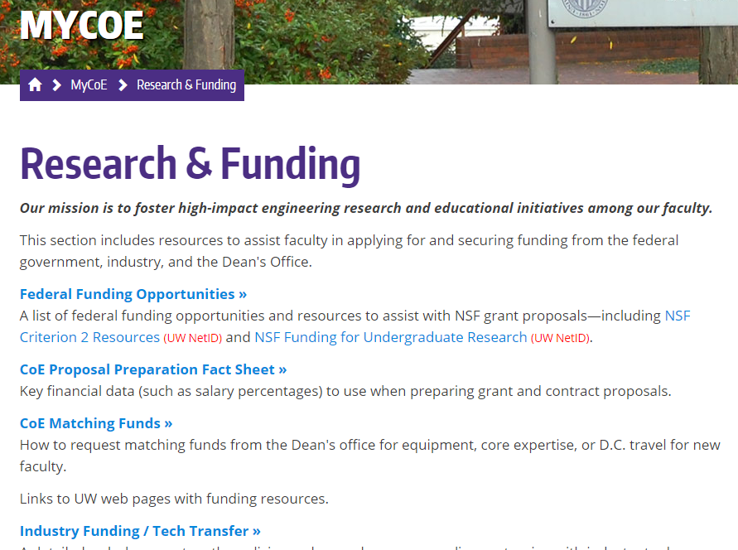
COE Criterion 2 Boilerplate
Research & Funding: http://engr.washington.edu/mycoe/research/index.html
Criterion 2 Boilerplates: http://www.engr.washignton.edu/?q=mycoe/research/criterion2/index.html

Slide 6
Additional Resources
ADVANCE resource library – 20+ past presentations/speakers on this topic (http://advance.Washington.edu/apps/resources/results.phtml?srchType=simple&srchTxt=NSF+career&matchStr=yes)
NSF Career Website – list of past awardees. Can search for ones here at UW
Marketing for Scientists: How to Shine in Tough Times book

Slide 7
Peter Pauzauskie
Assistant Professor,
materials Science and Engineering

Slide 8
CAREER Award Advice
Peter Pauzauskie (MSE)
Adapted from:
2014 NSF CAREER Workshop
University of Maryland
April 7-8, 2014
Funds the academic career development of new faculty (it is not a research award)
Is based on a development plan, ”a well-argued and specific proposal for activities that will, over a 5-year period, build a firm foundation for a lifetime of contributions to research and education in the context of the PI’s organization”
Duration: 5 years
Min amount: $400,000, $500,000 in ENG
Deadline for Engineering: July 21, 2016 (for other directorates, see solicitation)

Slide 9
Your Strategic Plan / Life Roadmap
Who are you?
  Your expertise/interests
  Your career/life goals
  Your position/resources
Your proposal should fit into your life plan
A strategic plan has three parts:
  Where are you today?
  Where do you want to be in the future (5, 10, 20 years from now)?
  How do you get from here to there?
What is your life plan? Do you need to develop a strategic plan?

Slide 10
Your Proposal
Should advance you toward your life goals
  Should be a stepping stone to the next thing
Should be compatible with your institution’s goals
Should represent a contribution to society at large
Test: If you accomplish your objectives, are you better off for the effort?

Slide 11
Dos & Don’ts
Dos
Don’ts
Have a strategic plan
Build on your strengths
Differentiate this proposal from your Ph.D. thesis work and other sponsored work
Perform a thorough literature search and exploratory research before writing the proposal
  Journal articles (update with personal contact)
  Read the NSF Grant Proposal Guide (GPG)
Establish and keep your contacts
Rush / Wait until last minute (1 month) to contact program directors
Make the proposed work (research and education) too broad
Make the proposed work too narrow
Ask for too much (or too little) money
Ignore rules (Grant Proposal Guide) and misc. items – violation of the GPG requirements will result in return without review
Submit your proposal late

Slide 12
Advice for resubmission
Dedicate space early in the proposal to a “CAREER development timeline” with lifelong career goals, starting from undergraduate studies; see next slide.
Be paranoid about GPG formatting guidelines – had proposal returned without review for an “et al.” citation in a figure caption. OSP will review the proposal, but they do not catch everything; ask graduate students to help make sure every reference is formatted properly, etc.
Meet with program manager in DC if possible; do no be afraid to switch programs if their response is negative.
If you have positive reviews from related submissions to a given program, then request to include “Reviewer #-X from NSF Proposal submission #-Y” to serve on the review panel. Consider recommending reviewers from outside the USA if research community is small.
Chair’s letter is important for many panels; make sure it is as strong as possible.

Slide 13
Example CAREER development figure

Slide 14
Lauren Buckley
Associate Professor, Biology

Slide 15
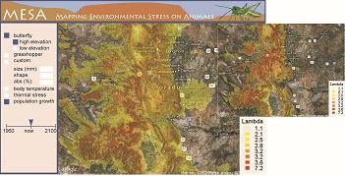
CAREER: Computational and visualization tools for translating climate change into ecological impacts
Lauren Buckley, UW Biology
Funded by NSF Division of Biological Infrastructure
Rejected: 2012; Funded: 2013
Challenges:
Single PI proposal despite collaborative research program
2. Meaningful and feasible broader impacts
3. Identifying appropriate NSF panel

Slide 16
Initial submission
Picked the wrong panel- Mediocre review by primary panel. Strong support from co-reviewing panel.
Revision
Extensive advice from program officers
Increased budget for training
Added letters of support demonstrating potential impact
Improved assessment plan (UW Office of Educational Assessment)
Elaborated on how proposal leveraged my training / past research

Slide 17

Lessons?
Identify a novel and compelling topic that builds on your research program.
Ideally integrate broader impacts with the science.
Build on existing education and outreach initiatives.
Maintain clear organization of traditional NSF proposal, but shift weight to broader impacts and broader context of your research program.
Communicate with program officers, but realize pre-submission input may be limited.
Ask for money necessary for research and broader impacts.
Build partnerships (letters of support).
Ask colleagues for examples and feedback.
Benefits of CAREER beyond funding.

Slide 18
Nathan Sniadecki
Associate Professor, Mechanical Engineering

Slide 19
Through the Looking Glass…
Advice from a Recent CAREER Panelist
Nathan Sniadecki
Mechanical Engineering

Slide 20
CAREER Panel is like a Regular NSF Panel
Reviewers have 8-10 proposals to read… while doing their day-jobs
How each proposal is reviewed:
  Lead reviewer who summarizes your proposal
  2nd reviewer who agrees or disagrees with the lead
  Scribe who is frantically taking notes
  Other panelists who are half-listening
Reviewers are knowledgeable in your field, but not world-class experts
Reviewers are typically awardees of program, so do your homework on what’s been funded

Slide 21
Intellectual Merit
Be bold, be transformative, but make sure it’s feasible… or something you’ve done before
Make important stuff easy to find: bold it, box it, use headers, draw a picture
Reviewers read your proposal in three phases:
  Skim read to find the best ones
  Careful read to write the review (with interruptions)
  Skim read before the panel discussion
  Other panelists will skim read during the discussion
Don’t have sloppy science: double check spelling, grammar, reference, and letters

Slide 22
Broader Impacts
Show your creativity and innovation in education
Cliché educational plans:
  Involving undergraduate researchers
  Training “next generation” graduate students
  Creating new classes based on proposal research
Don’t make hollow promises; get an evaluator or use assessment tools

Slide 23
Picking the Winners
Each proposal is ranked as:
  Highly competitive – must get funded
  Competitive – fundable if money is available
  Not competitive – not fundable
Win one or more champions on the panel
Avoid one or more adversaries
Keep your budget reasonable… or your program officer will be your adversary

Slide 24
Questions?

