Slide 1
When to Say Yes and When to Say NO!
Eve Riskin
Professor of Electrical and Computer Engineering
Faculty Director, UW ADVANCE
Associate Dean of Diversity & Access, College of Engineering
December 6, 2019

Slide 2
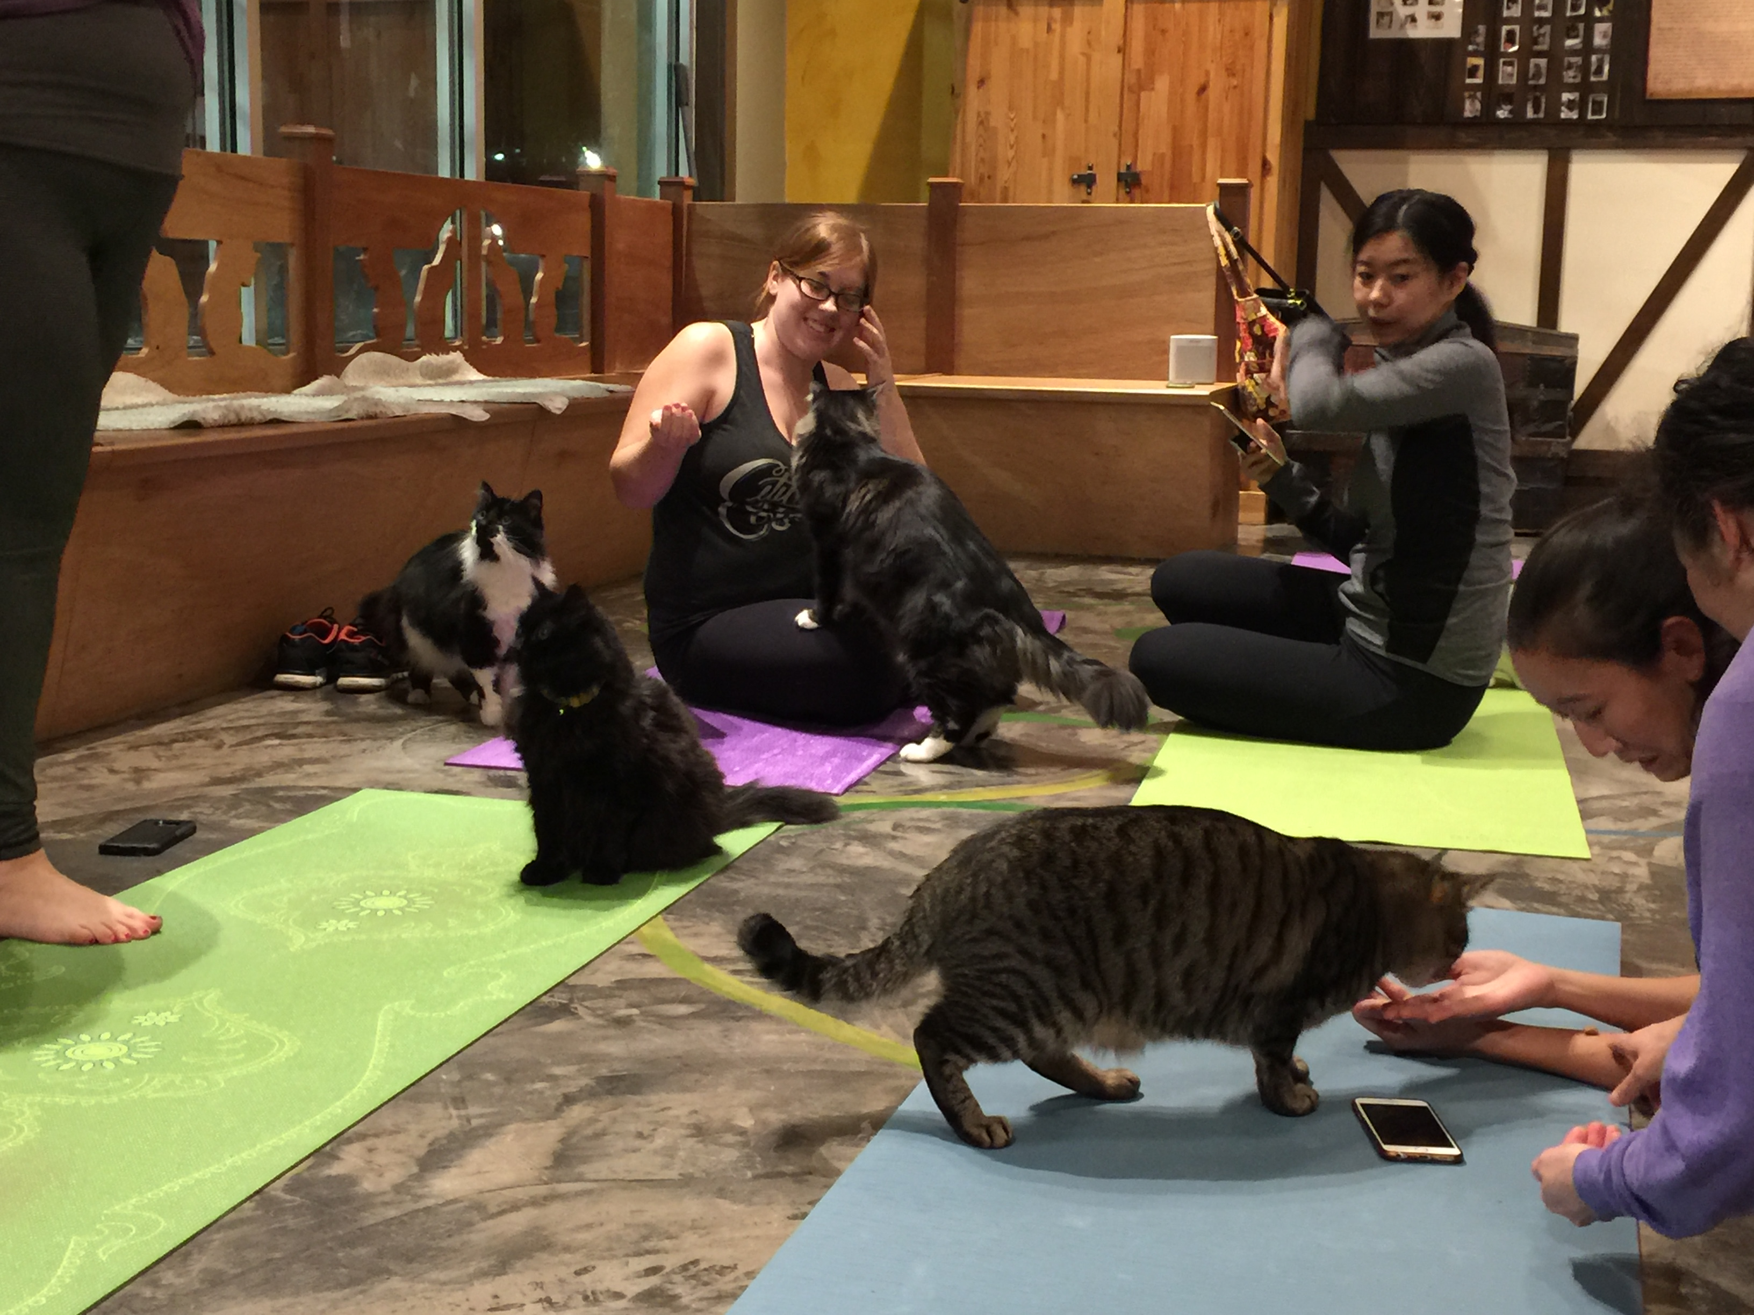
Time is Your Most Valuable Commodity

Slide 3
I Forgot to Say No

Slide 4
Eve’s 3 Key Principles for Time Management
Your success is your department’s success.
It’s not fair that people from underrepresented groups get asked more often to do service.
Junior faculty should not do service that old white guys can do.

Slide 5
Exercise 1: What Requests Are Compelling Enough to Make You Say Yes?
At your seat, jot down several situations where you were happy to say yes

Slide 6
Eve Suggests You Say Yes
When the request
comes from the Dean or Provost
comes from someone you need on your side
comes from someone to whom you owe a favor
When you would
have influence
meet important people
have fun

Slide 7
Also Say Yes When the Request Will Help Your Tenure Case

Slide 8
And Say Yes to Be co-PI on a Proposal!

Slide 9
Exercise 2: When Do You Say No?
At your seat, jot down several situations where you have said no and felt conflicted about it.

Slide 10
Say NO!
If you would hate it
If you don’t care about it
If you’re not good at it, e.g. analog circuits
If it’s from someone who can’t help your career
If it’s from a journal in which you don’t publish
If it’s from a foreign NSF that doesn’t pay you
If it is ABET or curriculum
If it can be solved with money, e.g. teaching an extra course

Slide 11
Say NO WAY!
If they tell you in the request that they are asking you because you are a woman or a URM
If the person who makes the request is an idiot
If the email request is badly written
If it feels like a “dump and run”
If you don’t know what the goal is

Slide 12
Dawn Tilbury’s Ways to Say No
“Do I have to say yes?”
“If I say yes, can you help me identify what I can say no to?
“Instead of me, why don’t you ask INSERT-NAME-HERE?”

Slide 13
My Final Thoughts
Do not work for free!
Keep your boundaries clear
If you are uncomfortable with a request, seek calibration from a friend/colleague
Say yes to the right people
Get yourself a “ventor” pronto

