Slide 1

Recruiting the Best and Brightest Graduate Students
Advance Junior Faculty Workshop, Nov. 9, 2006
Prof. Les Atlas
Department of Electrical Engineering

Slide 2
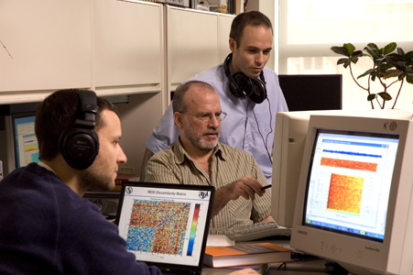
Acknowledgements
Scott Phillips, EE Ph.D. Student who has received EE department awards for his managing of our recruting day.
Arizona State Univ. document: “Best Practices for Successful Recruiting” http://www.asu.edu/graduate/&facstaff/docs/BestPractices.doc
Other past and present graduate students in my research lab and department.

Slide 3
Obvious #1: Create an Informative, Welcoming, and Transparent Website
Start with a general statement and demos which makes almost any student in your field aware of the importance and innovation of your research.
Make sure it is easy to find faculty and student interests and recent publications.
Include—no, feature—graduate student accomplishments (e.g., publications, awards).
Provide stories about current students and alumni.
Talk about funding available or potentially available.
Provide a link from your website to the place where you can get information about applying to your department and UW.

Slide 4
Obvious #2: Respond Quickly and Personally To Inquiries From All Top-notch Students and also be Proactive
Students expect a response within 24 hours of their email or phone call.
A personal response from faculty PI is important here. Yet other grad students can “chime in.”
Your current graduate students are your best “sales” people. Involve them in the recruitment process.
Don’t wait for applications to be complete before you start reviewing them to look for strong candidates.
  When you find excellent students whose applications are not complete, contact them to indicate your interest in their candidacy and encourage them to complete the application.

Slide 5
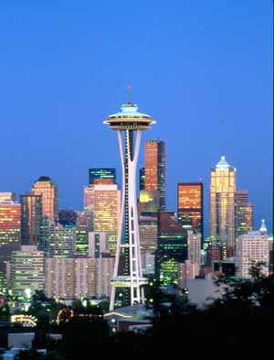
Obvious #3: Invite Potential Students for a Recruitment Visit: Treat it like Faculty Recruiting Visits
Bring your top recruits to campus at the same time—this builds a cohort feeling
Involve faculty and graduate students in the recruitment visit. Showcase graduate student achievements.
Offer a well-organized and full mix of social and academic activities (e.g., dinner at a faculty member’s home, hike and regional fun things).
Provide potential students an opportunity to meet with students and faculty in other disciplines, either through your own interdisciplinary initiatives or drawing on the various graduate student associations (e.g., leadership of the Black, Latino/a, and American Indian Graduate Student Associations).
Follow up with emails and phone calls when the student returns home telling them you enjoyed meeting them and hope they will decide to come to UW. Ask if there are any further questions you can answer.

Slide 6
Obvious #4: Invite Potential Students for a Recruitment Visit (Continued)
Fill their days up, for example, from our EE recruiting done last year:
VISIT DAYS AGENDA
Thursday, March 30, 2006
8:30 - 9:00 Gathering, continental breakfast, distribution of appointment schedules
9:00 - 10:00 Welcome, introductions, EE overview, info from the GSA
10:00 - 11:00 Poster session with current grad students
11:00 - 12:00 Individual meetings with faculty
12:00 - 1:30 Lunch and post-lunch Q&A with current graduate students at the UW Club
1:30 - 5:00 Individual meetings with faculty
6:30 Spaghetti dinner at Professor John Sahr’s house
Friday, March 31, 2006
9:00 - 10:30 Individual meetings with faculty
10:30 - 12:00 Research Labs Open House
12:00 - 1:30 Lunch – on your own, free to explore “U District,” campus eateries
1:30 - 5:00 Individual meetings with faculty
5:00 Buffet with faculty and grad students
evening Nightlife with current grad students, or time for personal agendas
Saturday, April 1, 2006
10:00 Current graduate students will coordinate Seattle sight-seeing.

Slide 7
Not-So-Obvious #1: Do Swaps with Colleagues at other Departments
For top departments: “I’ll send you my best undergraduates if you send me yours.”
Do consider less-known undergraduate programs:
  Great graduate students and, ultimately, famous people can came from less prestigious undergraduate programs.
  Get to know faculty at these schools.
  The absolutely top undergraduate students at some seemingly lesser-quality departments can become future industry or academic leaders!
But be careful, since this concept needs good communications to other faculty on admissions committee.

Slide 8
Not-So-Obvious #2: Be Ultra-Careful About Selectivity
Forget the expectation of absolute top grades at top departments.
  That system can be gamed
  But still expect fairly high GPAs
Forget GRE’s since they also can be gamed
  But still expect some reasonably high threshold.
Usually trust reference letters, but only if they include substantive examples.
Important: They show interest in your area or at least are curious about it, if they come from an initially different area.
  Most BSEE’s don’t know what they want to specialize in.
My best predictors of future success:
  Creativity in their statement of interest.
  Phone questions:
    Want to become a faculty member at a top school?
    Want to take risks in your research?

Slide 9
Not-So-Obvious #3: Instill Confidence
(No one is perfect so:) Share your failures and encourage your graduate students to also do that.
Discuss the statistics for your department’s qualifying, Ph.D. General, and Final Exams.
Comment on the positives you saw in the students’ statements of interests and academic record.
  Most important, point out what is unusual or special.
Excitement in them builds excitement in you.
  Share this with the graduate student “helpers” in your lab.
The visitors potential impact on your research and the field in general would be high if she comes here.
  Stress his or her impact 1st, and how good we are 2nd.

Slide 10
Not-So-Obvious #4: Instill Confidence in Future Academic Careers
Informal poll taken last Monday among EE graduate students interested in possible faculty positions:
  The #1 worry, by far, is the difficulty of the tenure system!
  Some possible things to help this specific problem:
    Relate the successes from your lab.
    Tell them your own experience.
    Most departments hire 1 faculty member for each for tenure-track positions
  The #2 worry, is the difficulty of getting funding.
  Some possible things to help this specific problem:
    Tell them your own experiences, good and bad.
    Relate how they will gain proposal writing experience in your lab.

Slide 11
Top Student Recruiting Takes Time!
Less immediately obvious:
It is time well-spent!
We can compete favorably against the top-name schools!
  But we need to offer more personal attention from faculty and a stronger sense of community than the top-name schools.

Slide 12
If the Student Chooses to Join Your Lab I
Quickly let them know your expectations, e.g.
  I might suggest problems and solutions, but
    I intentionally start with very difficult problems
    But I strongly encourage them to re-define the problems and find solutions which I would not have considered.
    E.g. without the above source of creativity, we’d still be working on designs of Grand Coulee Dam. (What UW EE was 1st famous for.)
    Everyone in the lab has to do their share of the more mundane tasks.
Their first choice of lab and advisor might not be the best choice. This happens all the time.
  It’s OK if the fit isn’t good and do inform the students that you are happy to help them transition to other labs.

Slide 13
If the Student Chooses to Join Your Lab II
Strongly encourage cooperation with others in the lab.
  There is no penalty for joint contributions!
  Keeping ideas secret so they won’t be stolen is usually inappropriate and a bad indicator of future success.
If you start have some misgivings about the student, be clear about problems, and give them a chance to improve.
  But if they don’t or can’t improve, counsel them out of your lab. 1 quarter is usually enough time for this assessment.
  The above is quite difficult to do, but dragging it out over time only makes the problem worse for all.
  Once in a while the difficult student is worth the trouble, but these cases are, in my experience, very rare.

