Slide 1
So you have tenure, now what?
UW ADVANCE
Mid-Career Workshop
March 15, 2016

Slide 2
Speakers
Dan Grossman – Professor, Computer Science and Engineering
Lyatt Jaegle – Professor, Atmospheric Sciences
Vikram Jandhyala, Vice Provost for Innovation and Professor, Electrical Engineering

Slide 3
Dan Grossman Professor, Computer Science and Engineering

Slide 4
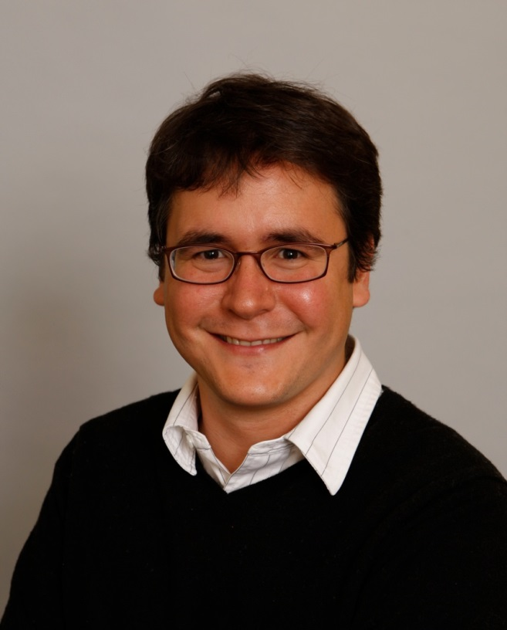
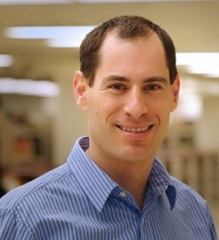
Conversation #1 2010 (Hindsight: I was wrong)
You gonna change post-tenure?
No, but I gave a talk in shorts…
Dan Grossman

Slide 5
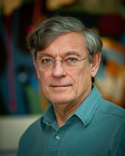
Conversation #2 2010 (we’re both right?)
Why do so few people slow down after tenure?
Because you’re so used to “pedal down”
Because “they” know your passions
Dan Grossman

Slide 6
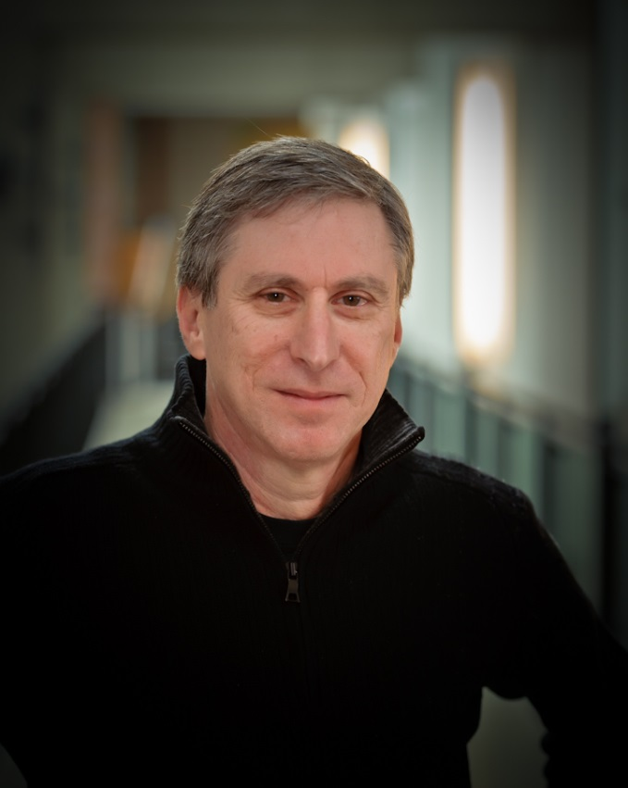
Conversation #3 2015 (Amen! 100% right)
Upon promotion to full professor:
I’m prouder of my post-tenure work than my pre-tenure work
Yeah, you did it your way rather than doing what you were told
Dan Grossman

Slide 7
Takeaways
Have a 1-5 year plan for your growth and impact
But don’t freak out if you don’t or it’s wrong
Now you really get to own your plan!
Grow, change, take risks
Still support your students and do the old stuff well
My evolution (hardware collaboration, education, curriculum, MOOCs, leadership, service, alumni relations, …) is not yours
Oh, also two kids born in years 10 and 12 on the faculty
Don’t get bored: I like my “job” now more than as an Asst. Prof.
Be proud of what you’re doing
Be unique
Dan Grossman

Slide 8
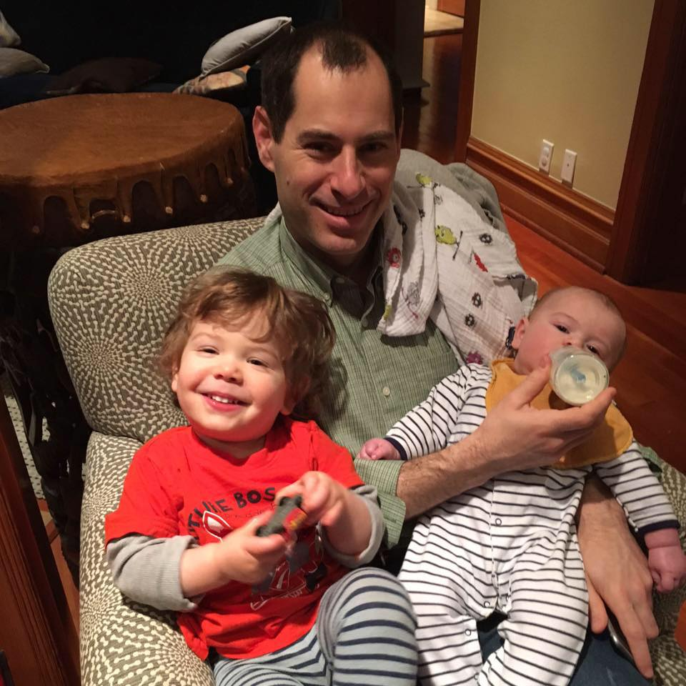
Dan Grossman

Slide 9
Lyatt Jaegle Professor, Atmospheric Science

Slide 10
Transition from Assistant to Associate Professor
You made it, yeah!
Manage students/postdocs: Make sure there is continuity in research group (funding/recruitment)
National/International visibility becomes important:
Participate in international conferences (give oral presentations, get invited); Seminars abroad
Positions in journals: advisory boards, editors, etc…
Take on national/international leadership position within your discipline (steering committee; working groups; etc…)
Start playing a bigger role in departmental/university committees with leadership role. But don’t overcommit!
Lyatt Jaegle

Slide 11
From Assistant to Associate Professor
More freedom in research directions
Continue strengthening your research portfolio
But also, figure out future research directions (a sabbatical is a good way to explore new things)
Plan sabbatical!
Department request
Host institution
Devote some of your time to doing something different (learn new technique; explore new field; start new collaborations, etc…)
Planning is key: It can take a long time to organize the logistics, but it’s worth it
Lyatt Jaegle

Slide 12
Transition from Associate to Full Professor
Enjoy the freedom!
Chance to explore more collaborations and interdisciplinary work. Take risks, start new projects.
You will likely be asked to have more administrative duties at the department/college/university level(s):
Be wise in your decisions. Commit to something you care about!
Chair of various administrative committees
Head graduate program or undergraduate program
Department Chair
Faculty senate
Etc…
Lyatt Jaegle

Slide 13
Thank you!

