Slide 1
Cultivating An Inclusive Culture for Faculty Retention:
UW ADVANCE
Spring Quarterly Leadership Workshop
April 26, 2017

Slide 2
AGENDA
10:00 – 10:10 Welcome and Introductions
10:10 – 10:40 Panel Overview
10:40 – 11:45 Small Group Activity: Case Studies
11:45 – 11:50 Wrap-up and Evaluations
11:50 – 12:30 Networking Lunch

Slide 3
welcome & Introductions

Slide 4
Panelists
Chad Allen, Associate Vice Provost for Faculty Advancement, Provost Office, and Professor, English
Toby Bradshaw, Department Chair and Professor, Department of Biology
Joe Tennis, Associate Professor, Associate Dean for Faculty Affairs, Information School

Slide 5
Chad Allen Associate Vice Provost for Faculty Advancement, Provost Office, Professor, Department of English

Slide 6
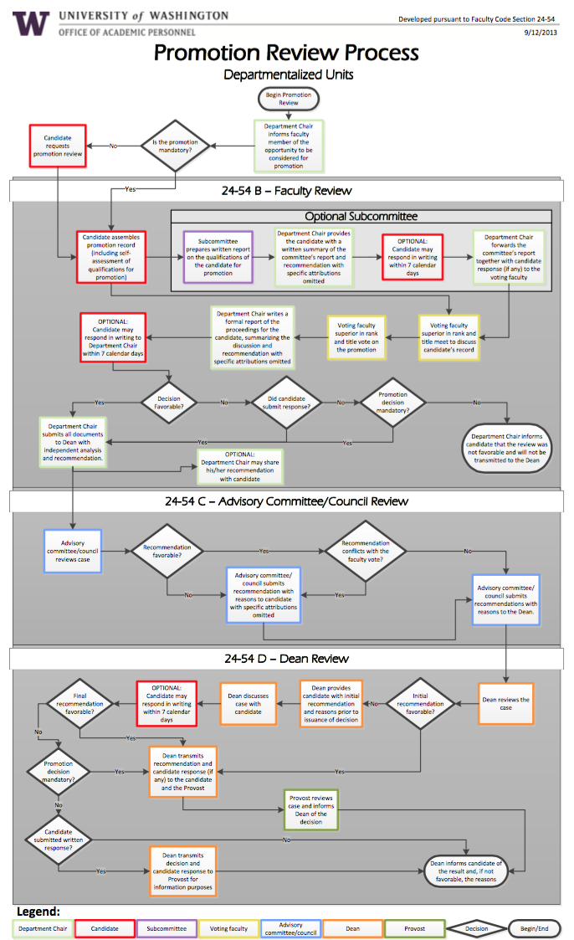
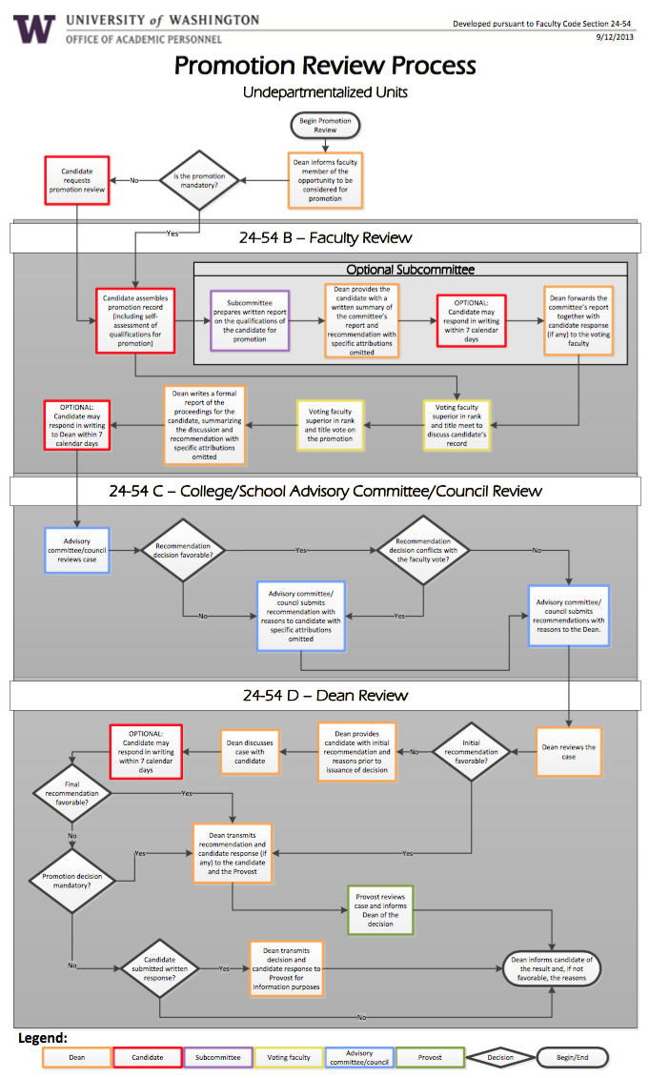
Promotion Review Process Flowcharts

Slide 7
Policies and Resources:
Where to look for answers
Faculty Code and Governance
Chapter 21: Organization of the University Faculty
Chapter 24: Appointment and Promotion of Faculty Members 24-32: Scholarly and Professional Qualifications of Faculty Members
24-54: Procedure for Promotions
Chapter 25: Tenure of the Faculty
Presidential Executive Orders
No. I: Directors and Chairs
No. VIII: Presiding Officers of Chairs, Schools, and Departments
No. 31: Nondiscrimination and Affirmative Action
No. 45: Documentation of Qualifications and Recommendations for Promotion, Tenure, and Merit Increases
No. 64: Faculty Salary Policy

Slide 8
Toby Bradshaw Department Chair and Professor, Department of Biology

Slide 9
Faculty annual review
Promotable (junior) faculty are reviewed by a 2-person team of Full Professors and Principal Lecturers who recommend merit and timing of promotion for faculty vote
Biology annual report WebQ asks faculty to “Please indicate contributions to diversity.”
FCG 24-57 conference with Chair to review criteria for promotion
Departmental salary structure (anonymized) is shared annually, including gender information
Toby Bradshaw
Professor and Chair
Notes:
Annual report WebQ includes research accomplishments, teaching, service, outreach
Typical reported activities include: recruitment of graduate students and postdocs from underrepresented groups, hosting undergrad researchers placed from BIOL 106, representing UW Biology at the national SACNAS meeting, sponsoring the Girls in Science program at the Burke Museum, raised awareness of best practices in faculty hiring

Slide 10
Promotion and tenure
Decision to seek letters from external evaluators is made by faculty vote in Sp
Candidate assembles a promotion package, including a section on contributions to diversity/inclusion/equity in their self-evaluation
Candidate gives a “promotion seminar” in Au, followed by a report from the 2-person review team and faculty vote on a recommendation to promote
Comment on diversity-related activities in the Chair’s letter to the Dean and College Council
Toby Bradshaw
Professor and Chair

Slide 11
Joe Tennis Associate Professor, Associate Dean for Faculty Affairs, Information School

Slide 12
Voice in Context: Culture, Inclusion, and Faculty Review
ADVANCE spring Leadership Workshop
“Cultivating an Inclusive Culture for Faculty Retention”
Joseph T. Tennis
Associate Professor &
Associate Dean for Faculty Affairs

Slide 13
Annual Review
Undepartmentalized College
Mentors
Two sr. faculty, reports
Merit Review: Faculty Activity Reports
List of activities plus narratives
Encouraged to highlight kinds of work
Annual Conference with the Dean
Mentors can be present for this conference
ADVANCE spring Leadership Workshop
“Cultivating an Inclusive Culture for Faculty Retention”

Slide 14
Promotion and Tenure Review
Wide consultation
Shop packet around for feedback on form and content
Letter writers: senior experts, colleagues, students, staff
Presentation to faculty catered to individual
Personnel Committee
Clear on focus of contribution to field, profession, and school
ADVANCE spring Leadership Workshop
“Cultivating an Inclusive Culture for Faculty Retention”

Slide 15
Small Group Activity: Case Studies

Slide 16
Conclusion and evaluations

Slide 17
Networking lunch

