Slide 1
“Using Data for Academic Planning”
UW ADVANCE
Fall Quarterly Leadership Workshop
December 11, 2014

Slide 2
AGENDA
10:30 – 10:35 Welcome and Introductions
10:35 – 10:55 Experience from a Dept Chair
10:55 – 11:35 UW Profiles
11:35 – 11:45 Break
11:45 – 12:25 My Plan
12:25 – 12:30 Conclusion and Evaluations
12:30 – 1:00 Networking Lunch

Slide 3
Welcome and introductions

Slide 4
Panelists
Greg Miller: Chair, Civil & Environmental Engineering
UW Profiles
  Carol Diem: Director of Institutional Analysis, Office of Planning & Budgeting
  Ann Wunderlin: Education and Communications Manager, UW-IT
My Plan
  Phil Reid: Associate Vice Provost, UW-IT
  Darcy Van Patten: Senior Program Manager, Student Information Systems, UW-IT
  Jill Yetman: Project and Product Manager for MyPlan, UW-IT

Slide 5
Experiences from a department chair

Slide 6
DATA IN THE TRENCHES
ADVANCE PRESENTATION, DEC 11, 2014
Greg Miller, Chair CEE

Slide 7
WHAT I USE DATA FOR (AS CHAIR)
Running the trains
Tracking enrollments, course demand, admissions, etc.
Assigning TAs, instructors, staff support
System tuning (levers and knobs)
Why…?
How can we…?
Internal/external audiences
Is x good, bad, ugly, possible/impossible…?
Understanding the Present, Planning the Future
Reality Checks
Notes:
What I’ll cover today
Will start with an update on our team

Slide 8
SOME GOOD SOURCES
Internal
UW Profiles
Office of Planning and Budgeting (OPB) Briefs
Your staff
Fingers and toes
Professional organizations
Census data
NSF
Bureau of Labor and Statistics
WA State.gov
External (benchmarking, calibration, etc.)
Notes:
What I’ll cover today
Will start with an update on our team

Slide 9
WOULDN'T IT BE NICE IF…
Automated standard reports (e.g., accreditation, 10-year program reviews)
Self citing data
Curricular content tracking
Google (Oops, already have that)
Notes:
What I’ll cover today
Will start with an update on our team

Slide 10
DATA
Lessons I've learned:
Know your audience, know your story
Know (and cite) your sources
A picture (plot) is worth a thousand tables
Beware snapshots, anecdotes, and extrapolation
Simplify (but don't oversimplify)
Be honest and be thorough
Use data to start discussions rather than preemptively end them: data are ultimately just data.

Slide 11
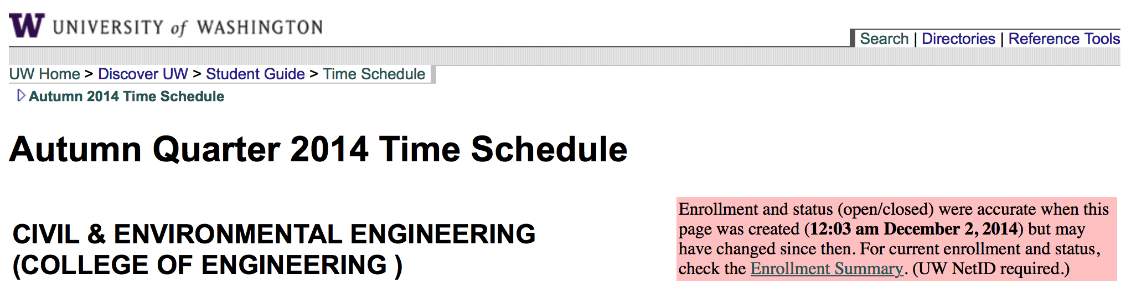
JUST IN CASE THIS IS NEW TO YOU
Enrollment Summary

Slide 12
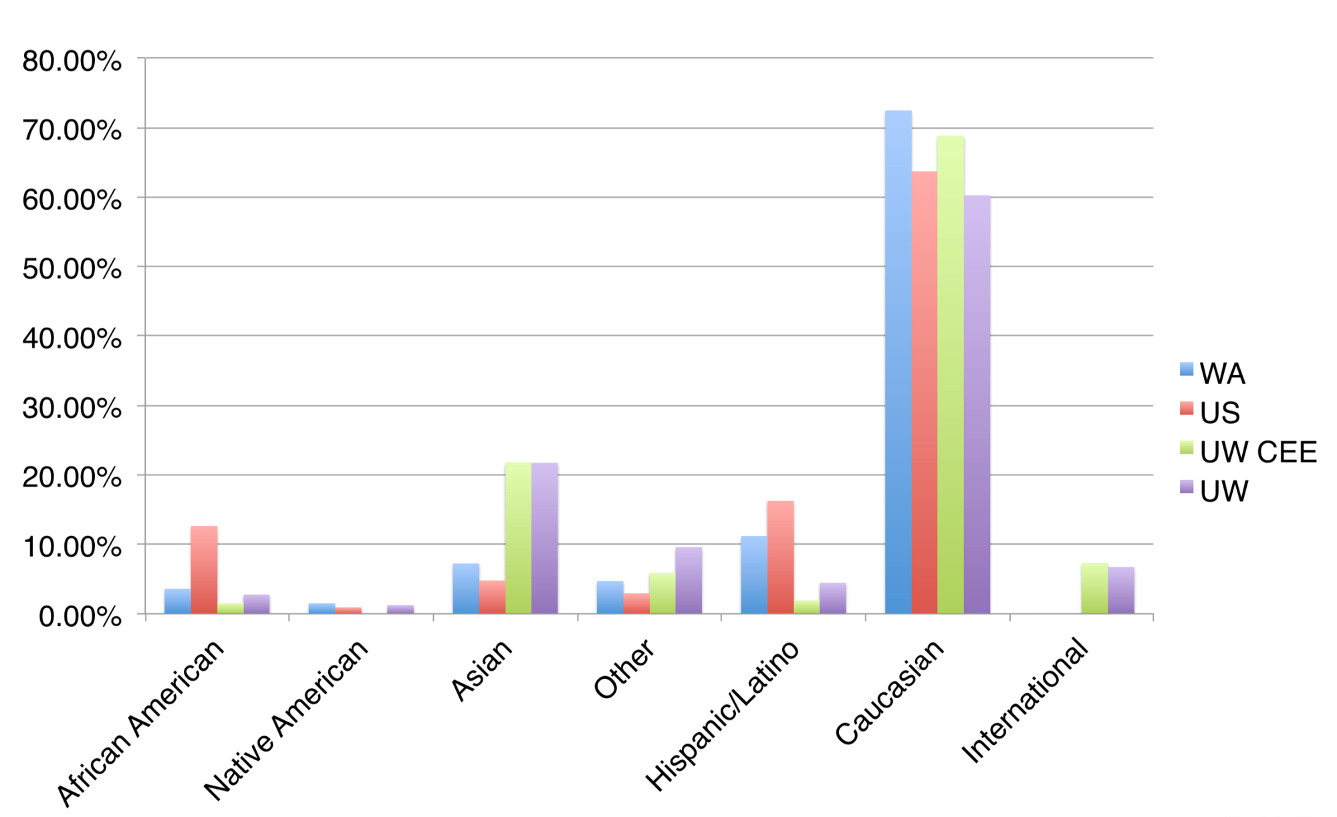
EXAMPLE: DIVERSITY DATA IN CONTEXT
Sources: College of Engineering data, 2010 US Census
Notes:
Have Jill tell us a little more about herself?

Slide 13
EXAMPLE: CEE ENROLLMENTS
Sources: CEE Advising, UW Profiles

Slide 14
EXAMPLE: WHY CAN'T MY KID GET IN?
Sources: US Census Data, UW Student Database

Slide 15
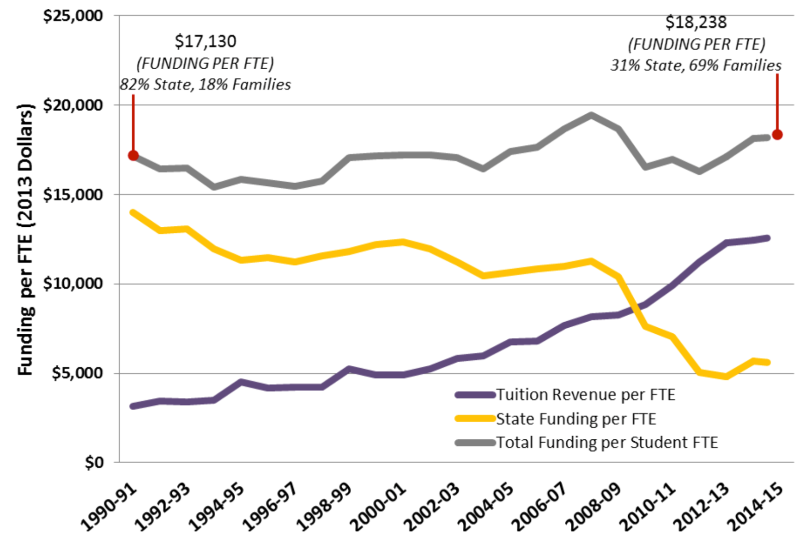
EXAMPLE: UW TUITION & STATE SUPPORT
Source: http://opb.washington.edu/sites/default/files/opb/Policy/Published_Price_vs._Net_Price_w_COP.pdf

Slide 16
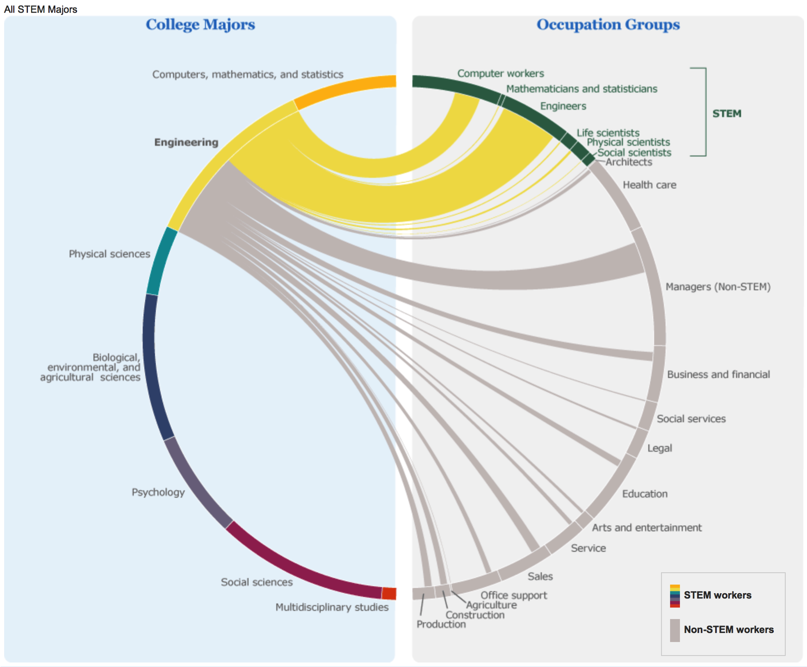
Source: http://www.census.gov/dataviz/visualizations/stem/stem-html/

Slide 17
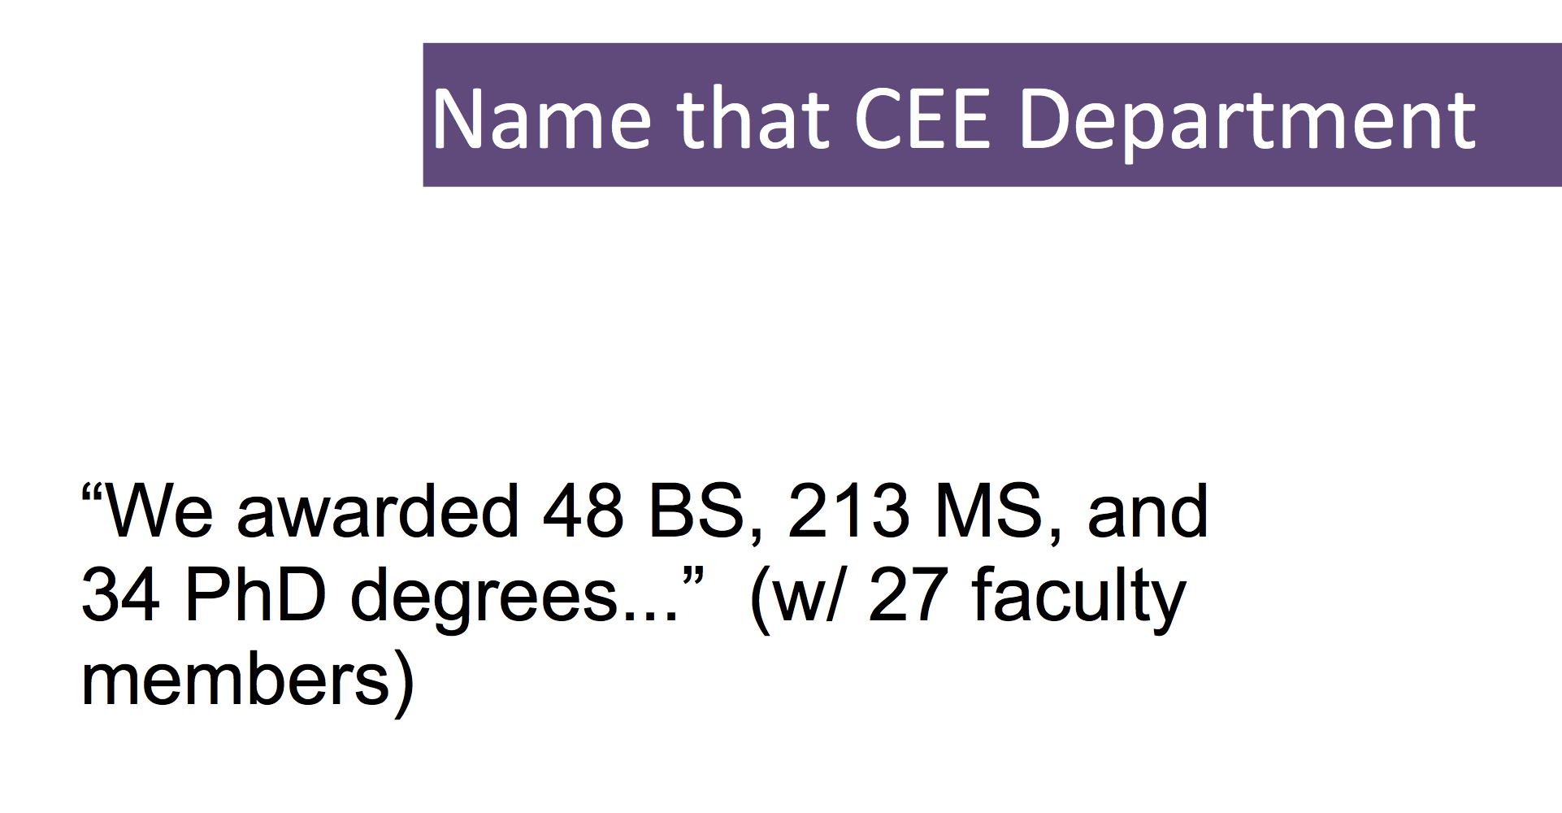
EXAMPLE: REALITY CHECK
Source: Annual newsletter

Slide 18
EXAMPLE: INTERNAL BENCHMARKING
Source: UW Data

Slide 19
BE BOUNDLESS
On-Brand Statement
Above all, it’s our belief in possibility and our unshakable optimism. It’s a connection to others, both near and far. It’s a hunger that pushes us to tackle challenges and pursue progress. It’s the conviction that together we can create a world of good. And it’s our determination to Be Boundless.
Notes:
Re-branding needed to happen anyway, but it is, at least in part, driven by the momentum of campaign. This central marketing team officially became a part of University Advancement last year. This fall (as of two weeks ago) we rolled out this new brand, which asks: What defines the students and faculty of the University of Washington?
This has set the tone for the rest of the brand and attitude our marketing and communication will have internally and externally.

Slide 20
UW PROFILES

Slide 21
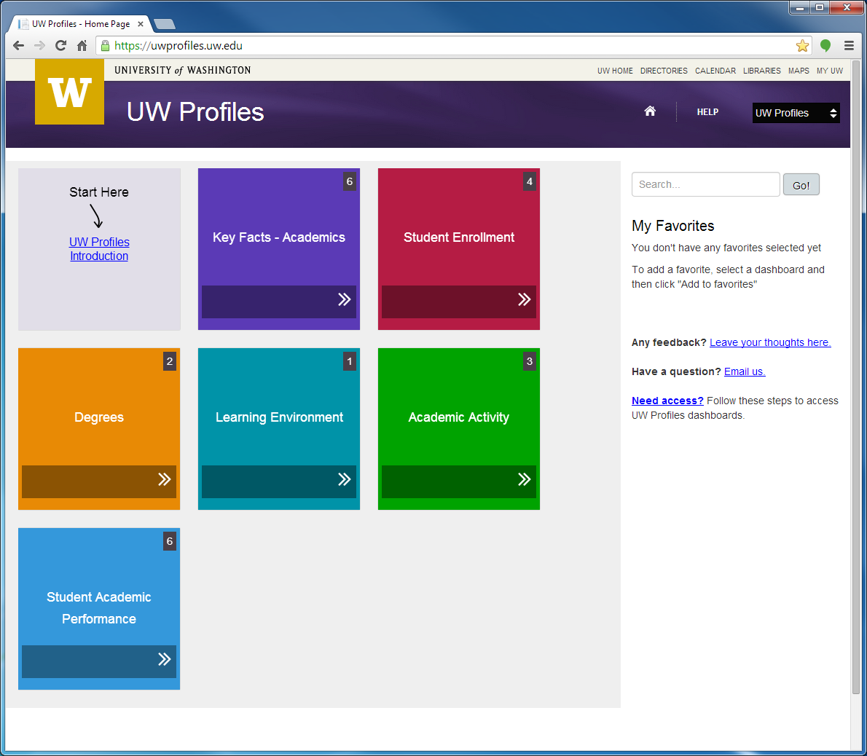
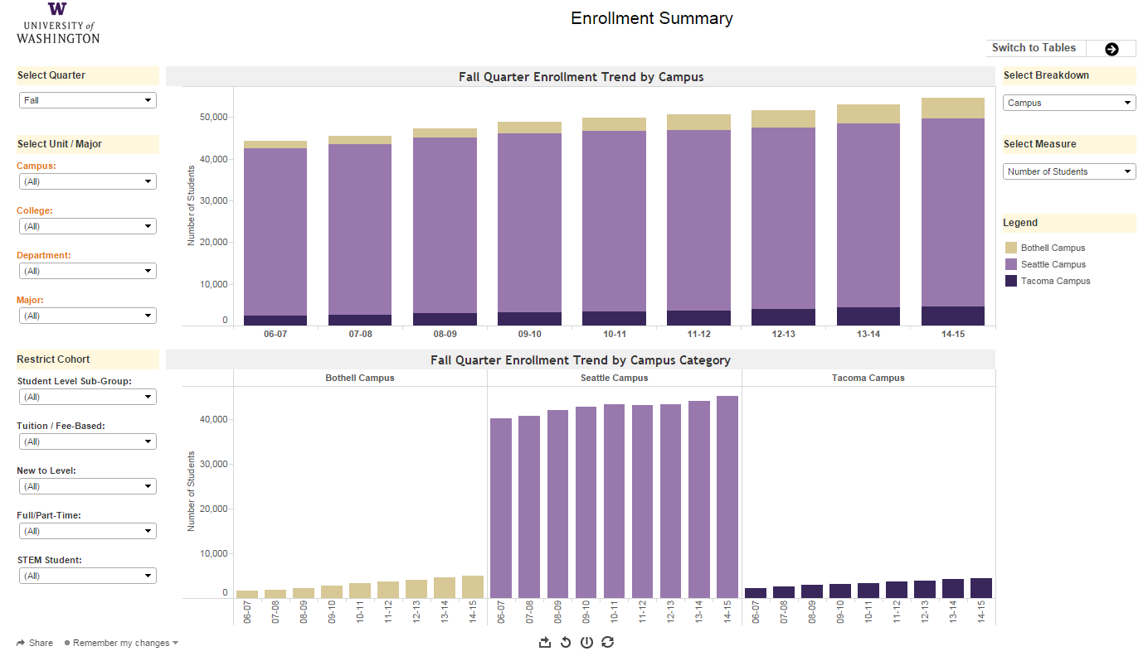

Slide 22
UW Profiles: An Introduction
December 11, 2014

Slide 23
WHAT iS UW PROFILES?
A set of interactive, dynamic displays of basic university data developed with Tableau software
Includes visualizations, which allow users to:
  Absorb more data more quickly
  Easily spot trends
  Understand & investigate vs. record & report
  Easily increase familiarity with institutional trends outside the user’s area of expertise

Slide 24
What is the Purpose of UW Profiles?
Provides easy access to basic high-level trend data about university activities
Makes it easy to find information about a unit at any level of the organization
Consistent, accessible information fosters more productive discussions
Access to information encourages further analysis
NOT intended to answer every question
NOT as useful for day-to-day operations

Slide 25
What data ARE INCLUDED IN UW Profiles?
For now, academic data: student enrollment, course taking, academic progress, and degrees.
NOTE: These numbers do not match ABB numbers; only ABB-specific dashboards should be used for ABB analysis.
  These will be made available in Spring 2015
Next on the release schedule:
  Underlying data models
  ABB Dashboards

Slide 26
Who has access to UW Profiles?
All faculty and staff who are part of the ASTRA security system
Students who act in an official capacity (e.g. ASUW President)

Slide 27
Who has access to UW Profiles?
All faculty and staff who are part of the ASTRA security system
Students who act in an official capacity (e.g. ASUW President)

Slide 28
WHAT ABOUT EVERYONE ELSE?
There is a public version of UW Profiles
  Information at the campus level only
  Graduation/retention details redacted for small cohorts
opb.washington.edu/content/public-profiles

Slide 29
Questions?
Email us: uwprofiles@uw.edu

Slide 30
break

Slide 31
My Plan

Slide 32

Towards Predictive Analytics using Academic Planning (or visa versa)
Philip J. Reid
Associate Vice Provost, UW-IT Academic Services
Professor of Chemistry

Slide 33
Notify.UW

Slide 34

Origins & History
Released in April 2013 as an official replacement for UW Robot, a paid course availability notification service.
Notifies students via email or mobile text message when a closed course reopens.

Slide 35
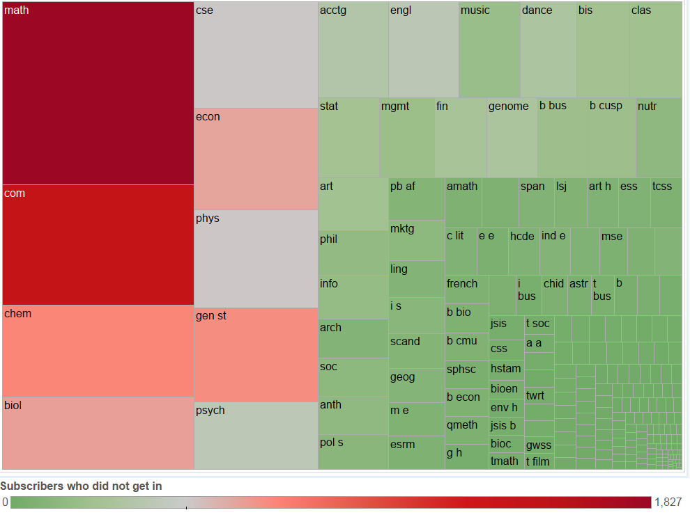
Subscription density by curriculum
Size represents the number of subscribers by unique UW NetIDs.
Colors represents the number of subscribers who did not get in.

Slide 36
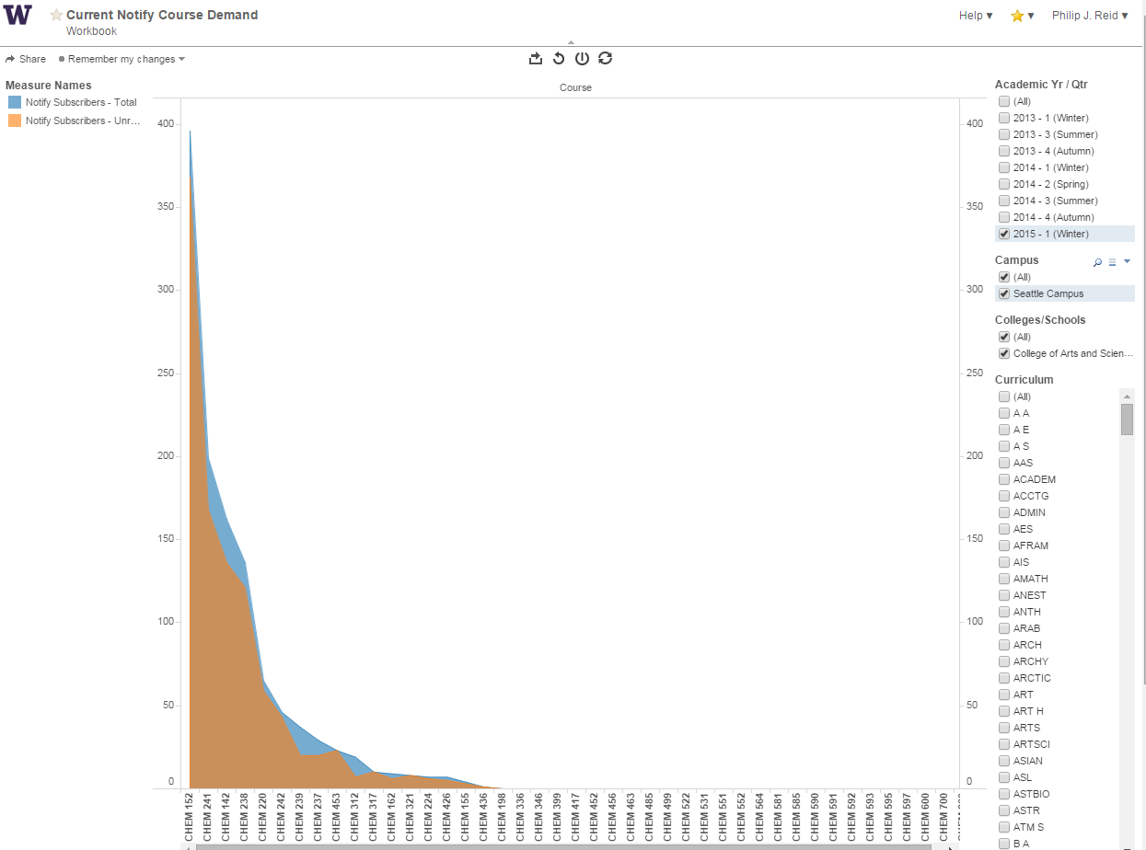
Chemistry Courses
Course: CHEM 241
Total Subscrib.: 199
Unreg. Subscrib.: 168
Available at https://biportal.uw.edu/Viz

Slide 37
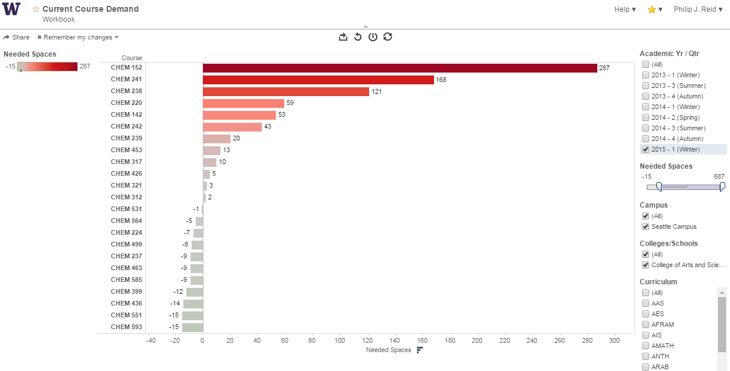
Chemistry Courses
Course: CHEM 241
Needed Sp.: 168
Sp. Available: 0
Subscribers: 168
Provides information on immediate “course demand”

Slide 38
MyPlan: Academic Planning

Slide 39
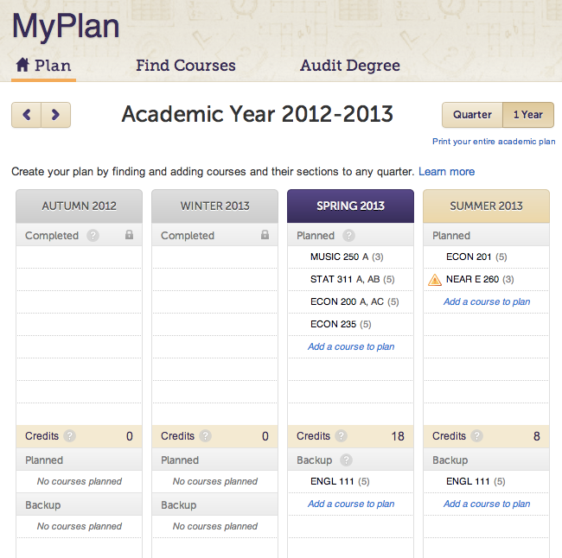
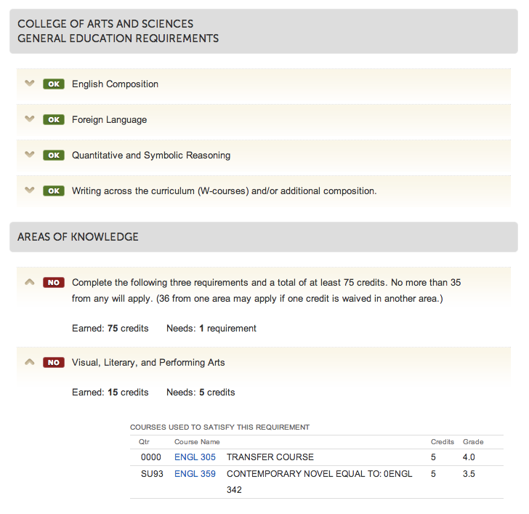
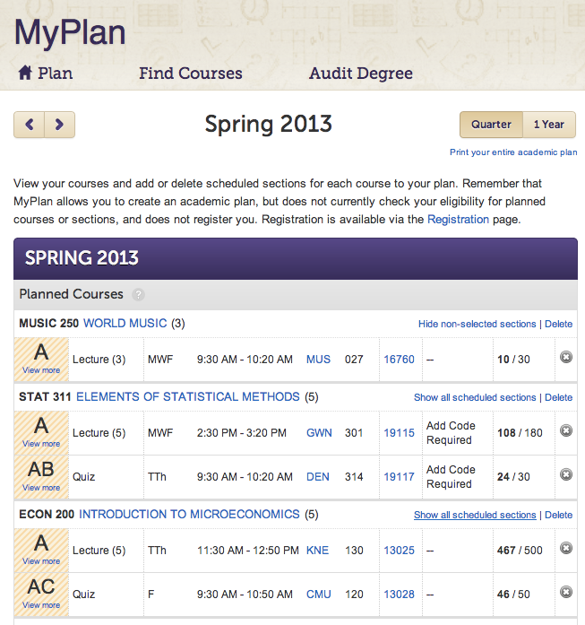
MyPlan – Online Academic Planning
Academic Planning
Progress Tracking
Registration Planning

Slide 40
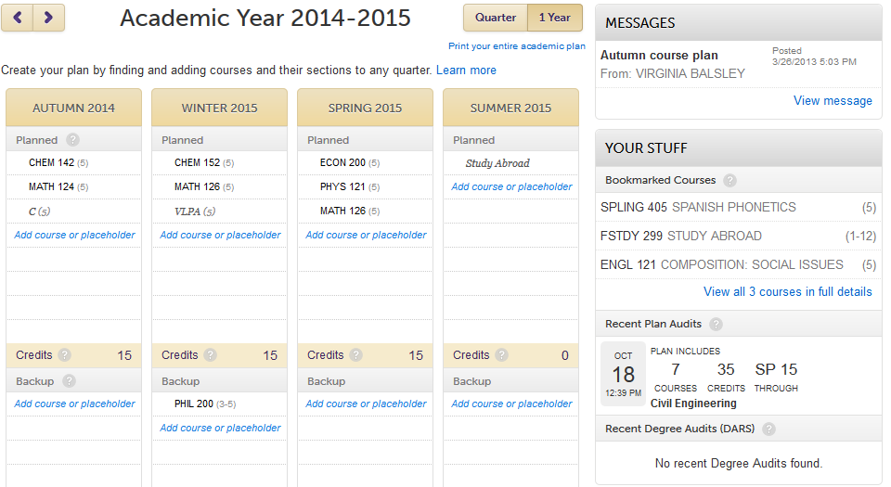
MyPlan is an academic planning tool that allows students to, up to 6 years in advance:
Plan specific courses to take
Add placeholders for courses TBD
Identify back-up courses
Bookmark courses of interest
What is MyPlan?
Their planning can inform our planning …

Slide 41






MyPlan: Metrics
Fall Adoption Rates
Over 30,000 students have created a plan
Adoptions Rates
  45% Overall
  54% for Undergrads
  58% for Sophomores
User profile
  Enrolled at UW Seattle (~85%)
  Female (~60%)
  Undergraduate (~82%)
    In a major (~46%)
Fall 2014 Users
Biochemistry
Biology
Business
Engineering
Comp Sci
Psychology

Slide 42

Concierge as a Concept
Concept borrowed from the service industry
Consider the familiar experience of dining out
Strategic
    What do I want?
    What are my options?
Explore
Assess
Decide
    “Optimization” problem with constraints
 Information
Restaurant
Previous Patrons
Transactional
Execute
    How do I make it happen?
Now let’s consider the experience of academic planning …
Notes:
NOTE on the overlay the experience of academic planning: the question of what students are generally trying to optimize is once we’ve been looking to answer thru our research

Slide 43


Concierge as a Framework
Individual
Record
Preferences
Explore
Institution
Offerings
Rules/Requirements
Assess
Decide
Execute
Collective Experience
Patterns
Predictions

Slide 44

Concierge In Action: Academic Explorer
What is UW Academic Explorer?
Single integrated tool for students to explore programs, assess personal and academic fit, discover related programs, understand requirements, and consider back-up options
Why build UW Academic Explorer?
To help students find their “academic home” more quickly
  … thereby improving degree attainment efficiency
To reduce the stress of choosing a major
… thereby improving the student experience
To logically extend the academic planning toolset
… thereby addressing the entire lifecycle

Slide 45
Student Experience w/ Majors
Most rewarding
The process of self-discovery
Finding a good fit
Most frustrating
The competitive admissions process
Disconnect between admission requirements and odds.
Most concerning
Not being admitted to major of
choice or choosing the wrong major
Wasting time and credit
Pre-Req GPA | Business | CSE
Published | 2.5 | 2.0
Actual Average | 3.3 | 3.6
Actual Mode | 3.3 | 4.0
% with GPA 3.0+ | 85% | 97%
40% rated the overall experience of choosing a major difficult or very difficult
¹Based on two large-scale student surveys regarding choosing/changing a major

Slide 46
Academic Explorer Proposed Features
#1 …. “The program exists”
Search/Browse for Programs
Discover Related Programs*
Save/Bookmark Programs
#2 … “The program has features that I like”
View Popular Courses
View Program Details
Browse Sample Plans/Paths
#3 … “I can get into the program”
Understand Admissions Requirements
View Admissions Profiles*
#4 … “I will not struggle academically or take too long to complete”
Run Degree Audit
Understand Outstanding Credits
* Based on the “Collective Student Experience”

Slide 47
Discover Related Programs
“I knew I wanted to do something with computers, but after taking a couple computer science classes I knew I didn't have the aptitude nor desire to pursue a degree strictly related to coding ... luckily I found the Informatics program, but too often many students around me don't know that options like Informatics exist for them.”
Option 1: Manual Tagging of Programs
“Adviser Intelligence”
Option 2: Systematic Analysis of Student Transcripts
  “Machine Intelligence”
  Measure of the overlap in the transcripts of students who have graduated from the program
  Based on student behavior
UW Degree Programs
Undergraduate Majors
College of Arts & Sciences
Computer Science
The Information School
Informatics
College of Engineering
Computer Engineering

Slide 48
View Popular Courses
Option 1: Systematic Analysis of Student Transcripts
“Machine Intelligence”
Dsitribution of courses taken by students who have graduated from the program
Based on student behavior
Browse Sample Plans/Path
Option 1: Adviser Created Sample Plans
“Adviser Intelligence”
Option 2: Systematic Analysis of Student Transcripts
  “Machine Intelligence”
  Common curricular pathways based on the transcripts of students who have graduated from the program
  Based on student behavior
View Admissions Profiles
Option 1: Systematic Analysis of Admitted Students
“Machine Intelligence”
Demographic and academic profile of students admitted to the major
Based on institutional/student behavior

Slide 49
On the Horizon
Implementation of Academic Explorer in MyPlan (~9 months).
Continued adoption of MyPlan as academic planning tool (social authentication as catalyst).
Begin analysis of student major and enrollment trends (w/ IR).
Use in combination with LMS (Canvas) and student data base for student success and retention analytics (Civitas).

Slide 50
Conclusion and evaluations

Slide 51
Networking lunch

