Slide 1
When to say yes and how to say no: balancing teaching, research, service, and the rest of life
Dawn Lehman, Professor, Civil & Environmental Engineering
Eve Riskin, Associate Dean, Professor of Electrical Engineering, Faculty Director, UW ADVANCE

Slide 2
Setting up for success:
When to say “yes”
When to say “no”
Dawn Lehman, Professor, Civil & Environmental Engineering

Slide 3
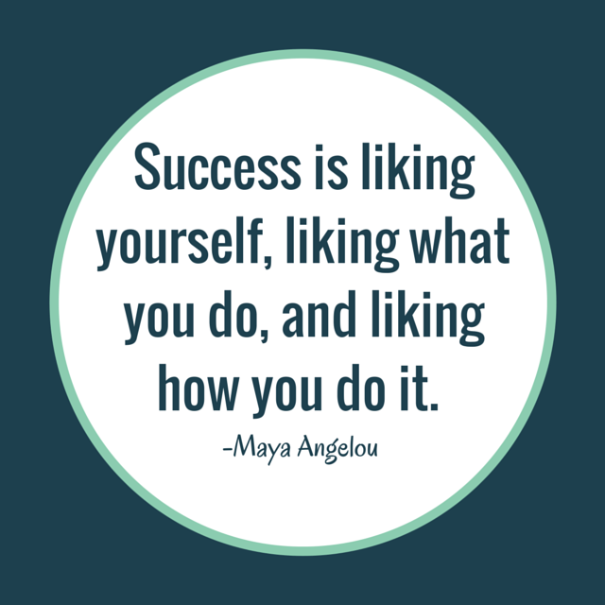
Success: What defines it?
Getting promoted…
Research
Teaching
Service
Your definition…
Impact
Reputation
Mentoring
Money
https://www.linkedin.com/pulse/20140623032323-105475546-21-tips-on-how-to-be-the-most-successful-professor-you-can-be

Slide 4
(Lehman’s rules for)
Deciding to say yes or no (as an Assistant Prof)
Will this help me get tenure?
Papers (YES!!)
Research funding (YES!!)
Mentoring
Teaching (within reason; spending too much time can backfire)
Service (tricky… pick one national, university and department service activities and say no to the rest)
Am I willing to take this amount of time away from…
My family?
My social life (yes, you can still have one)?
My health (mental and physical)?
All of the things I “should” be doing (see Item 1)

Slide 5
JUST SAY NO TO…
Additional classes (e.g., teaching in the summer)
Avoiding publishing
Too much SERVICE!
Pointless committees
Chairing committees
Doing service that no one else wants to do
Anything that takes too much time, won’t show up on your vitae, and/or you don’t care about it.

Slide 6
When to Say Yes and When to Say NO!
Eve Riskin, Associate Dean, Professor of Electrical Engineering, Faculty Director, UW ADVANCE

Slide 7
My Approach to Time Management
Time is your most valuable commodity
Your success is your department’s success
Underrepresented groups get asked more often for service
People from underrepresented groups should not do service that could be done by old white guys

Slide 8
Say Yes
When the request
comes from the Dean or Provost
comes from someone you need on your side
comes from someone to whom you owe a favor
When you would
have influence
meet important people
have fun

Slide 9
Say NO!
If you would hate it
If you don’t care about it
If you’re not good at it, e.g. analog circuits
If it comes from someone who can’t help your career
If it comes from a journal in which you don’t publish
If it comes from a foreign NSF that isn’t offering to pay you
If it is ABET or curriculum
If it is unfair
If it can be solved with money, e.g. teaching an extra course

Slide 10
Say NO WAY!
If you are asked to do it because you are a woman
If the person who makes the request seems like an idiot
If the email request is badly written
If it feels like a “dump and run”

